Slide 1

AGENCY
“HOW TO DO GUIDE”

Slide 2


BOOKINGS OVERVIEW

Slide 3
BOOKINGS OVERVIEW
PART 1

Slide 4
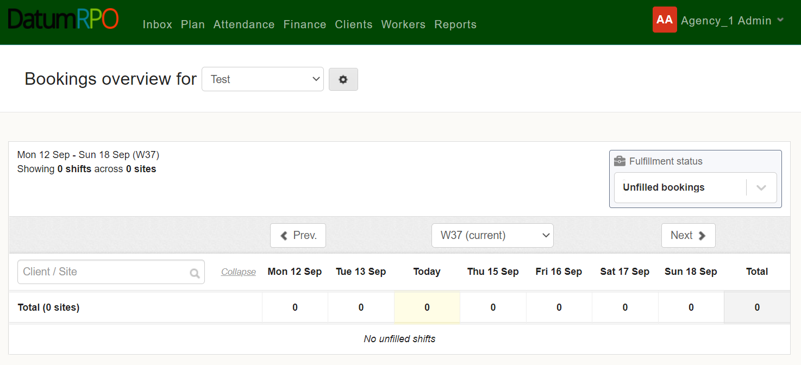
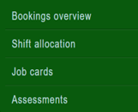
How Do I Create A New Reporting Group?
To create a New Reporting Group, click on ‘Plan’ & ‘Bookings Overview’

Slide 5

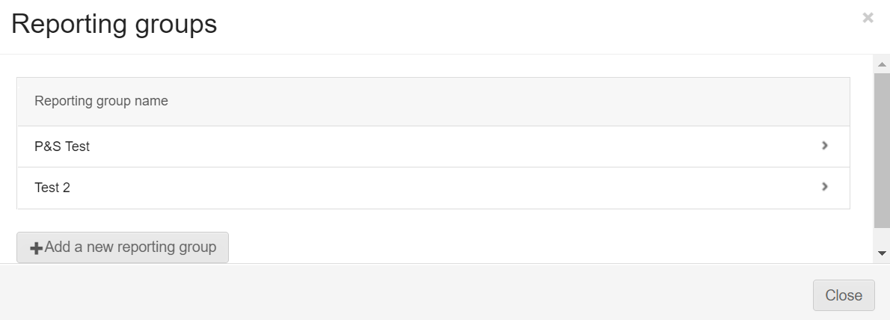
How Do I Create A New Reporting Group?
To create a new reporting group - click the cog icon and select ‘add a new reporting group’ from the pop up.

Slide 6
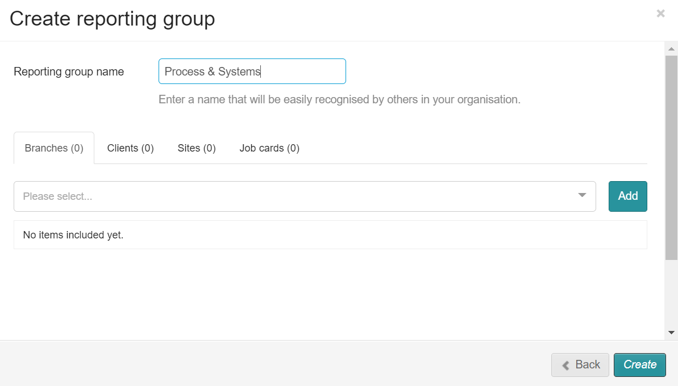
How Do I Create A New Reporting Group?
Enter a name for the new reporting group

Slide 7
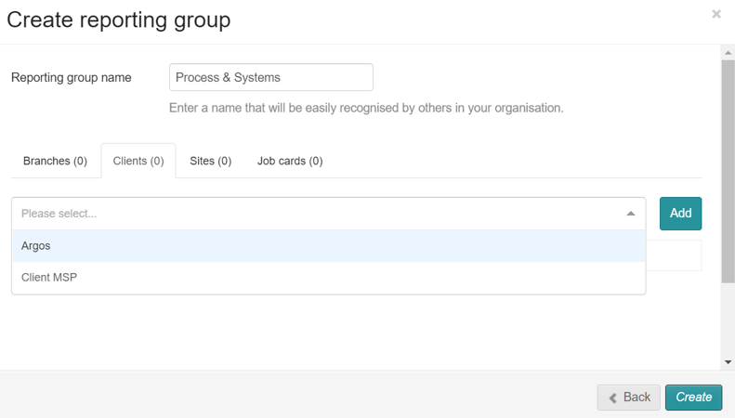
How Do I Create A New Reporting Group?
Next, select the ‘Clients’ tab and select your desired client(s) from the dropdown list followed by ‘Add’.
(You can only select and add one client at a time)

Slide 8
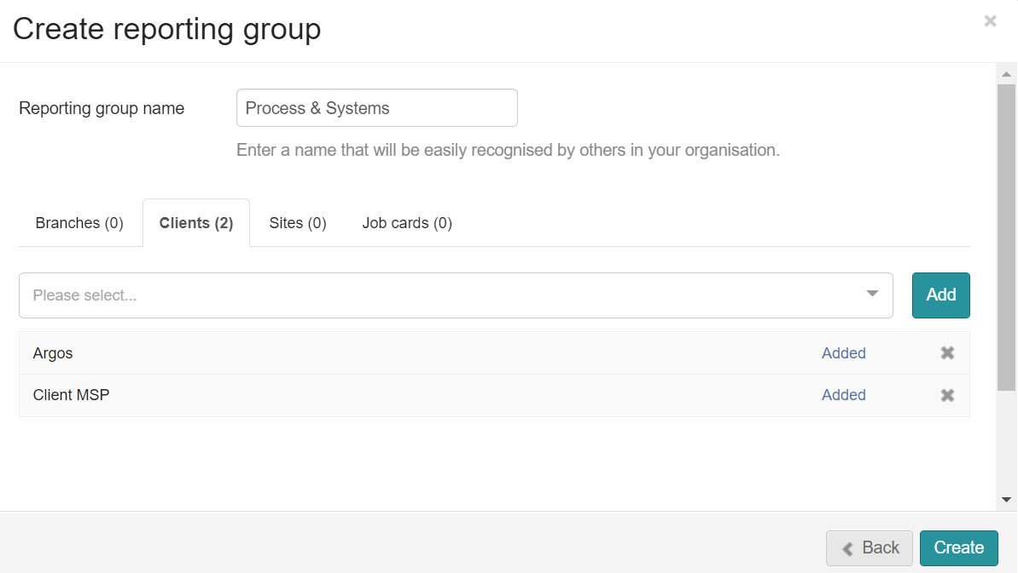
How Do I Create A New Reporting Group?
Next, select the ‘Clients’ tab and select your desired client(s) from the dropdown list followed by ‘Add’.
(You can only select and add one client at a time)
The ‘Clients’ tab will now show a list of any client you have added to your new reporting group.

Slide 9
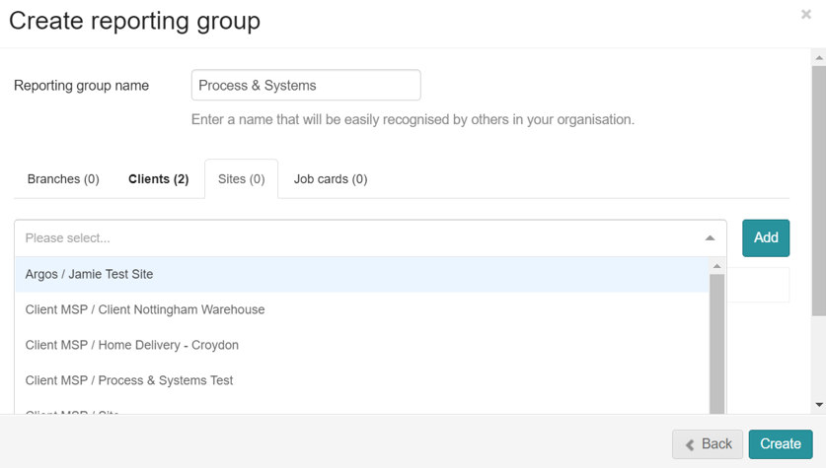
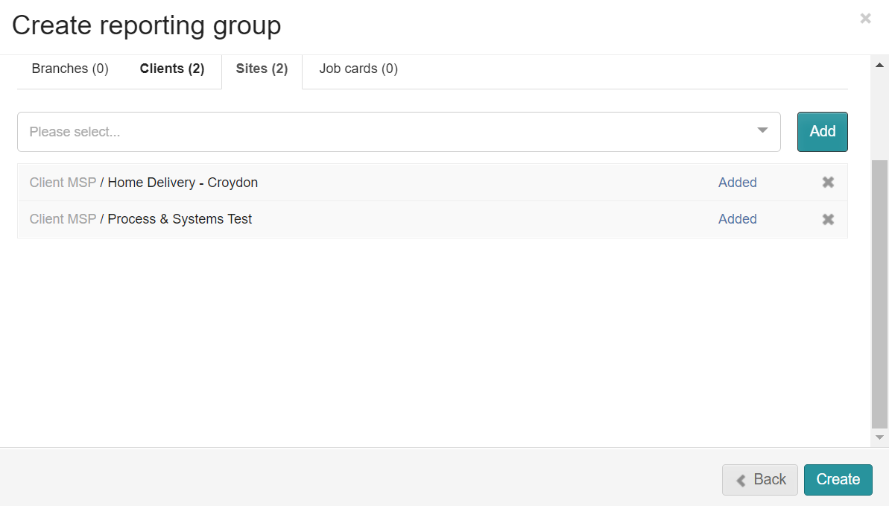
How Do I Create A New Reporting Group?
Next, select the ‘Sites’ tab and select your desired site(s) from the dropdown list followed by ‘Add’.
(You can only select and add one site at a time)
The ‘Sites’ tab will now show a list of any sites you have added to your new reporting group.

Slide 10
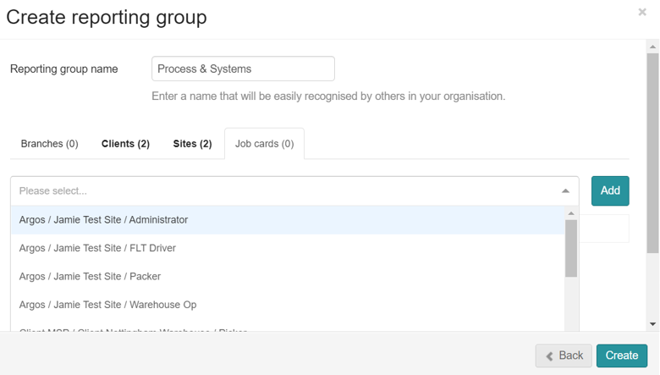
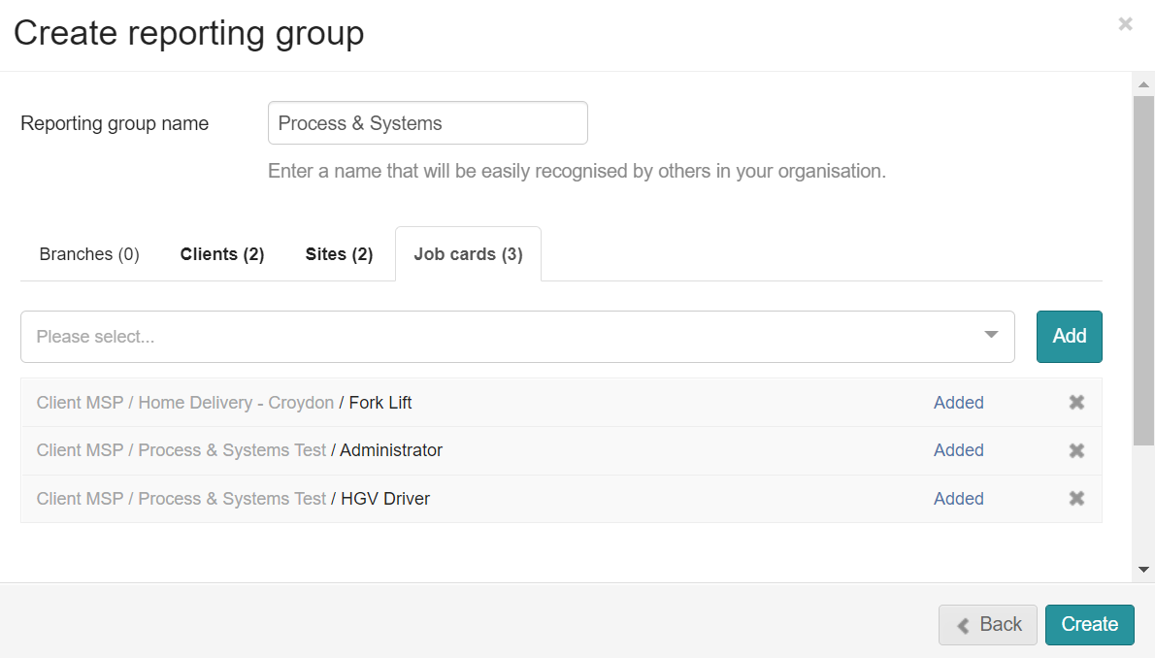
How Do I Create A New Reporting Group?
Next, select the ‘Job Cards’ tab and select your desired Job Card(s) from the dropdown list followed by ‘Add’.
(You can only select and add one Job Card at a time)
The ‘Job Card’ tab will now show a list of any Job Cards you have added to your new reporting group.

Slide 11
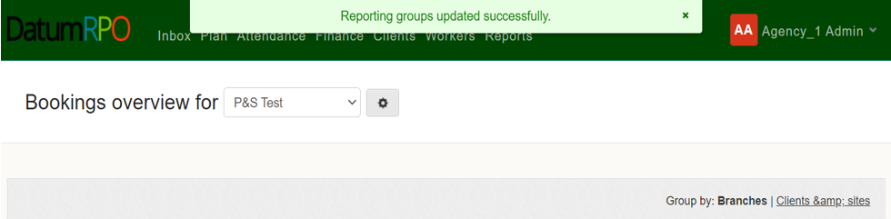
How Do I Create A New Reporting Group?
When you are happy with your Reporting Group, click ‘Create’ to save it.
A brief message will appear at the top of the page showing that your reporting group has been created.

Slide 12
BOOKINGS OVERVIEW
PART 2

Slide 13
Where Do I Find The Bookings Overview?
To view an overview of your bookings, click on ‘Plan’ & ‘Bookings Overview’

Slide 14
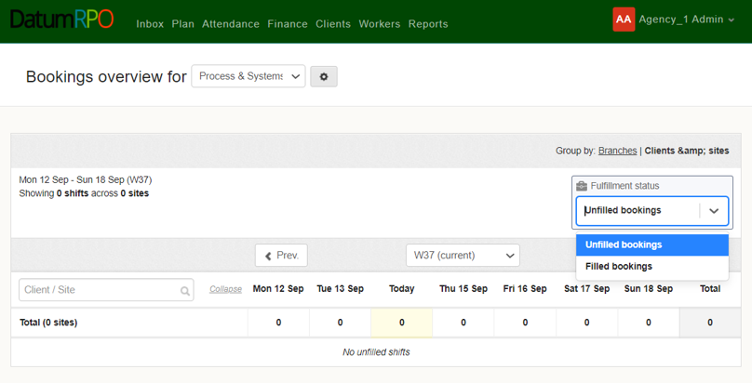
How Do I View The Bookings Overview?
From here, select the Reporting Group you want to see the bookings overview for using the dropdown box & ensure you have ‘Clients & sites’ selected. You can now use the dropdown box to view any unfilled bookings.
You can now use the dropdown box to view any unfilled bookings.

Slide 15
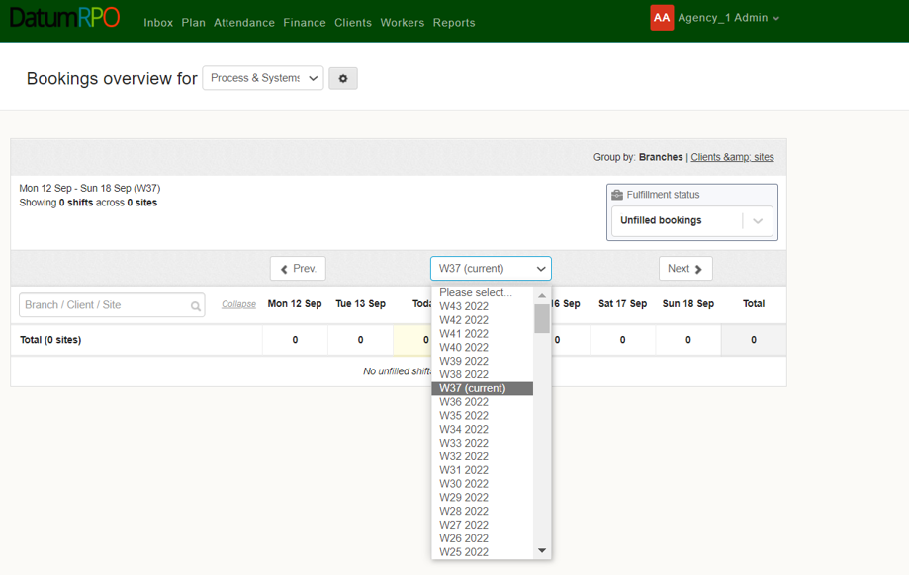
How Do I View The Bookings Overview?
You can change the week you are viewing by using the button to go back 1 week or the button to go forward 1 week. You can also select the week using the dropdown box.

Slide 16
JOB CARDS

Slide 17
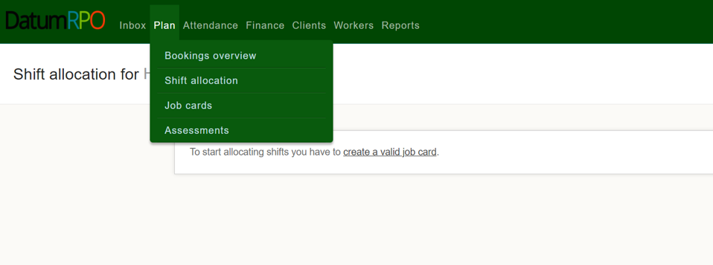
Where Do I Find Job Cards?
To view you job cards and order templates, go to ‘Plan’ and select ‘Job Cards’.

Slide 18
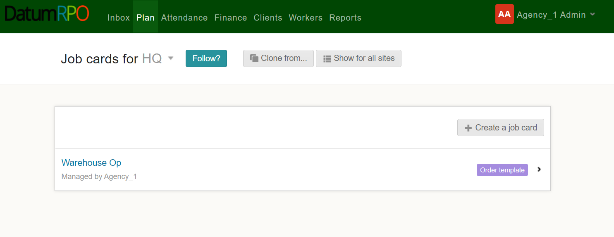
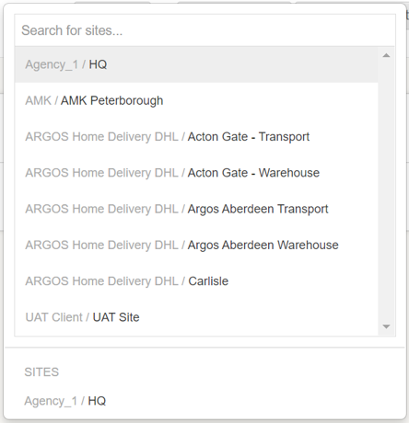
How Do I Find Job Cards For My Site?
Select the site for the ‘Job Cards’ you want to view using the dropdown box.

Slide 19
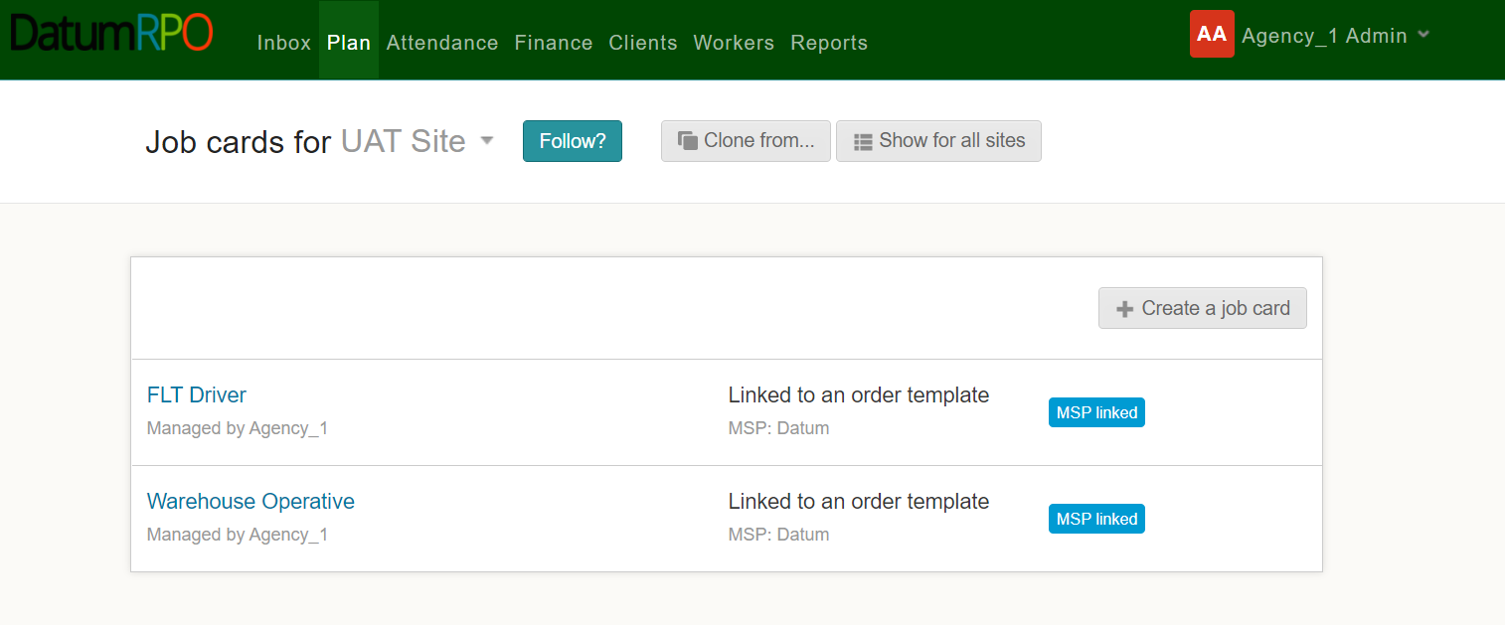
How Do I Find Job Cards For My Site?
You will now see a list of the job cards for your chosen site.

Slide 20

How Do I Follow My Site?
You can ‘Follow’ or ‘Unfollow a site by clicking

Slide 21
How Do I View The Job Card Details?
To view the job card details – click on the job card you want to see the details of.

Slide 22
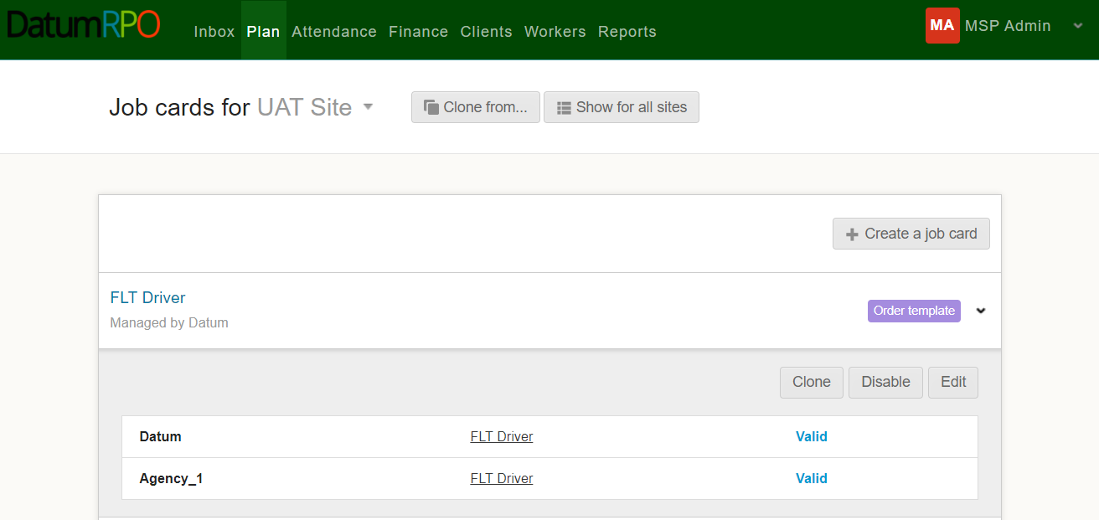
How Do I View The Job Card Details?
Then click on the hyperlinked name of the job card.

Slide 23
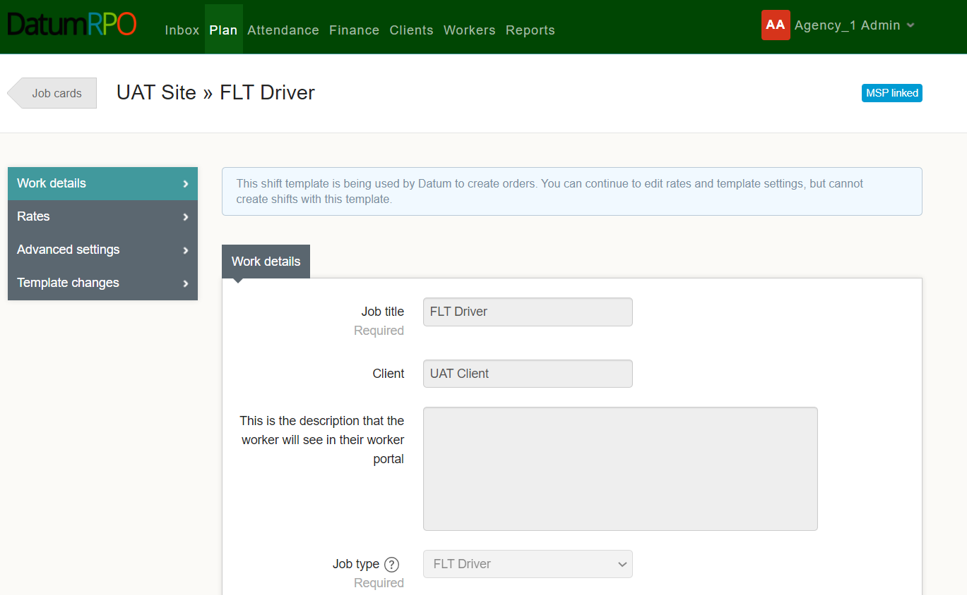
How Do I View The Job Card Details?
You will then be taken into the job card where you will be able to view the ‘Work Details’, ‘Rates’, ‘Advanced Settings’ and details of any ‘Template Changes’

Slide 24
ASSESSMENTS

Slide 25
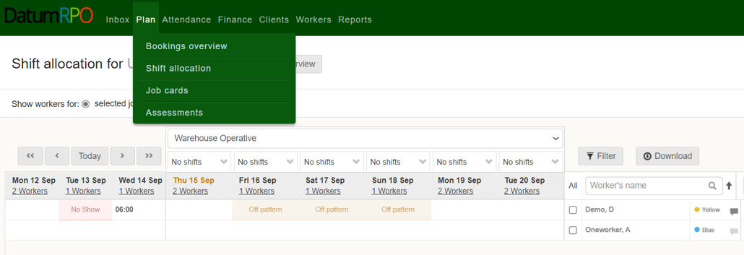
Where To Go To Book Assessments?
To view or create assessments, go to ’Plan’ and select ‘Assessments’

Slide 26
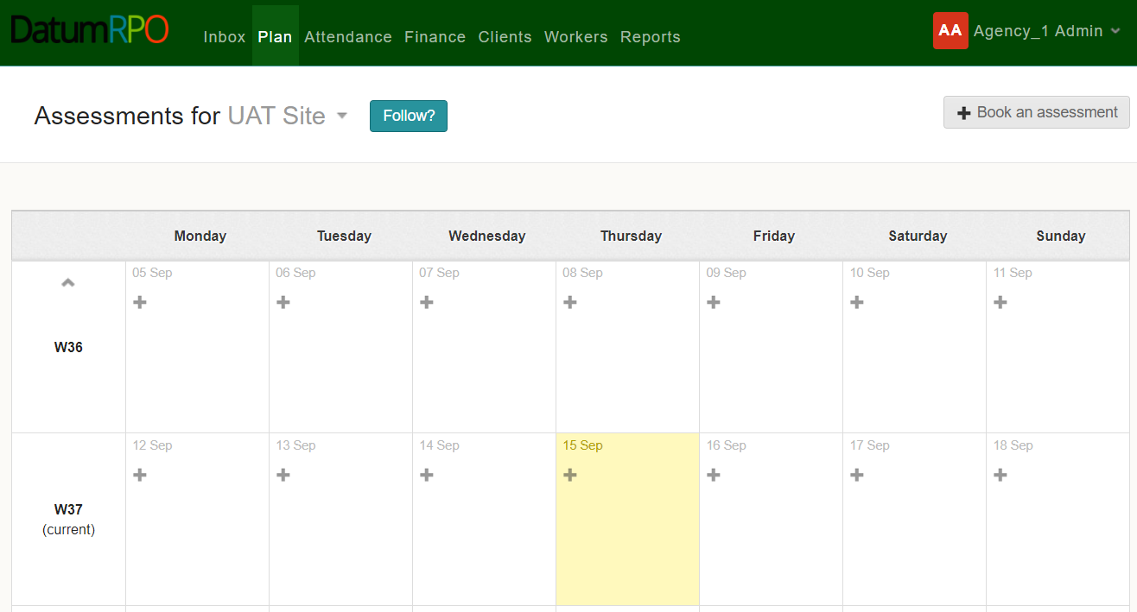
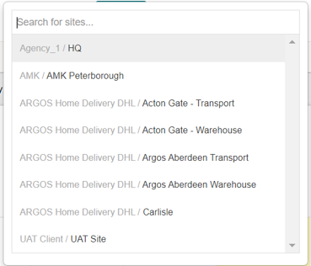
Where To Go To Book Assessments?
Next, use the dropdown box to select the site you wish to create or view assessments for.

Slide 27

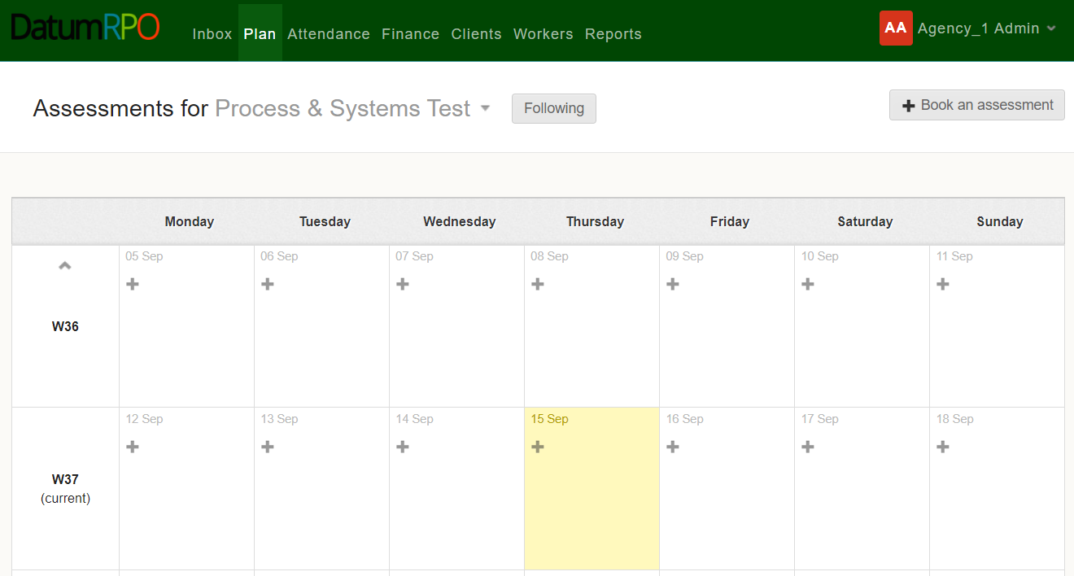


Where To Go To Book Assessments?
Click the on the date you wish to create the assessment, or you can click

Slide 28

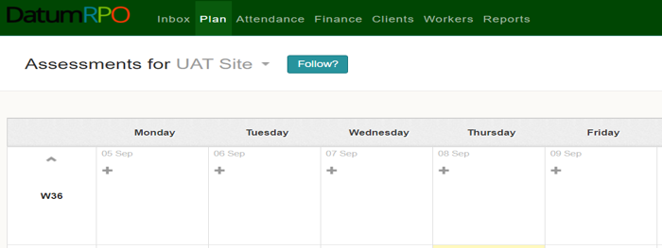
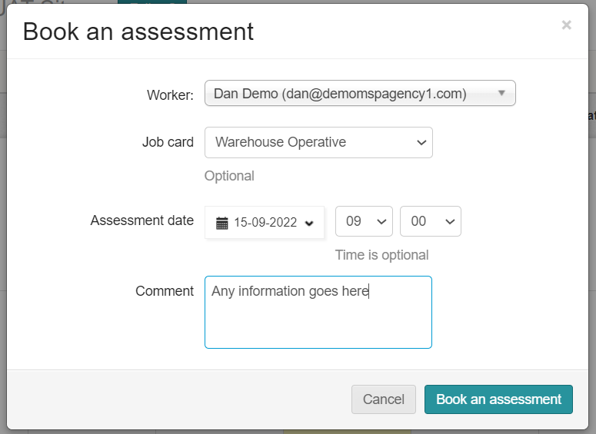
Where To Go To Book Assessments?
In the pop-up box, enter the workers name, the job card the assessment will be for, the assessment date and time (time is optional) along with any other relevant information – then click

Slide 29

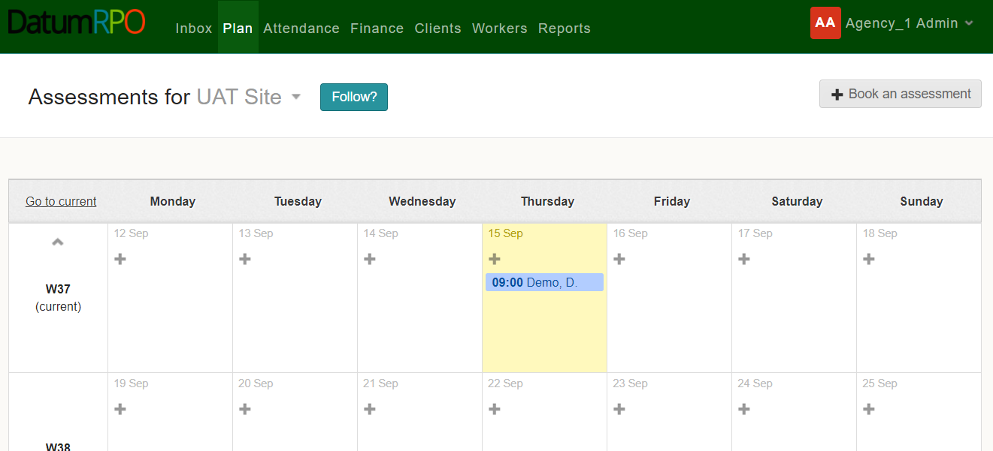
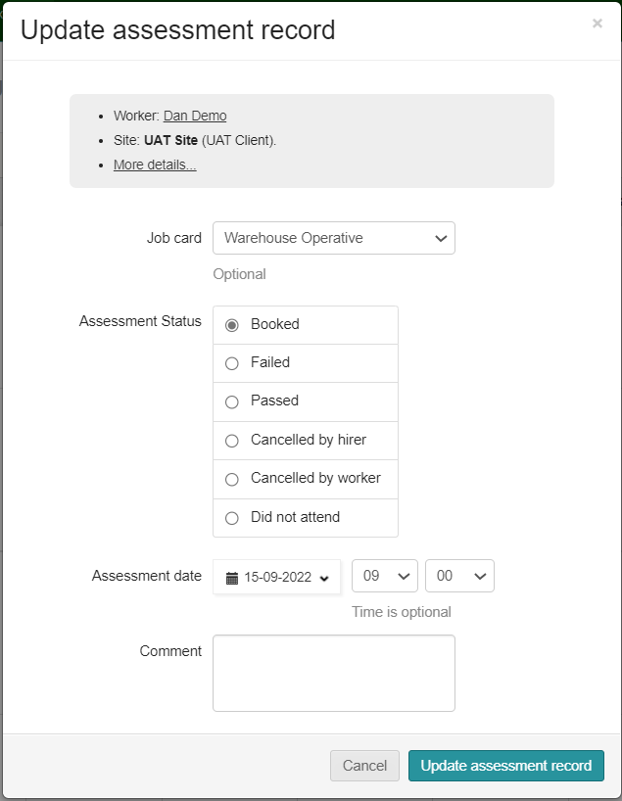
Where To Go To Book Assessments?
You will now see the assessment on the day you selected. Clicking on the assessment will allow you to update the assessment record in the pop-up box. To complete the update click

Slide 30
ATTENDANCE
OVERVIEW

Slide 31
BATCH EDIT START / STOP TIMES

Slide 32
BATCH EDIT SHIFTS
AMEND TIME
​

Slide 33
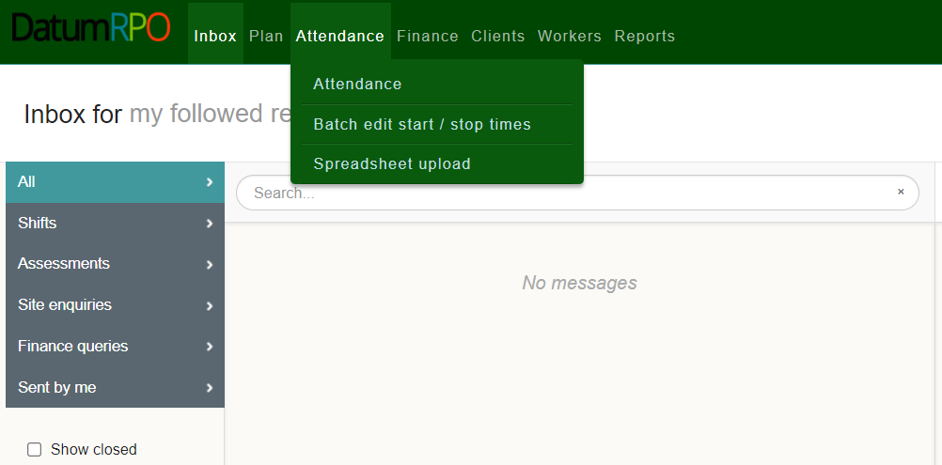
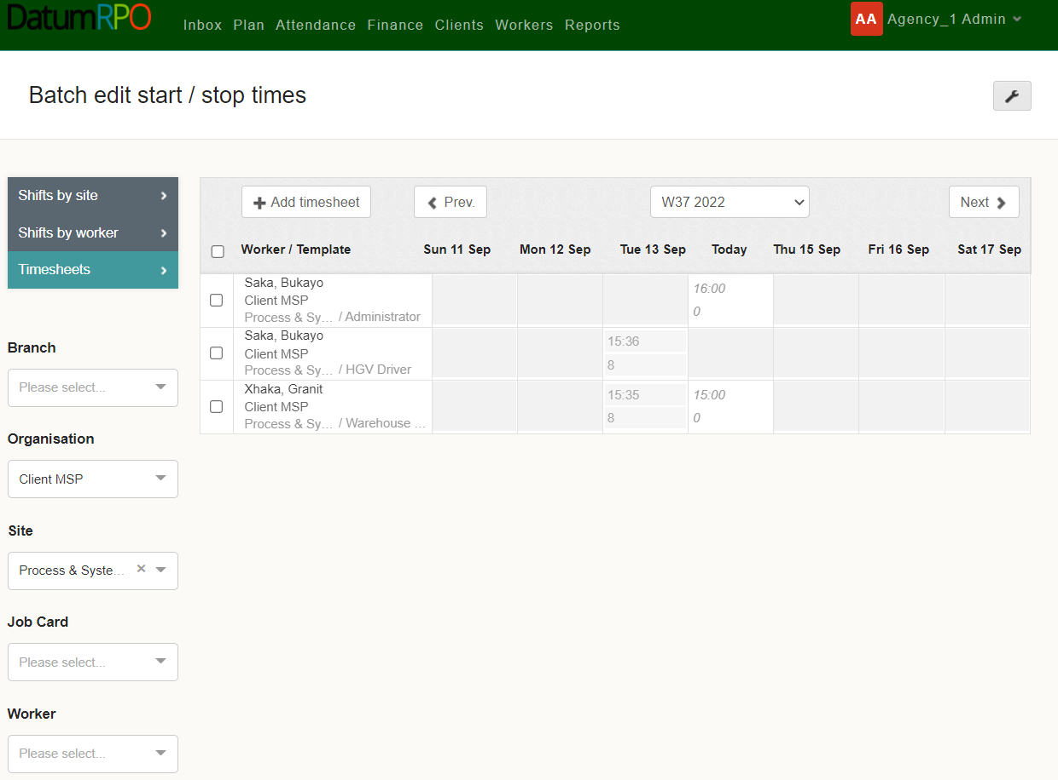
Where To Find Batch Edit Shifts?
This process happens after the shift has been completed. You can Batch Edit or Stop times (please refer to Start Stop times how to do guide on this process.)
Go to Attendance>Batch edit start/stop times.
Next go to Organisation to search for your Client.

Slide 34
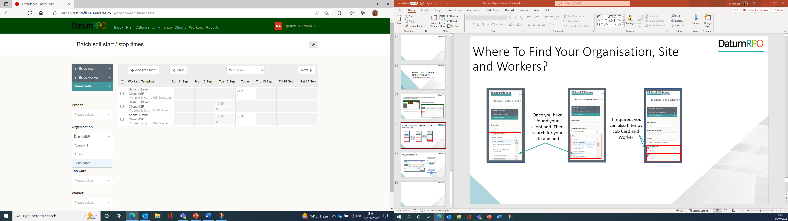
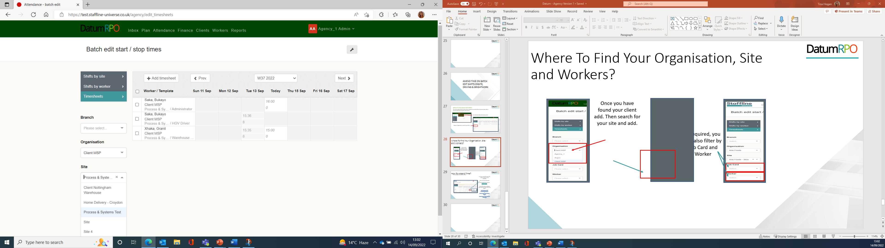
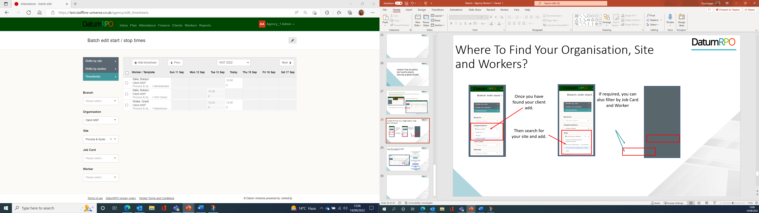
Where To Find Your Organisation, Site and Workers?
Once you have found your client add.
If required, you can also filter by Job Card and Worker.
Then search for your site and add.

Slide 35
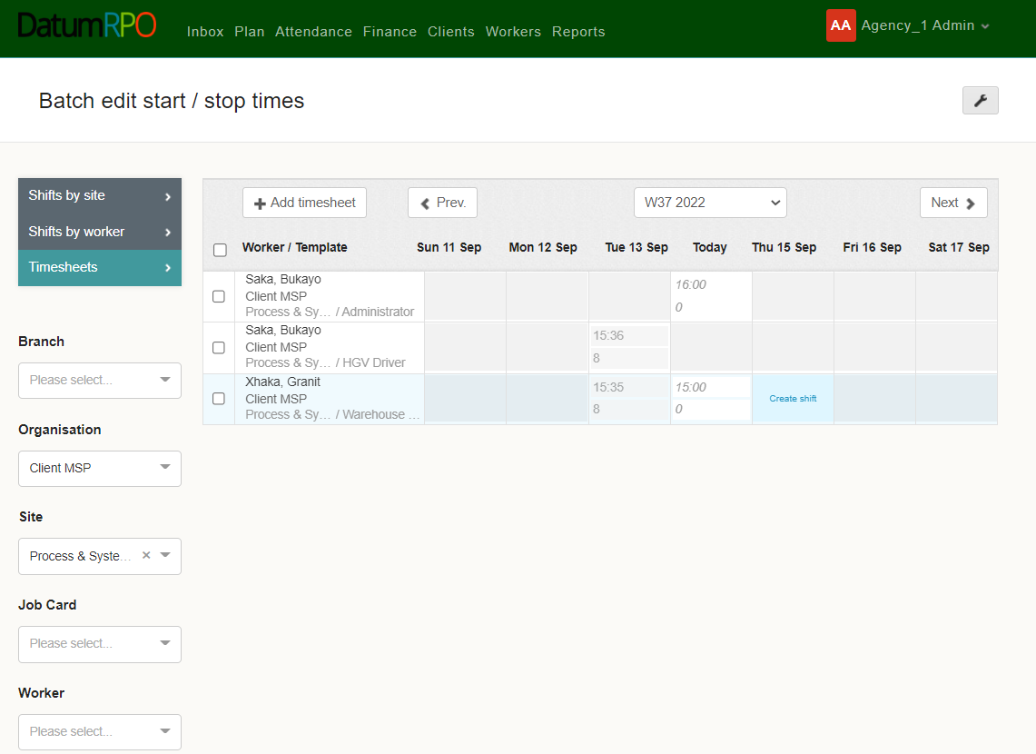

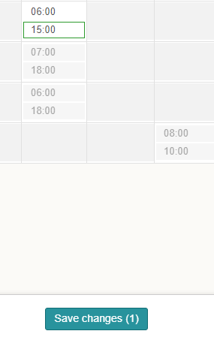
How To Amend Time?
Go to the day you would like to amend.
It is easy to amend the time if the workers shift hasn’t been submitted.
Click on the time and amend.
Once amended then click save.

Slide 36
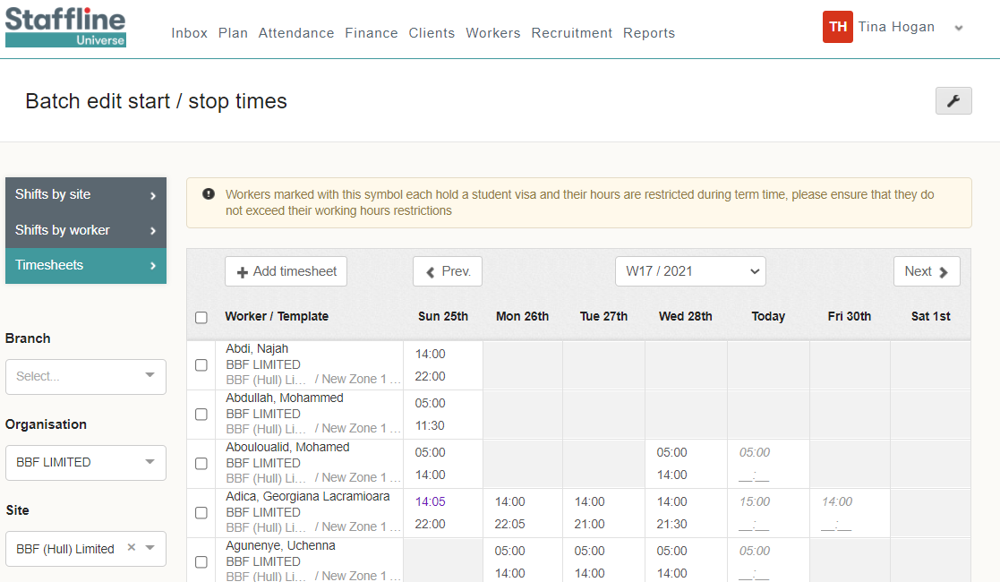


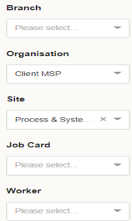

How To Add Finish Time?
The next part is to add the finish time or hours.
We are going to start with finish times and input the end time.
You can see we have already processed the finish time.
Add your finish time working on a 24-hour clock.
Once added click on the button.
A notification will pop up if you have a student working with restricted hours.

Slide 37
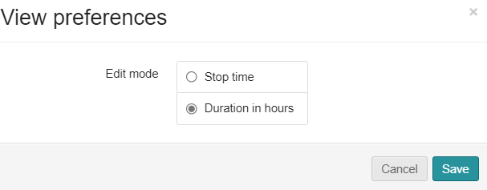
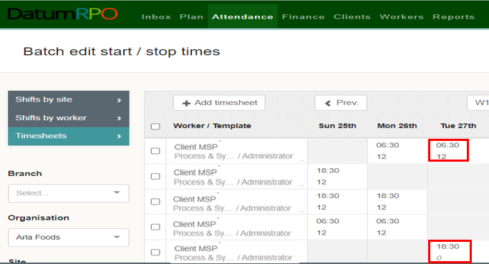

How To Add Finish Hours?
This is the same process as before; however, we are going to change the view preferences from Stop time to Duration time. To do this click on the to change and save.
Add your finish time working on a 24-hour clock. This can also be done on a 100 decimal.
Once added click on the button.

Slide 38
CANCEL A SHIFT THROUGH BATCH EDIT

Slide 39
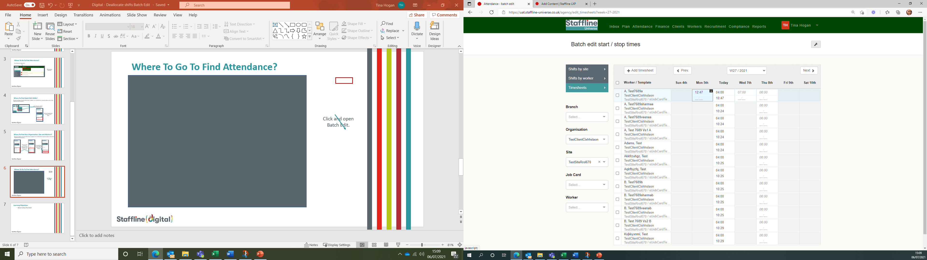

How To Open The Shift?
Click on the to open the shift.

Slide 40
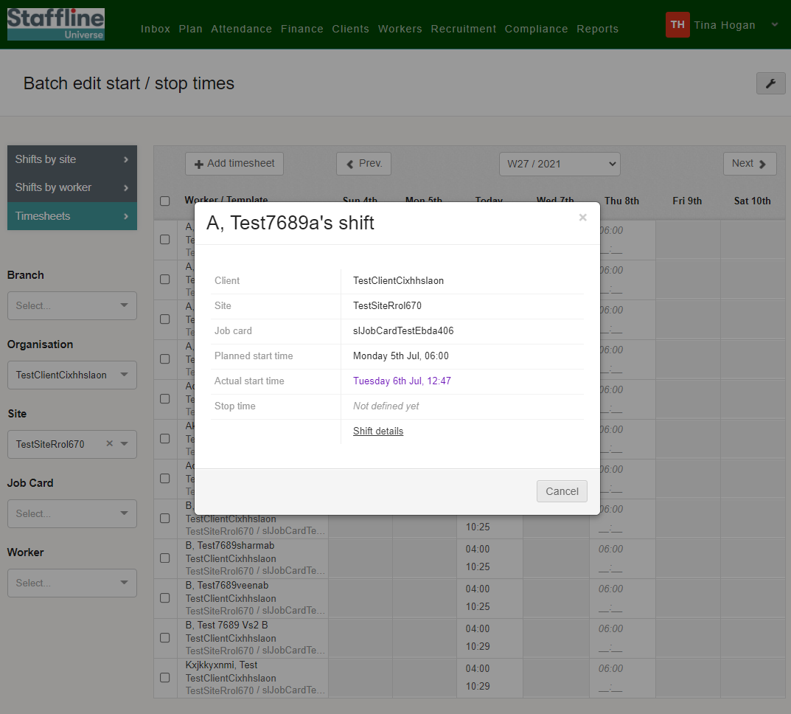
How To Open The Shift Details?
Click here to open the shift details.

Slide 41
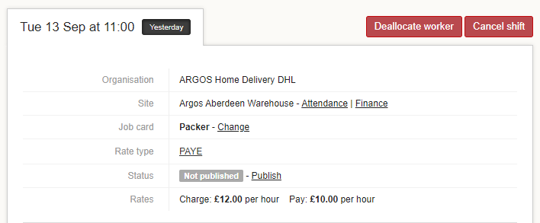

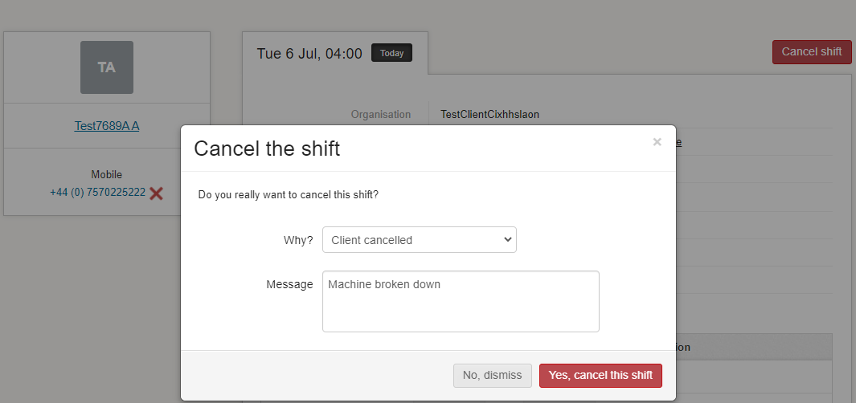
How To Cancel The Shift?
Click on cancel shift.
Add in the reason why?
Once complete click 'Yes cancel the shift'.

Slide 42
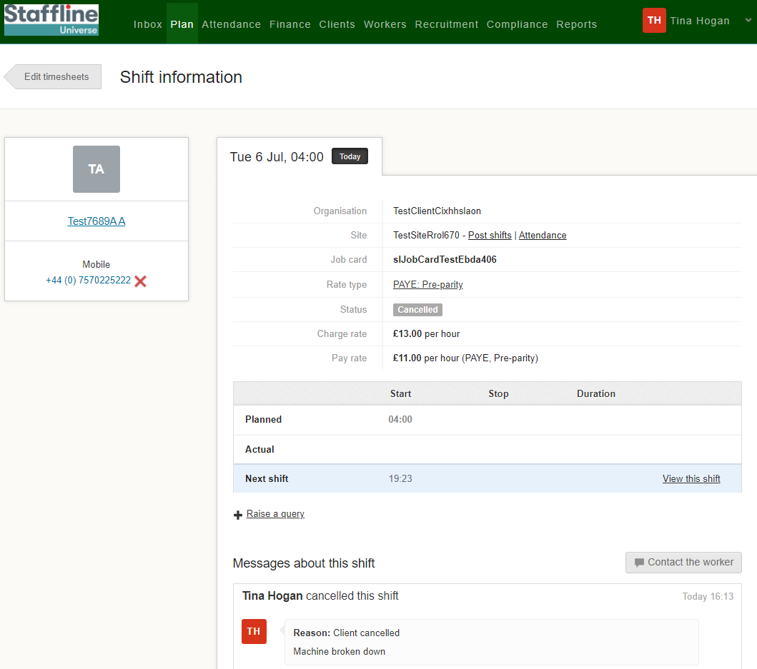
How To View The Cancelled Shift?
You will now see the cancelled shift has been removed and a comment added to the cancelled shift information.
Once complete click on Edit timesheets button to go back to the Batch Edit page.

Slide 43
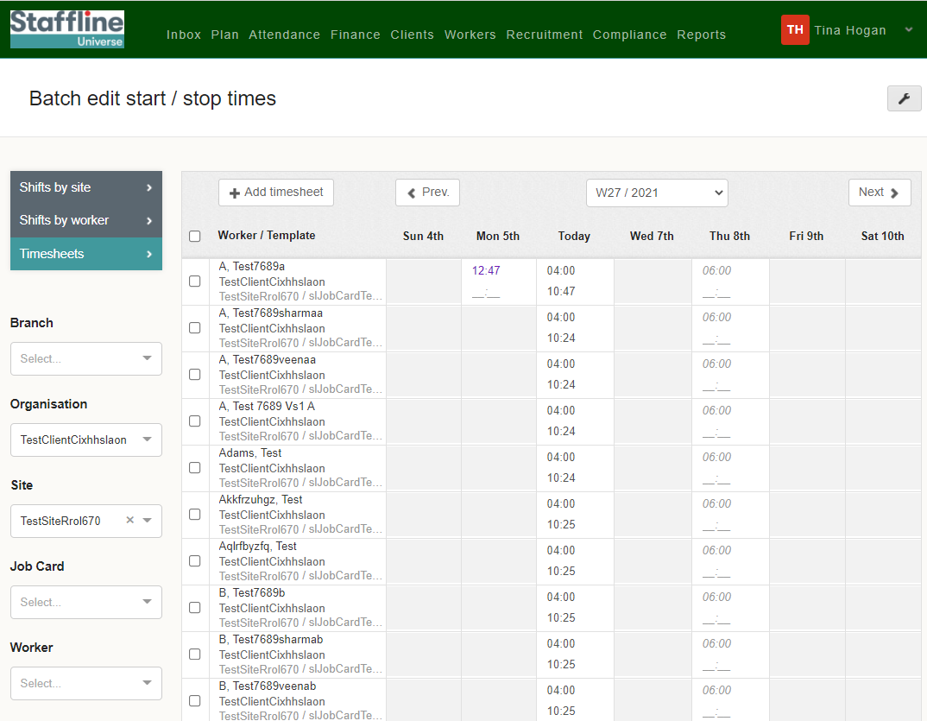
How To View Batch Edit Once Completed?
The shift has now been removed.
Repeat the process if you are deallocating a worker from the list. Only difference is reasons why.

Slide 44
HOW TO VIEW
SHIFT DETAILS

Slide 45
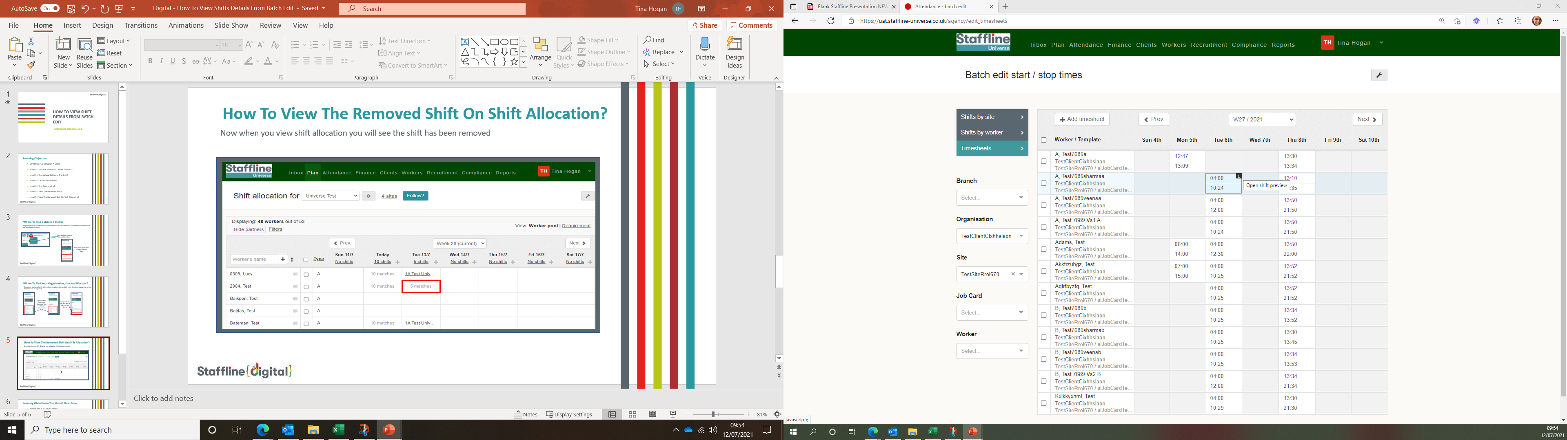
How To Open Shift Details?
Next click on the to open the shift details.

Slide 46
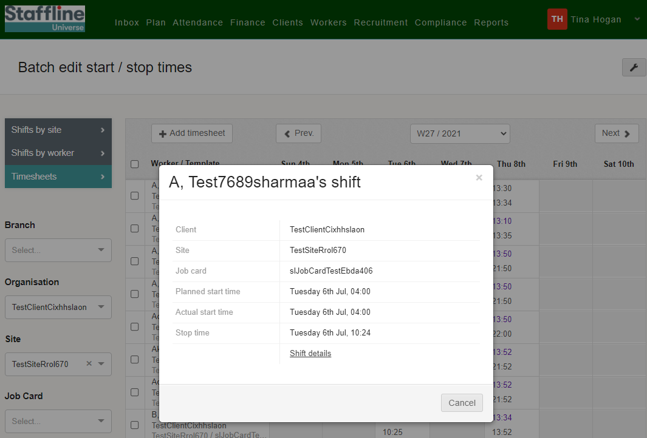
How To Open Shift Details?
Next click on here to open the shift details.

Slide 47
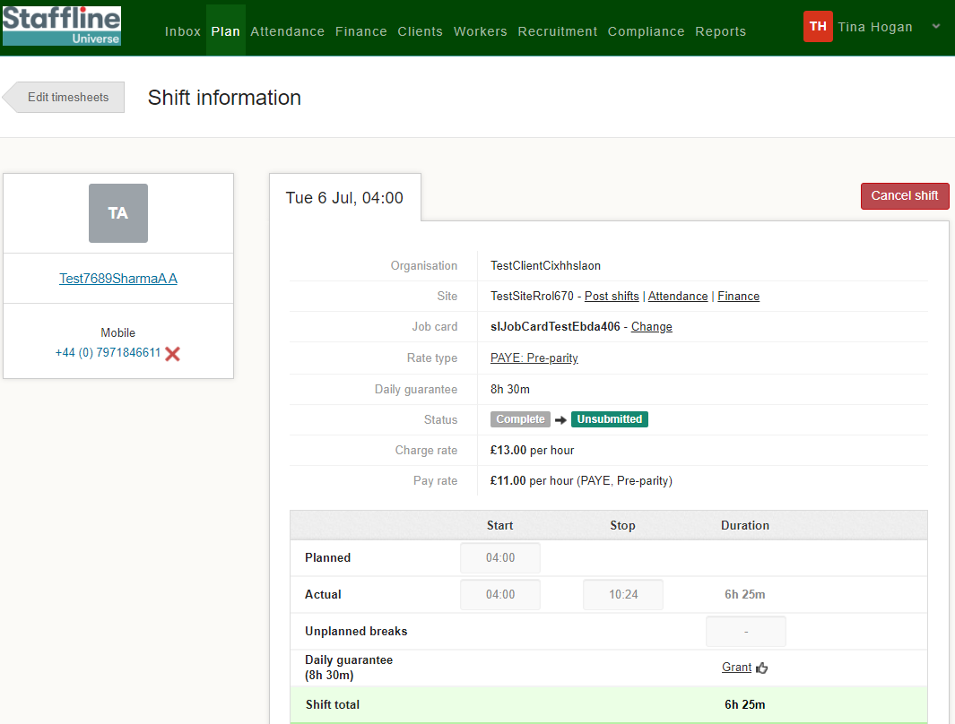
How To View Shift Details?
You have now opened shift details and are able to view job card information, start and finish time, hours worked, Adjustments, Expenses and are able to query a shift from here.
It also shows you who booked or cancelled a worker.

Slide 48
HOW TO VIEW
SHIFTS BY SITE

Slide 49
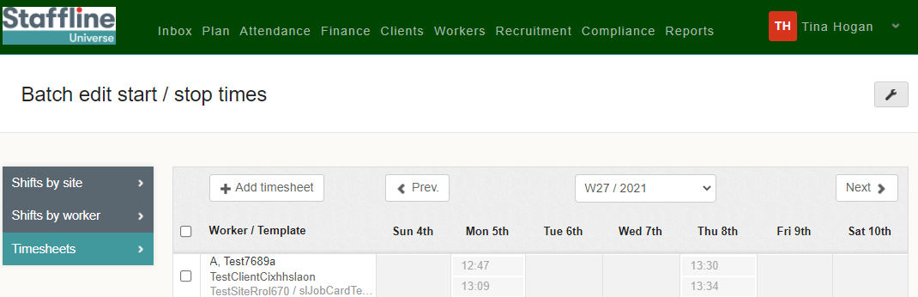
Where Do I Go To Open Shifts By Site?
Next click on 'Shifts by site'.

Slide 50
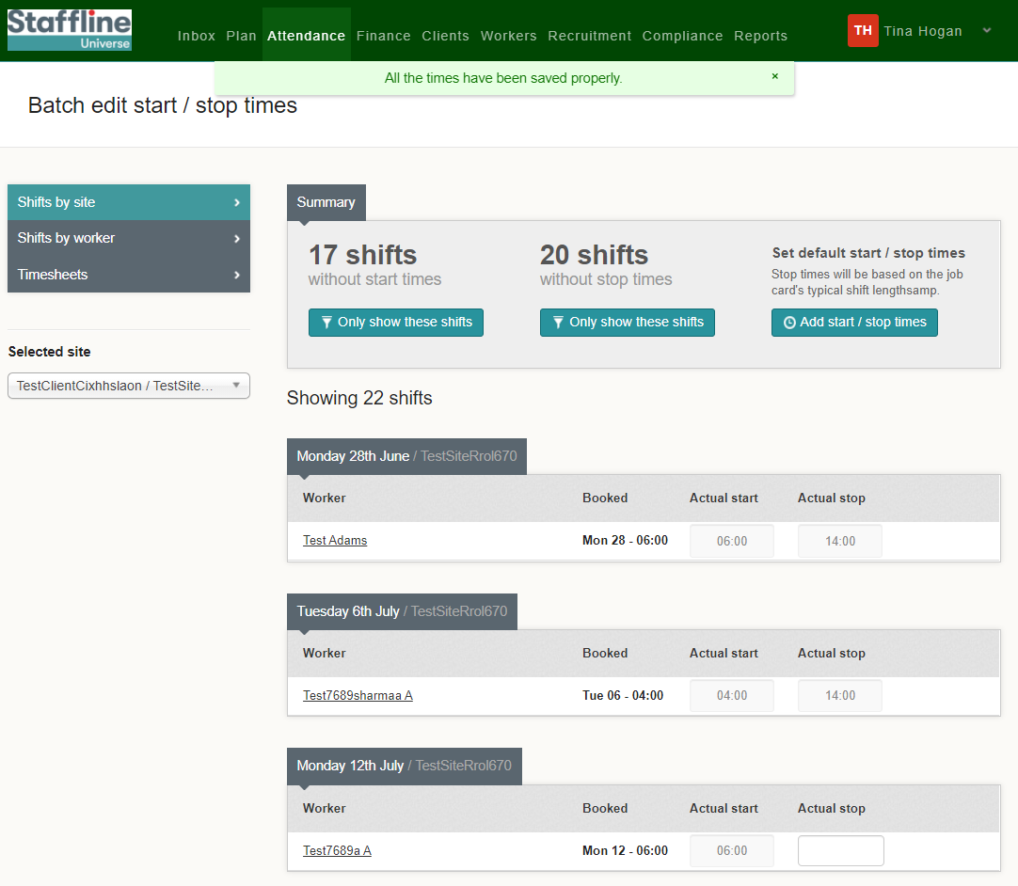
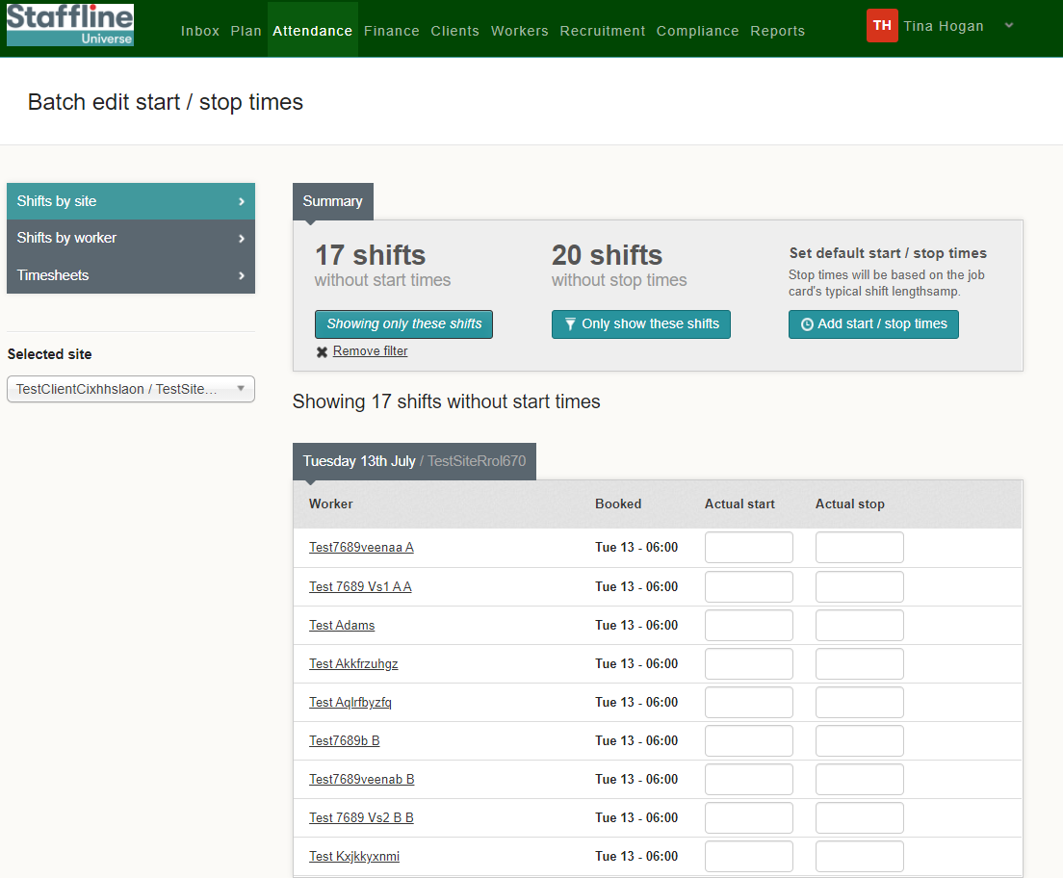
How To Only Show Shifts Without Start Times?
Search for your site in the dropdown box.
You can view the workers who have not got start times.
Click on only show these shifts.
You can manually add the start and stop times or add all by clicking on add start/stop times.

Slide 51

How To Only Show Shifts Without Stop Times?
You can view the workers who have not got stop times.
Click on only show these shifts.
You can manually add the start and stop times or add all by clicking on add start/stop times.

Slide 52
How To Add Start/Stop Times?
Now we have viewed who has start or stop times we can now add those who haven't.
Click on Add Start/Stop Times.

Slide 53

How To Check And Complete Start/Stop Times?
This function will input the start/stop times for you.
Next click on save shift times.
You can either amend times now or you can save and go back and amend.
It is quicker to amend before saving.

Slide 54

How View Complete Start/Stop Times?
You can now see the start and stop times are greyed out and it is now showing no shifts without start or stop times.
You have now completed how to view shifts by site and complete start/stop times!

Slide 55
HOW TO VIEW
SHIFTS BY WORKER

Slide 56
Where To Go To Open Shifts By Worker?
Next click on 'Shifts by worker'.

Slide 57

Where To Go To Select The Worker?
Next, search and select the worker you would like to view.

Slide 58

How To Only Show Shifts Without Start Times?
You can view the shifts of the worker that don't have start times.
Click on only show these shifts.
You can manually add the start and stop times or add all by clicking on add start/stop times.

Slide 59
How To Only Show Shifts Without Stop Times?
You can view the shifts of the worker that don't have stop times.
Click on only show these shifts.
You can manually add the start and stop times or add all by clicking on add start/stop times.

Slide 60
How To Add Start/Stop Times?
Now we have viewed the shifts that don't have start or stop times we can now add those in.
Click on Add Start/Stop Times.
This will add in both start and finish times which is taken from the job cards.

Slide 61

How To Check And Complete Start/Stop Times?
This function will input the start/stop times for you.
Next click on save shift times.
You can either amend times now or you can save and go back and amend.
It is quicker to amend before saving.

Slide 62

How View Complete Start/Stop Times?
You will also notice at the top of the page when you save it will advise if it has saved properly
You can now see the start and stop times are greyed out and it is now showing no shifts without start or stop times.

Slide 63
SPREADSHEET
UPLOAD

Slide 64
HOW TO DOWNLOAD
YOUR WORKERS THROUGH A CSV UPLOAD

Slide 65


How Download Workers Into Universe?
Go To Attendance>Spreadsheet Upload
Next, click on Import CSV Files and the arrow

Slide 66

How Download Workers Into Universe?
Click on the download Template to upload all your workers information. Once you download the template file out the information as required

Slide 67
How I Fill Out The Template?
Below shows the mandatory fields that need to be completed. Please ensure you complete the highlighted section to ensure our system doesn’t contact your workers
First name | Surname | Email | NI number | Is driver role | Preferred site ID | Employment status | Skip email confirmation until | Enable email comms | Enable SMS comms
Upload | Test6 | upload@test6.com | NA233333A | N | 6.01E+08 | PAYE | 20/12/2022 | N | N
Upload | Test7 | upload@test7.com | SS663526C | N | 6.01E+08 | PAYE |  | Y | Y
Upload | Test8 | omeradm2016@gmail.com | NA233335A | N | 6.01E+08 | PAYE |  | Y | N
First Name
Last Name
Email Address
NI Number
Is driver role (Y or N)
Preferred Site ID (the ID of a site the worker will work at, which can be find in the client page)
Employment Type (PAYE, LTD_Company, Umbrella)
Enable email comms = N
Enable SMS comms = N

Slide 68
How I Fill Out The Template?
You can also populate the 'Skip email confirmation until' column which will mean they don't need to manually skip the email to use the profile. They provide a date (e.g., 20/12/2022) and the email will be skipped until that point
If an email address or NI number exists anywhere in DatumRPO (not just that agency) the profile will not be created. You need to use a different email or NI number
If you don't put N for email/SMS comms, there is a risk that a worker will receive comms from the system.
Only a user for the agency can uploader the workers for that agency. Eg Datum cannot upload for Bob's Recruitment and Bob's Recruitment cannot upload for Jeremy's Recruitment
Whilst the uploader only requires the details stated. The created profile cannot be linked to a job card until the following as been completed;
Mobile Number
Date of Birth
Nationality
Address
The personal and employment status validations must have been passed (by clicking the buttons at the bottom of the personal information page). For each profile you would need to manually validation (clicking those buttons) after the upload has happened

Slide 69


How To Download Workers Into Universe?
Now we have downloaded the report, we can now see who has no conflicts and who has conflicts blocking items creation.
Any worker that is not valid, will now show an issue and how many issues.

Slide 70

How To Download Workers Into Universe?
When you click on the arrow it will dropdown the reasons of the issue and also which line from the report it is from for you to be able to rectify. Once amend re upload the report.

Slide 71

How To Download Workers Into Universe?
Once the upload has been completed again you will now see Valid on the right hand side. You can now create 8 items.

Slide 72

How To Download Workers Into Universe?
Next, click on Create 8 Items and select all.
Top Tip
You can only create 50 at a time. Once you have created 50 select all again and repeat the process

Slide 73
How To Download Workers Into Universe?
Once the system has created the items you will see conformation on the right side as created.
Once completed search for your worker and double check the details.

Slide 74
FINANCE OVERVIEW

Slide 75
TIMESHEETS

Slide 76

Where To Find Timesheets?
Timesheets are the start and finish times you have processed through either Stop/Start or Batch Edit Shifts.
Each day is processed as a timesheet, and you will be able to find them on each worker.

Slide 77



What's On The Timesheets?
Below is some information on the timesheets represented by different columns.
Status of open timesheets and unsubmitted
Total value to client for all workers
Total charge to client with adjustments for all workers
How many timesheets
Total pay for all workers
Total hours processed for all workers

Slide 78
What's On The Timesheets?
Further information on the timesheets represented by different columns.
Job card which the worker is being pay rolled on
Total value to client
Total pay to worker
Worker's name
Total charge to client with adjustments
Total hours processed

Slide 79

How To View Timesheets?
The timesheets represent each day the worker has worked, including hours processed
with charge and pay totals for each day.
Timesheets which have been created for the worker, that haven't yet been submitted and are highlighted pink

Slide 80

What Information Is On Each Timesheet?
Click on the day you would like to view. Each section represents the job card rules and hours processed.
The first part is information that has been placed on the job card.
You can also go to the job card from this section by either
clicking on:
Job Card
Rate schedule
Shift details

Slide 81
What Information Is On Each Timesheet?
The second part of the timesheet is the shift value breakdown.
This part shows the shift length, any adjustments, unpaid breaks and the total shift length billable to the client

Slide 82
What Information Is On Each Timesheet?
The last part of the timesheet is the total costs.
The final part is the charge rate, pay rate, hours, charge value and pay value

Slide 83
What Are Historic And Manual Adjustments?
These are for any missing payments or adjusted rates.
Please see the How To Guide on historic and manual adjustments
for more information.

Slide 84
UNSUBMITTED SHIFTS

Slide 85

What Is An Unsubmitted shift?
An Unsubmitted Shifts are timesheets that have been created and are waiting to be processed for payroll.
This is where you can check the hours and costing for each job card before submitting the Unsubmitted Shifts.
Go to Finance > Unsubmitted Shifts.

Slide 86


How To Submit Your Unsubmitted Shift?
You will be able to view all workers with hours on Universe.
When submitting unsubmitted shifts you are on your way to locking lines.
You can either submit all workers at a time or one by one.
For all workers you need to click on:
To submit worker's individually, click one box at a time.

Slide 87
APPROVED SHIFTS
CLIENT PROCESS

Slide 88
The Client Will Need To Approve Shifts?
Approved shifts need to be approved by your client by completing the next stage.

Slide 89


Where To Find Shifts To Be Approved?
This process happens after the shift has been submitted and continues the process of locking the payroll. The process will need to be completed by your client, find your site, go to Finance > Shifts to be approved.
Next Unlock the shifts to approve.

Slide 90


How To Approve Shifts?
Client can now approve the shifts either individually or select all shifts.
Then a warning sign will pop up, and your client will need to press

Slide 91
QUERY SHIFTS

Slide 92


Where To Query A Shift?
A query is where you have processed hours, approved the shifts and then noticed they are overpaid or underpaid due to incorrect start/stop times.
Click on the worker where you need to
raise a query.

Slide 93



How To Raise The Query?
Open the timesheet you need to make the changes to.
Click on the 1 shift at the top
Click on Raise a qu this then will enable you to make changes.

Slide 94


How To Complete The Query?
Open the query and select from the dropdown the reason for the query.
You can also add notes to message the worker regarding the query.

Slide 95


Where To Open And View Shift Details To Amend?
Go to Finance > Queried shifts.
Open the query you have created and click on shift details.

Slide 96

Where To Change The Time?
Click on the actual start time and change the start time to the correct time.

Slide 97



Where To Change The Time And Add Reason?
Add in the new time and use the dropdown to add in the reason. If required add a message for the worker. You will get a pop up advising on the start time, was the worker late. Click 'No' Unless they were late.
Once completed press:

Slide 98

How To Close The Query?
There are two ways you can close a query under queries.
At the top of the page close queries and submit
Or close - if you click on close you will then need to resubmit your shift

Slide 99

Where To View The Changes?
Once you have completed the changes you can view the closed query on the timesheet.
You have now completed how to amend, view and close a query!

Slide 100
WEEKLY GUARANTEES

Slide 101

How Do I View & Action Weekly Guarantees?
To view and manage any weekly guarantees you may have, go to the ‘Finance’ tab and select ‘Weekly Guarantees’.
You will now see any workers how are eligible for weekly guarantees.

Slide 102

How Do I View & Action Weekly Guarantees?
To grant a workers weekly guarantees, click on the eligible workers banner to view the detail and then click
‘Grant Weekly Guarantees’.

Slide 103

How Do I View & Action Weekly Guarantees?
Once the weekly guarantees have been granted, you will be able to view the details of the weekly guarantee and see the hours and charge value.

Slide 104

How Do I View & Action Weekly Guarantees?
If a weekly guarantee has been granted in error, you will be able to remove it by clicking ‘Revoke Weekly Guarantee. This will remove the weekly guarantee & restore the timesheet to its original state.

Slide 105
STATEMENTS

Slide 106


How To Find Statements?
Go to Finance > Statements
This gives you past or present timesheets where you can review hours and costings per job card.

Slide 107



How To View Statements?
You can view a statement by downloading the CSV into excel spreadsheet.
Client on the week or weeks you require and click on download.

Slide 108
INVOICES

Slide 109

How Do I Create A Invoice?
On your finance page go to your Invoices and once you have processed the hours you need to click on invoices.

Slide 110

How Do I Create A Invoice?
Once you have created your invoice you will see created on the profile.

Slide 111
MANUAL ADJUSTMENTS -
BONUS

Slide 112

What Is A Manual Adjustment?
A manual adjustment can be entered at any time if there is a timesheet. A manual adjustment is where we need to deduct, refund or pay a shift bonus. The correct way to process this is through a manual adjustment and not an historic adjustment.
Click on Finance > Timesheets and search for your site.

Slide 113


Where To Find Manual Adjustment To Add Shift Bonus?
To add a manual adjustment, click on the worker you require to make the adjustment to and open the timesheet.
cv
Next click on the workers timesheet

Slide 114

How Do I Add A Bonus?
Click on Shift details to open the workers detail to add your bonus.
Now you have opened the Shift detail page click on Add an Adjustment

Slide 115




How To Add A Manual Shift Bonus Adjustment?
The manual adjustment can be entered at any time, if there is a timesheet.
Shift bonus payments are for any extra pay that is a bonus, and the worker doesn’t accrue holiday pay. This means it doesn’t go through the shift allocation but is done as a manual adjustment or a download adjustment.
Go to type and click in the box.
You will then see your drop down and click on shift bonus.
Next click on the charge amount then add the payment amount click on the
box and add amount.

Slide 116


How To Add A Manual Shift Bonus Adjustment?
Next you need to add your description and invoice description.
Go to Description, click in the box and type in what it is for.
Last thing is to click on invoice description and select SR01 from the drop down.
If shift bonus is for supervisor check in don’t add charge amount, add in description 'Supervisor Check In'.

Slide 117

How To Complete A Manual Shift Bonus Adjustment?
Finally do your check list before saving.
Correct Type ✓
Correct Charge amount ✓
Correct Pay amount ✓
Correct Description ✓
Correct Invoice description ✓
Then click on

Slide 118
HISTORIC ADJUSTED
RATES

Slide 119
What Is A Historic Adjustment?
A historic adjustment is where we have missed payment for a worker. It might be basic hours, overtime or backpay. This is the correct way to process missing payments and not through manual adjustments.
Click on Finance > Timesheets and then search for your site.

Slide 120

How To Add An Historic Adjustment?
To add an historic adjustment, click on the worker you require to make the adjustment to and open the timesheet.
cv
Next click on

Slide 121

How To Add An Adjustment To The Relevant Week?
When adding an adjustment for a historic week you must ensure you are on the week you need to pay and the week the payment was missing from.
Adjustment week is the current week that you are payrolling.
Historic week is the week you need to pay the worker.
Click on the relevant week for the Historic Adjustment.

Slide 122



How To Add In The Charge And Pay Rate Difference?
Next, we need to add the rate band which will bring up charge rate and the pay rate for processing the hours.
You must ensure a charge rate is processed and not just a pay only.
Now add the difference of the charge rate and the pay rate. You can work this out by the difference between the New Pay Rate and Old Pay Rate. Then do the same with the charge rate.

Slide 123

How To Add In The Hours?
Now we have added the charge and pay rate difference, we now need to add the hours in the correct day of which the hours need to be the same as the hours for the week you are adjusting.

Slide 124



How To Add In Standard Rate Information?
Once with have opened the edit adjustment section, you need to select either Missed pay (basic), Missed pay (overtime),
Adjustment rate or Adjustment Rate Overtime ONLY.
Next click on Adjusted Rate or if overtime adjustment click Adjusted Rate OT.
This will be on your drop down.
Next click on the reason and

Slide 125



How To Check Before Saving?
We have now added all the information to save the adjustment. Next, we need to check to ensure the information is correct.
Correct Adjustment week of payment ✓
Correct Historic week of payment ✓
Correct Charge & Pay Rate Difference ✓
Correct Hours✓
Correct reason✓
Then click on
If you have inputted anything incorrect you will see the below message appear.

Slide 126




How To View The Adjustment In Timesheets?
The Adjustment has now been processed and there are two ways of finding the adjustment.
The first one is allocated on the timesheet
When you open the timesheet, you will see the adjustment.

Slide 127



How To View The Adjustment In Adjustments?
The second way is to go to timesheets and on the left side you will see adjustments.
When you open the timesheet, you will see the adjustment. If required, you can adjust from here by clicking

Slide 128
HISTORIC ADJUSTED
MISSING HOURS

Slide 129


What Is An Historic Adjustment?
An historic adjustment is where we have missed payment for a worker. It might be basic hours, overtime or backpay. This is the correct way to process missing payments and not through manual adjustment.
Click on Finance > Timesheets and then search for your site.

Slide 130
How To Add An Historic Adjustment?
To add an historic adjustment, click on the worker you require to make the adjustment to and open the timesheet.
cv
Next click on

Slide 131
How To Add An Adjustment To The Relevant Week?
When adding an adjustment for a historic week you must ensure you are on the week you need to pay and the week the payment was missing from.
Adjustment week is the current week that you are payrolling.
Historic week is the week you need to pay the worker.
Click on the relevant week for the Historic Adjustment.

Slide 132

How To Add In The Charge And Pay Rate?
Next, we need to add the rate band which will bring up charge rate and the pay rate for processing the hours.
You must ensure a charge rate is processed and not just a pay only.
Now add in the charge rate and the pay rate.

Slide 133

How To Add In The Hours?
Now we have added the charge and pay rate we now need to add the hours in the correct day of which the hours were missing.
Next, click on Missed pay and add in the reason (if missed pay (basic) you don’t need to click and change).
This will then bring up a drop down to select reason.

Slide 134

How To Add In Standard Rate Information?
Once you have opened the Edit Adjustment you need to select either Missed pay (basic), Missed pay (overtime),
Adjustment Rate or Adjustment Rate Overtime ONLY.
Next click on the reason and

Slide 135
How To Check Before Saving?
We have now added all the information to save the adjustment. Next, we need to check to ensure the information is correct.
Correct Adjustment week of payment ✓
Correct Historic week of payment ✓
Correct Charge & Pay Rate ✓
Correct Hours✓
Correct reason✓
Then click on
If you have inputted anything incorrect you will see the below message appear.

Slide 136
How To View The Adjustment In Timesheets?
The Adjustment has now been processed and there are two ways of finding the adjustment.
The first one is allocated on the timesheet
When you open the timesheet, you will see the adjustment.

Slide 137
How To View The Adjustment In Adjustments?
The second way is to go to timesheets and on the left side you will see adjustments.
When you open the timesheet, you will see the adjustment. If required, you can adjust here by clicking

Slide 138
SITE LOCKS

Slide 139
When Is The Deadline For Locking Sites?
DEADLINE FOR LOCKING SITES IS:
MONDAY
2PM
If you don’t lock or advise of an issue the site will be locked for you which will result in receive a complete and correct invoice

Slide 140


What Do I Need To Check Before I Lock Site?
Site Locks is the final process before you complete payroll. Once you lock the site you are not able to do anything if you find something wrong. It is important that you do your checks before finalising.
Go to Finance and back to your timesheet page.
You need to check your hours and charge rates match.

Slide 141



Where To Find Period (Week), Division And Client?
Next you will need to add your Period. This is the week of payroll you are processing, division which your client sits under and then find your client.

Slide 142

Where To Generate Your Lock Report?
Click on get report and this will then generate a CSV report.
The report will show you
Worker, Workers ID, Job Card, Hours, Pay Rate, Charge Rate, Total Pay and Total Charge.
This will enable you to do a final check before locking your payroll.

Slide 143


How To Lock Your Site?
You are now ready to lock your site. The final stage is to add in PO if required. There are also options to add to job card or worker.
You can now lock your site.
The site will go from lock to unlock.
It is forbidden to unlock a site and will not allow you to do so.

Slide 144
WORKER OVERVIEW

Slide 145
MANAGE WORKER

Slide 146


How To Fill Out The Workers Details?
Enter the worker's type. You need to select worker here.
Select the role from the dropdown.

Slide 147

How To Fill Out The Workers Details?
Enter the candidate’s name here. ‘First name’ and ‘Last name’ must be completed, but ‘Middle name’ is optional.
Enter gender here.

Slide 148

How To Fill Out The Workers Details?
Enter their mobile number.
If Non-UK mobile number, please tick the box.
If you required to add any notes add in the First Note section
Finally press on the right hand
corner to create new worker.

Slide 149


How Do I Fill Out The Workers Details?
Next, we need to complete the about you section, add date of birth and nationality.
Under notes on the top right, you will notice a message stating
'Onboarding email sent'.

Slide 150

How To Reduce Incomplete Profile?
Once a section is completed, the profile percentage will start to decrease until it reaches 100%. Underneath the profile percentage, it will also show issues that are outstanding with the profile.
The following sections will need to be completed so that the registration percentage reaches 100%, this way the worker can then be made compliant.

Slide 151

How To Complete Contact Details?
Contact details need to be verified, this will be through email and text message. If the worker doesn’t confirm email address, you can skip for 30 days while you get the worker to confirm.

Slide 152

How To Complete Your Address?
To complete the address, you can manually add in all the information or add in the post code which will give you a drop down to find the number of the house/road.
Once the address has been found press enter and this will fill out all the slots.
The worker can also be added to – Do you want to work in another location,
click 'Yes' or 'No'.

Slide 153



How To Complete Licence?
Go to Licence, Tacho and CPC on the left-hand side of the worker's profile.
Please fill in the following information:
Add in the country of issue. Follow the UK guidelines for licenses. If other use the dropdown to select the country.
Entre the full name on the Licence.
Enter the Licence number on the driving Licence card
Enter the issue number.
Date of Issue.
Date of Expiry.

Slide 154


How To Complete Licence Categories?
To add a category, click on to the category that appears on the licence.
Then enter the valid date from and to.
Click on save changes.

Slide 155


How To Complete Licence Endorsements?
If a worker has any endorsements on their licence, you need to make sure you add them to Universe. To find your endorsement click on the drop-down arrow to review the dropdown list.
Once you have entered the reason you will need to fill out the dates of offence.

Slide 156

How To Complete Licence Endorsements?
Add the date of the offence
The points issued
If required add any additional endorsements.
Once completed press save change.

Slide 157


How To Complete Your Tacho?
Now we need to complete the Tacho part, if required click 'Yes'.
Next, we need to add in the Tacho number and expiry date.
Once completed press save changes.

Slide 158


How To Complete Your CPC/DQC?
Now we need to complete the CPC/DQC part if required click on 'Yes'.
Add in the DQC number and expiry date.
Once completed press save changes.

Slide 159



How To Complete Validations For Licence And Tacho?
To validate the workers Licence And Tacho, you will need to click onto each one and validate.
Click on update.
Pass the worker.
If you click fail the worker will not be able to be placed out into work. This would be a decline in the interview process.
Add any comments.
Click on
'Create
Validation record'.
Repeat the process on the
Tacho Card.
You will now see both sections have been updated and status is Pass.

Slide 160


How To Upload Driving Licenses And Checks?
The next section to complete is the scanned document section.
Click on the section you would like to upload DVLA checks.
You can either drag and drop the file or upload from your desktop.
Click on the section and take the expiry date from the passport/ID card.
Once you have pressed upload this file, you will see a padlock next to the selected box. This means the worker cannot delete the file.

Slide 161


How To Complete Skills And Experience?
To complete Skill’s first select a primary skill.
If you don’t have a primary skill, click on the roles that they have experience on in their previous work history. You can also select other skills and sub-skills.
Once added press save changes.

Slide 162



How To Complete Skills And Experience?
To complete professional qualifications, select whether you have an FLT license or not.
If yes is selected, an additional box will appear with FLT qualification provider and FLT qualification date.
Insert the license from the drop down and input the most recent qualification date or refresher date.
Once added press save changes.

Slide 163


How To Complete Validations For Skills?
To validate the skills section of a worker's profile, you will need to click on each one to validate.
Add any comments
Click on
'Create
Validation record'.
Pass the worker.
If you click fail the worker will not be able to be placed out into work. This would be a decline in the interview process.
Repeat the process on the work positions.
You will now see both sections have been updated and the status is Pass.

Slide 164


How To Validate The Workers Personal Information And Employment Status?
This is the same process as validating the skills section, but you will have to do your check list before you click pass.
Click on update for
personal information and
employment status.
When confirming the validation of the worker you are confirming the following.
One happy, you can pass the worker, add a comment and then select 'Create validation record'.

Slide 165




How To Make The Worker Compliant?
The last requirement to enable you to place the worker onto an Induction is to confirm if the right to work check outcome adheres to company policy.
Once you have click on 'Yes' you will see at the top of the page the worker will turn compliant.
If you click on 'No' you will see at the top of the page the worker will have failed compliant.

Slide 166
LINKING A WORKER TO A JOB CARD

Slide 167


How To Search For A Worker?
Open Universe go to workers and then search for your worker in the search bar.
Once you have searched for your worker click on their name to open.

Slide 168

How To Add And Link Job Card?
Click on add another job card.

Slide 169




How To Link A Worker To Job Card In sections?
Click on organisation and add your site. Next click on Site.
Next allocate the job card.
Finally click link to add the job card.

Slide 170

How To View The Linked Job Card?
You can now see your job card is linked to the worker. Click on add another job card to repeat the process if required.
You can also repeat this process on the workers profile!

Slide 171
UNLINKING A WORKER

Slide 172
How To Search For A Worker To Unlink?
Open Universe go to workers and then search for your worker in the search bar.
Once you have searched for your worker click on their name to open.

Slide 173


How To Link A Worker To A Job Card?
You can either go into the workers profile or click on the linked job cards.
On the left of the workers profile, select 'Linked job cards’.
Otherwise you can remove from this page.

Slide 174




How To Unlink A Worker From Job Card?
Click on the arrow.
It will then drop down to show you
Click on the 'Unlink job card'.

Slide 175


How To Complete The Unlinking Of The Worker?
Click on the unlink and it will remove the linked job card.
This should be completed every time you stop using a worker or you make them a leaver.

Slide 176
WORKING TIME

Slide 177

How Do I View Working Time?
Go to Workers>Working Time

Slide 178

How Do I Navigate Around Working Time?
You can type in the workers name and search
You can view from 2 to 16 days
Workers Names

Slide 179
How Do I Navigate Around Working Time?
Find Your Client
Total hours for the days you have showing
Days/Dates
Hours for the day

Slide 180
AGENCY WORKER REGULATION

Slide 181

Where To Go To Find Agency Worker Regulations?
Go to Workers > Agency worker regulations.

Slide 182

How To View Your Sites AWR?
At the top of the page, you will see a colour chart, which gives you the reason for the colour. You can also download a CSV report from here.

Slide 183
How To View Your Sites AWR?
As we go from left to right you have 2 tick boxes where you can hide inactive or hide qualified. You can add the week you want to view, organisation and site.

Slide 184
How To View Your Sites AWR?
Next you can search for a worker, and you can also view the weeks of employment. The tab at the side will move you back or forward a week.

Slide 185
How To View Your Sites AWR?
Here you can use the arrow up (A-Z) or down (Z-A). 'ES' will show your employed status workers and 'Cur' is current qualified workers.

Slide 186

How To View Your Sites AWR?
Below you can see we have blue and pink lines. The blue lines mean they were in their qualifying period and once qualified they move to pink.
The salmon pink shows when their clock would reset if they didn’t work.

Slide 187
REPORTS OVERVIEW

