Slide 1

AGENCY
“HOW TO DO GUIDE”

Slide 2


FINANCE OVERVIEW

Slide 3
SITE LOCKS

Slide 4
When Is The Deadline For Locking Sites?
DEADLINE FOR LOCKING SITES IS:
MONDAY
2PM
If you don’t lock or advise of an issue the site will be locked for you which will result in receive a complete and correct invoice

Slide 5
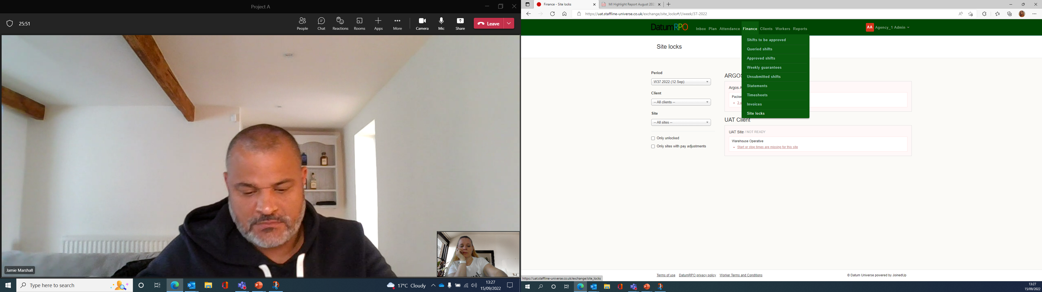
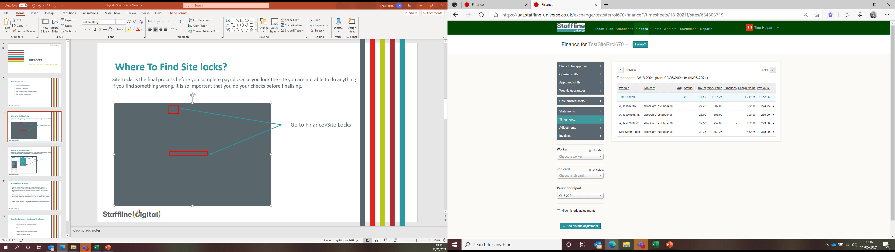
What Do I Need To Check Before I Lock Site?
Site Locks is the final process before you complete payroll. Once you lock the site you are not able to do anything if you find something wrong. It is important that you do your checks before finalising.
Go to Finance and back to your timesheet page.
You need to check your hours and charge rates match.

Slide 6
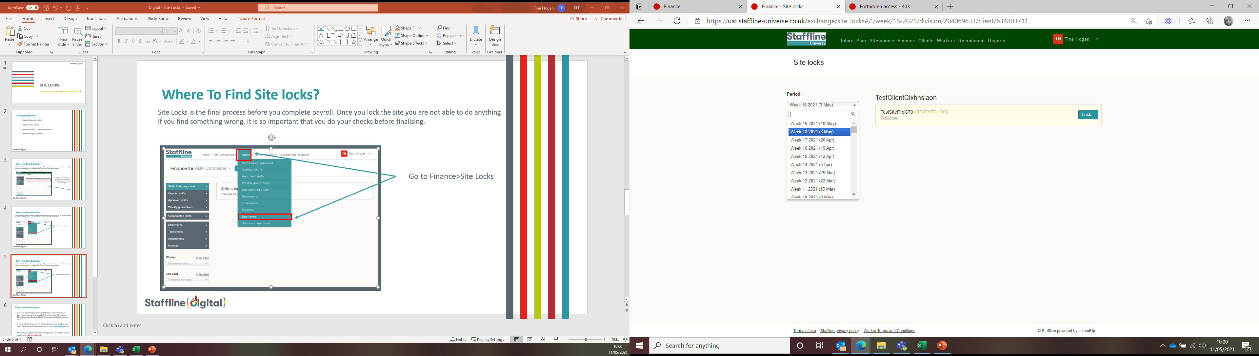
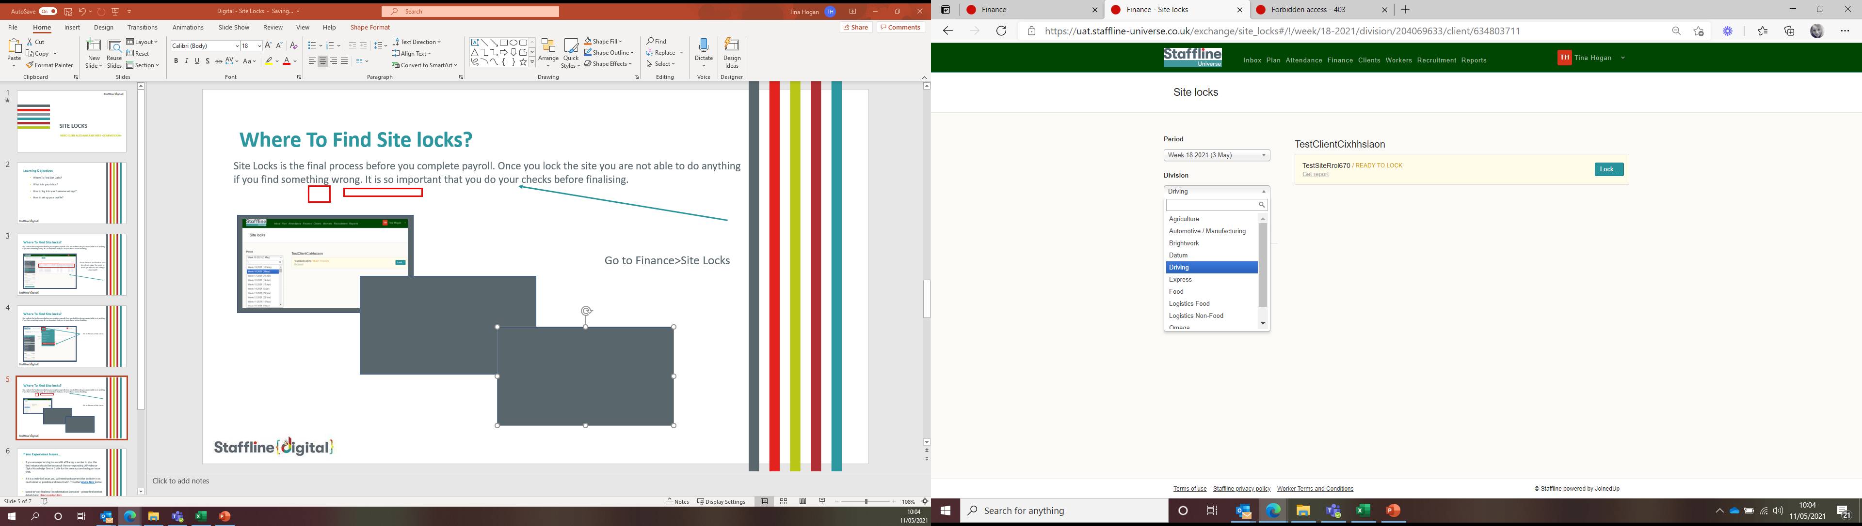
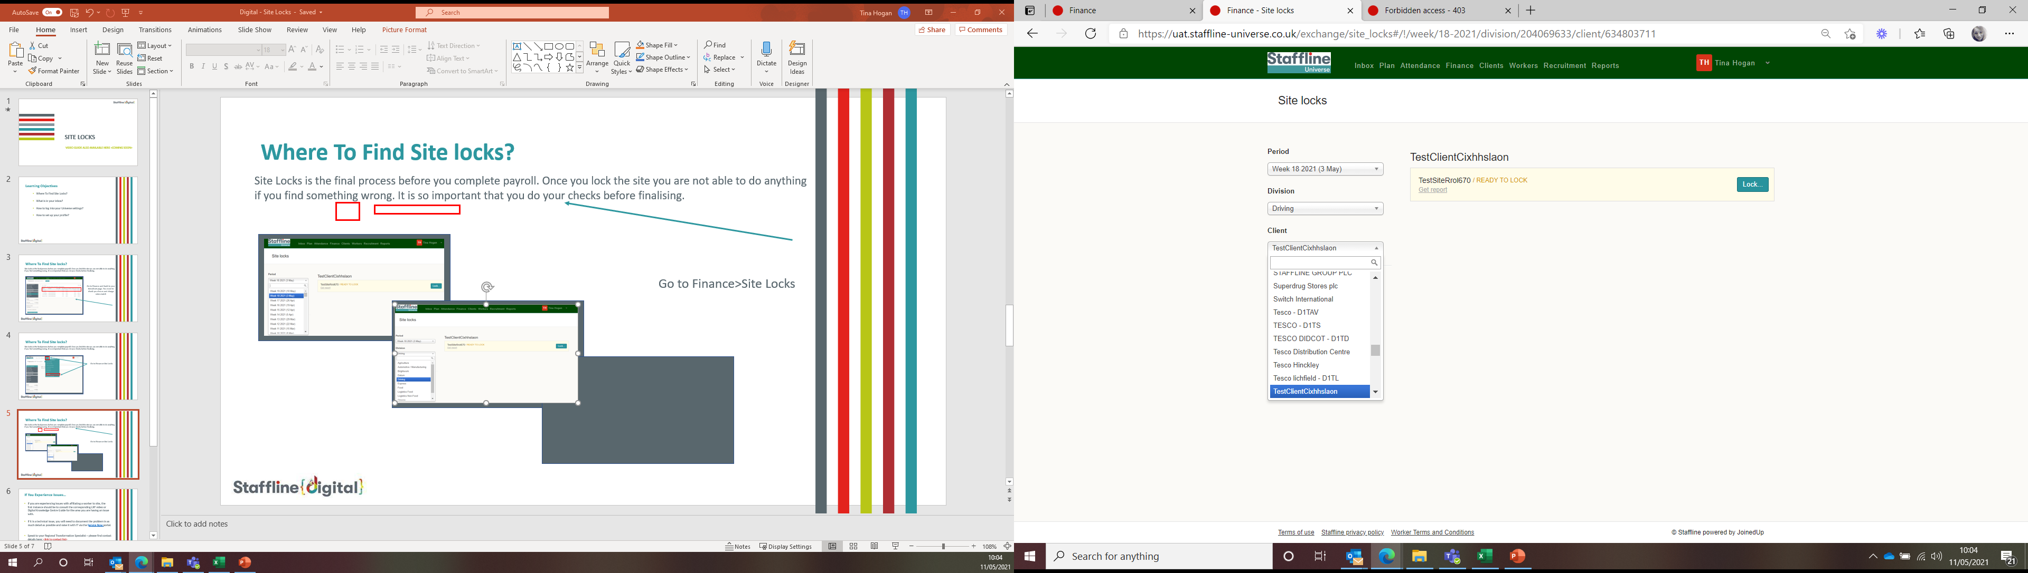
Where To Find Period (Week), Division And Client?
Next you will need to add your Period. This is the week of payroll you are processing, division which your client sits under and then find your client.

Slide 7
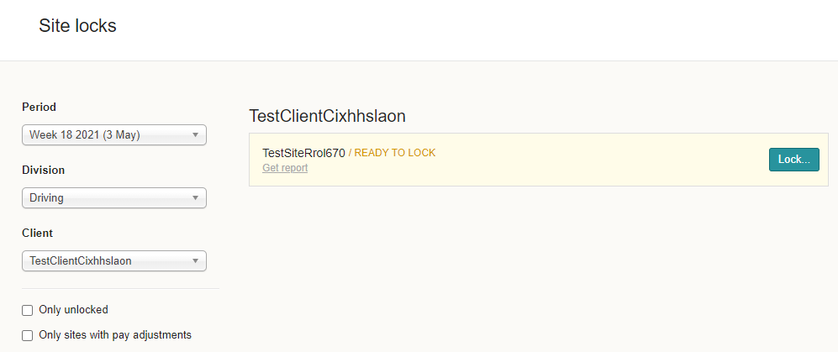
Where To Generate Your Lock Report?
Click on get report and this will then generate a CSV report.
The report will show you
Worker, Workers ID, Job Card, Hours, Pay Rate, Charge Rate, Total Pay and Total Charge.
This will enable you to do a final check before locking your payroll.

Slide 8
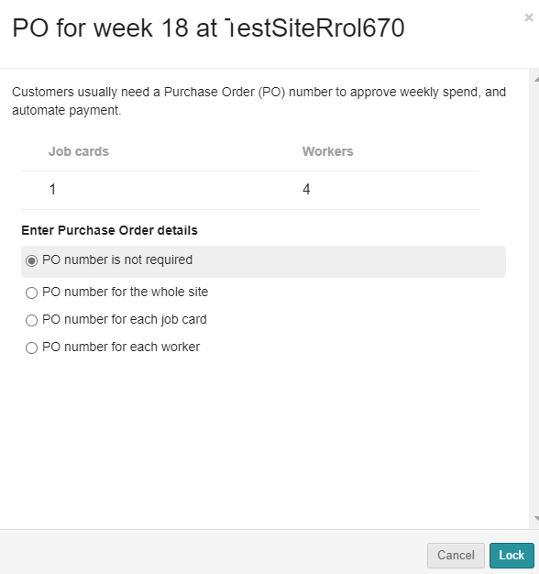
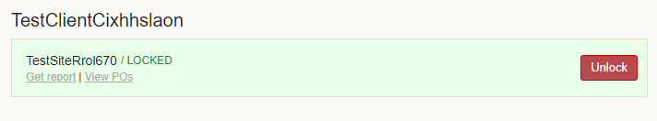
How To Lock Your Site?
You are now ready to lock your site. The final stage is to add in PO if required. There are also options to add to job card or worker.
You can now lock your site.
The site will go from lock to unlock.
It is forbidden to unlock a site and will not allow you to do so.

