Slide 1

AGENCY
“HOW TO DO GUIDE”

Slide 2


FINANCE OVERVIEW

Slide 3
UNSUBMITTED SHIFTS

Slide 4
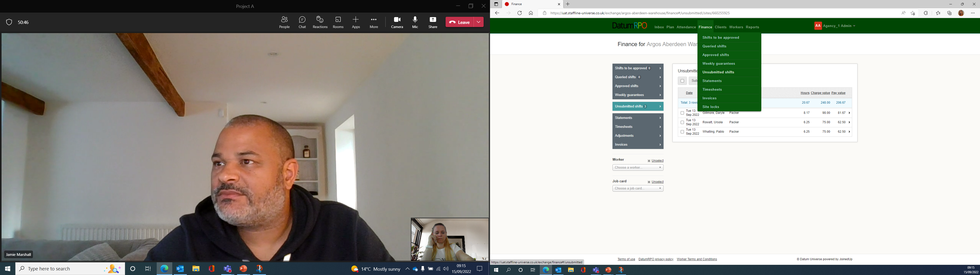
What Is An Unsubmitted shift?
An Unsubmitted Shifts are timesheets that have been created and are waiting to be processed for payroll.
This is where you can check the hours and costing for each job card before submitting the Unsubmitted Shifts.
Go to Finance > Unsubmitted Shifts.

Slide 5
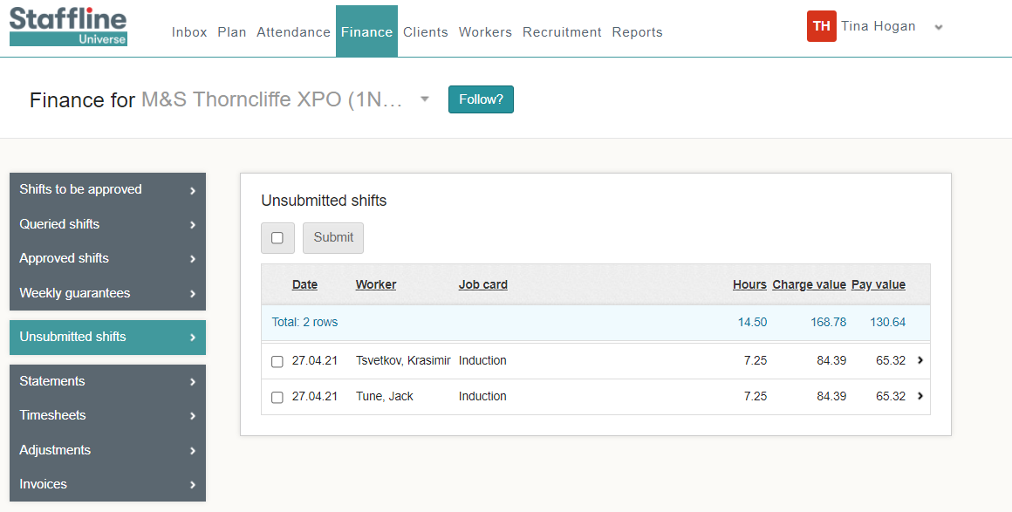

How To Submit Your Unsubmitted Shift?
You will be able to view all workers with hours on Universe.
When submitting unsubmitted shifts you are on your way to locking lines.
You can either submit all workers at a time or one by one.
For all workers you need to click on:
To submit worker's individually, click one box at a time.

Slide 6
APPROVED SHIFTS
CLIENT PROCESS

Slide 7
The Client Will Need To Approve Shifts?
Approved shifts need to be approved by your client by completing the next stage.

Slide 8
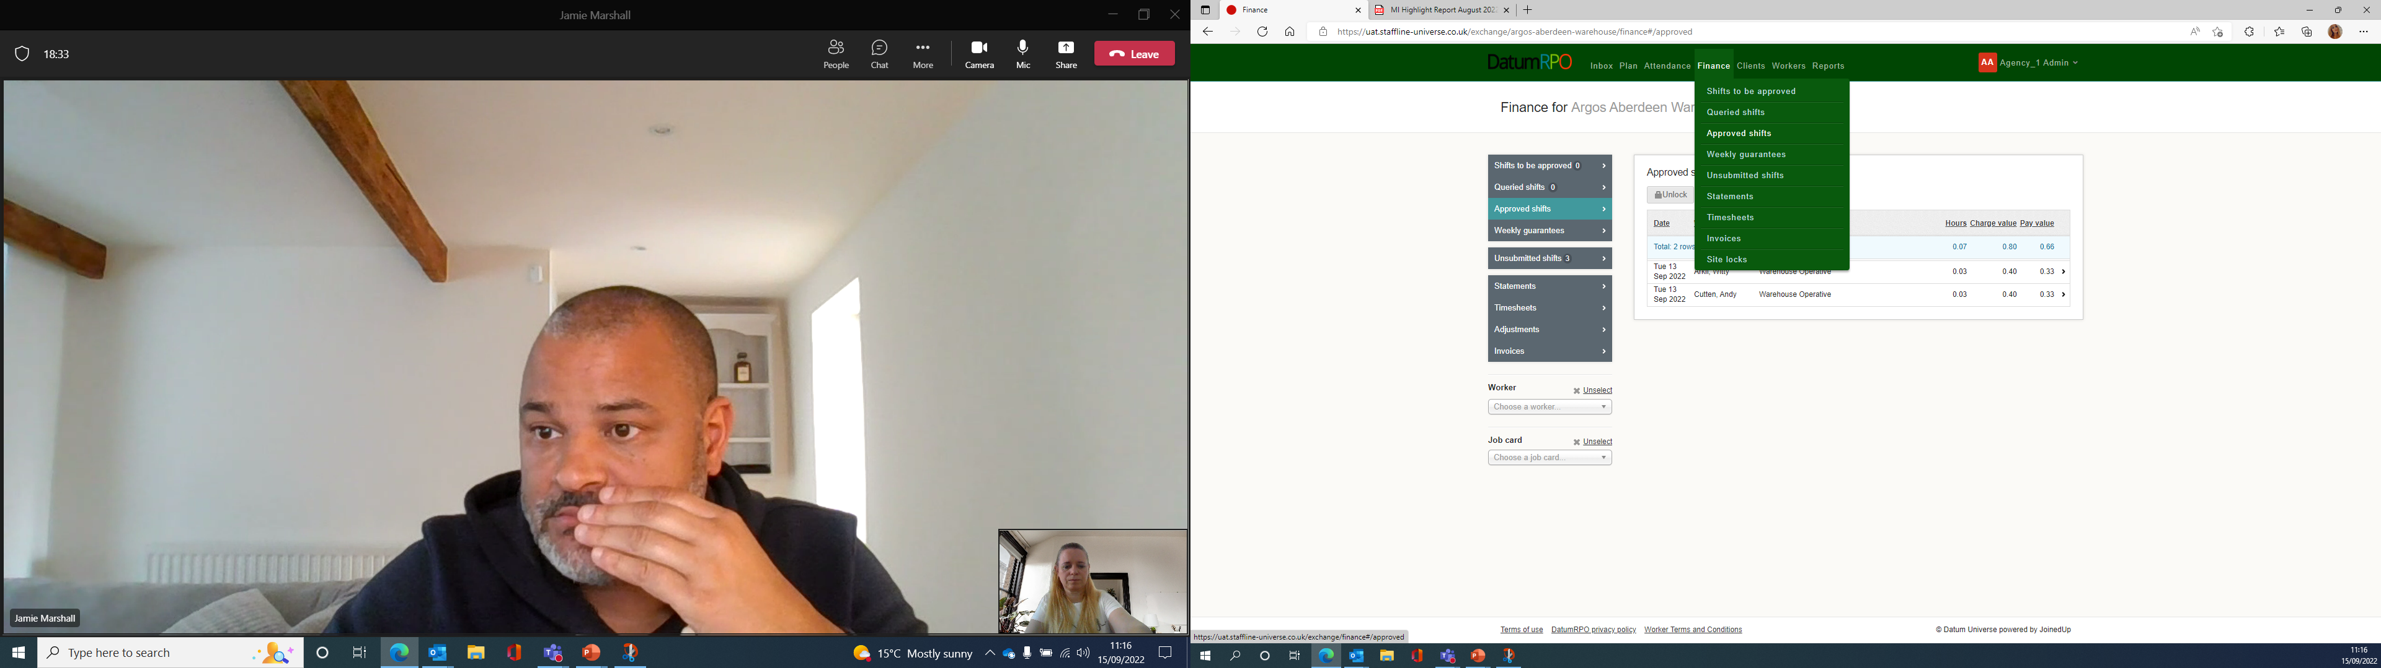
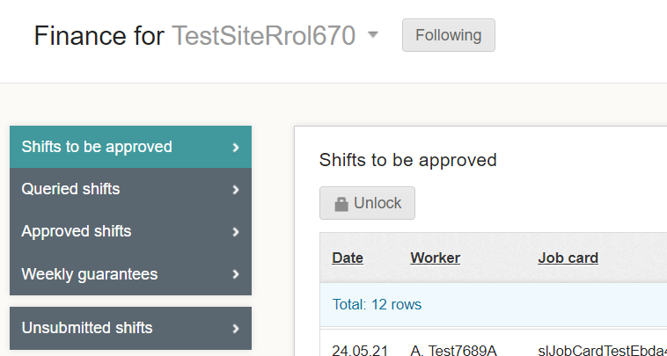
Where To Find Shifts To Be Approved?
This process happens after the shift has been submitted and continues the process of locking the payroll. The process will need to be completed by your client, find your site, go to Finance > Shifts to be approved.
Next Unlock the shifts to approve.

Slide 9
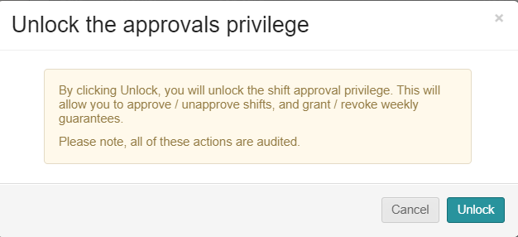
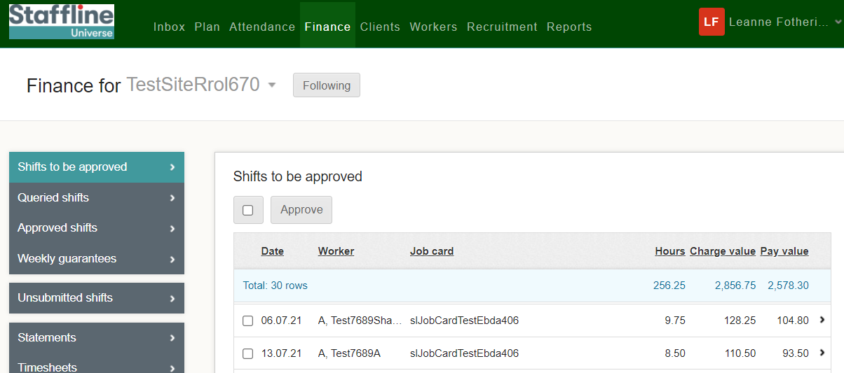
How To Approve Shifts?
Client can now approve the shifts either individually or select all shifts.
Then a warning sign will pop up, and your client will need to press

Slide 10
QUERY SHIFTS

Slide 11
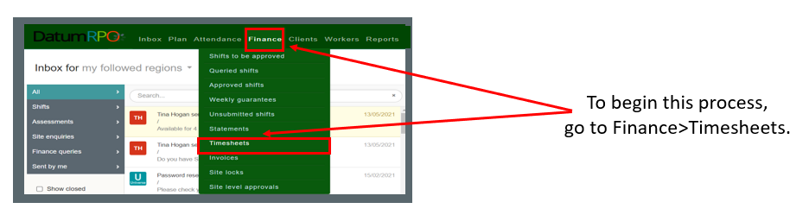
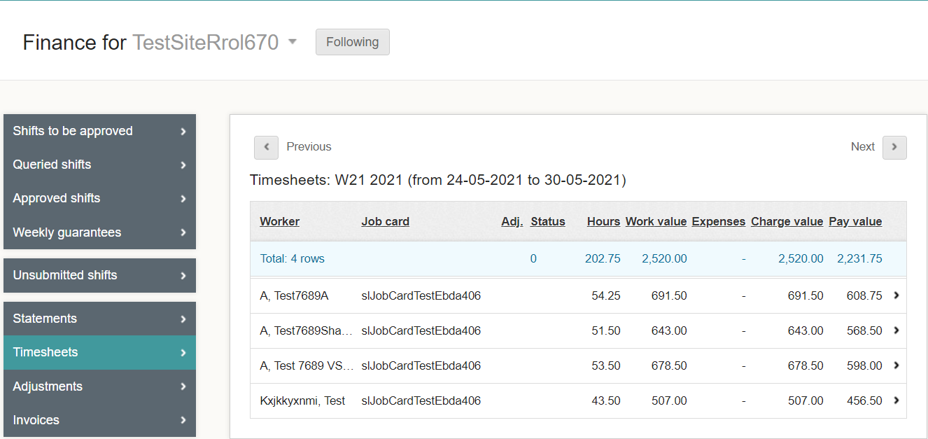
Where To Query A Shift?
A query is where you have processed hours, approved the shifts and then noticed they are overpaid or underpaid due to incorrect start/stop times.
Click on the worker where you need to
raise a query.

Slide 12
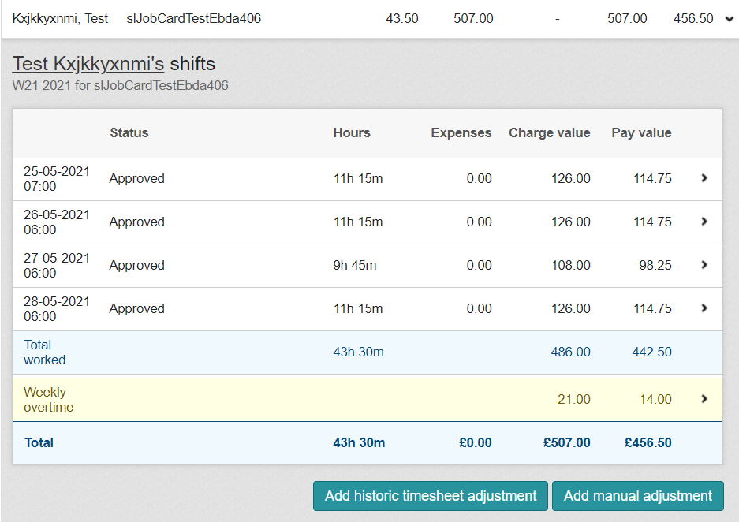
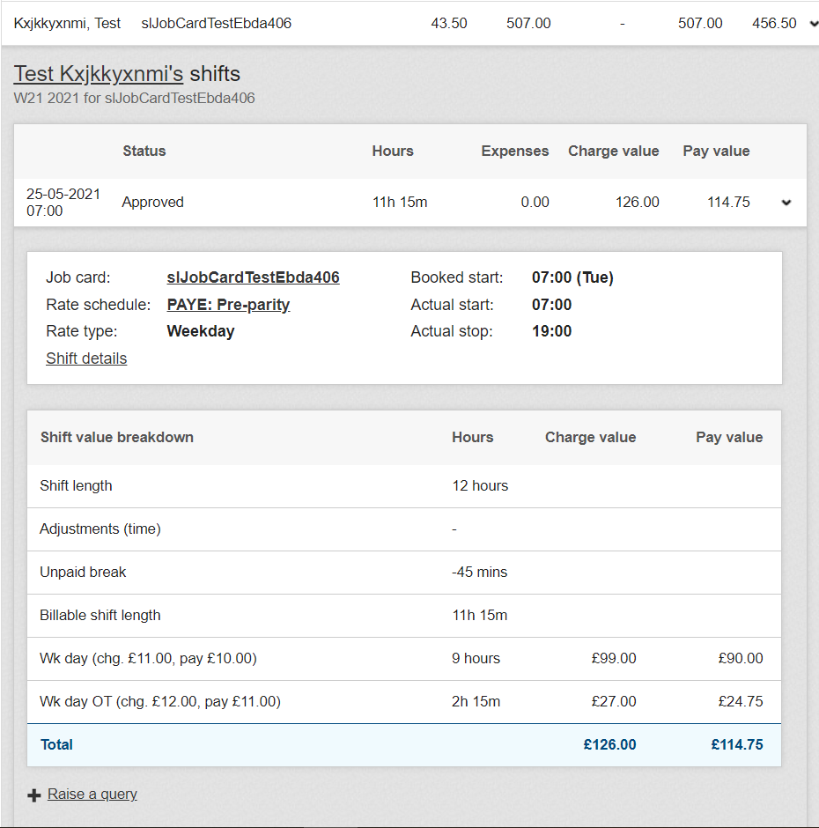

How To Raise The Query?
Open the timesheet you need to make the changes to.
Click on the 1 shift at the top
Click on Raise a qu this then will enable you to make changes.

Slide 13
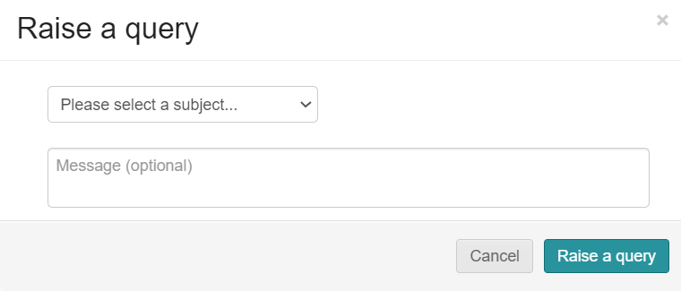
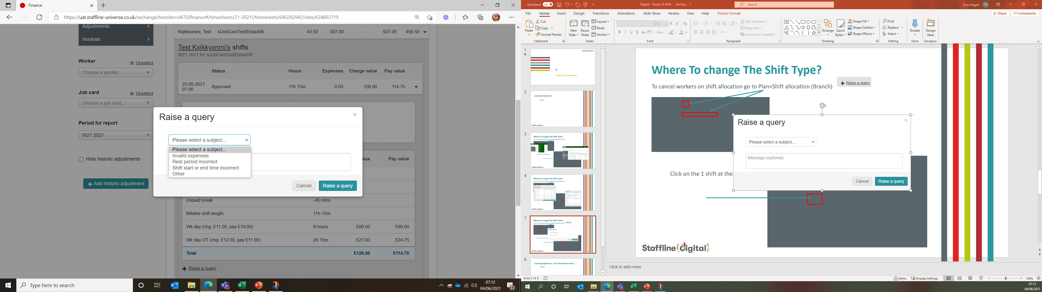
How To Complete The Query?
Open the query and select from the dropdown the reason for the query.
You can also add notes to message the worker regarding the query.

Slide 14
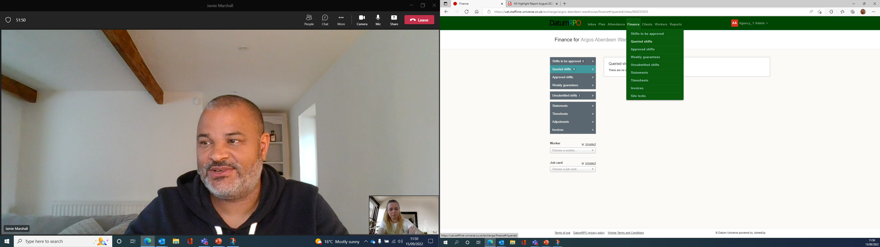
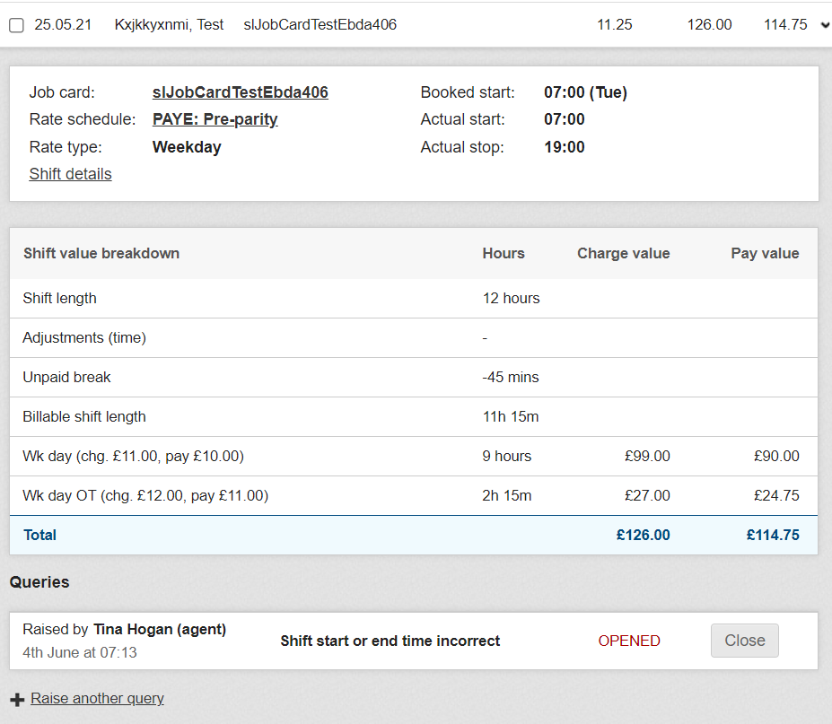
Where To Open And View Shift Details To Amend?
Go to Finance > Queried shifts.
Open the query you have created and click on shift details.

Slide 15
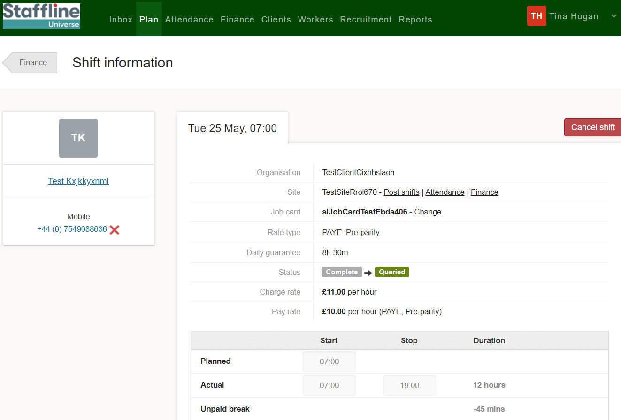
Where To Change The Time?
Click on the actual start time and change the start time to the correct time.

Slide 16
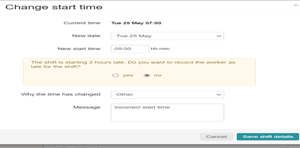
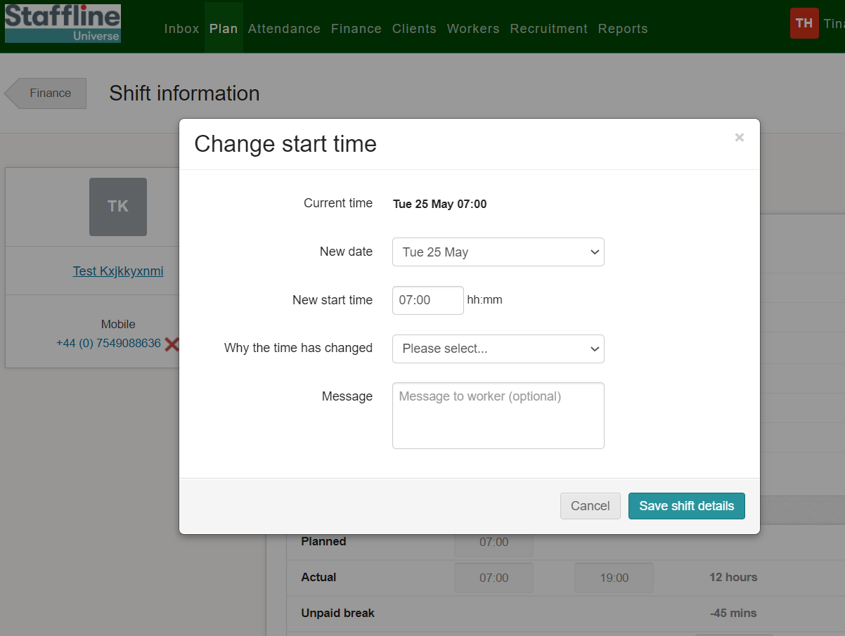
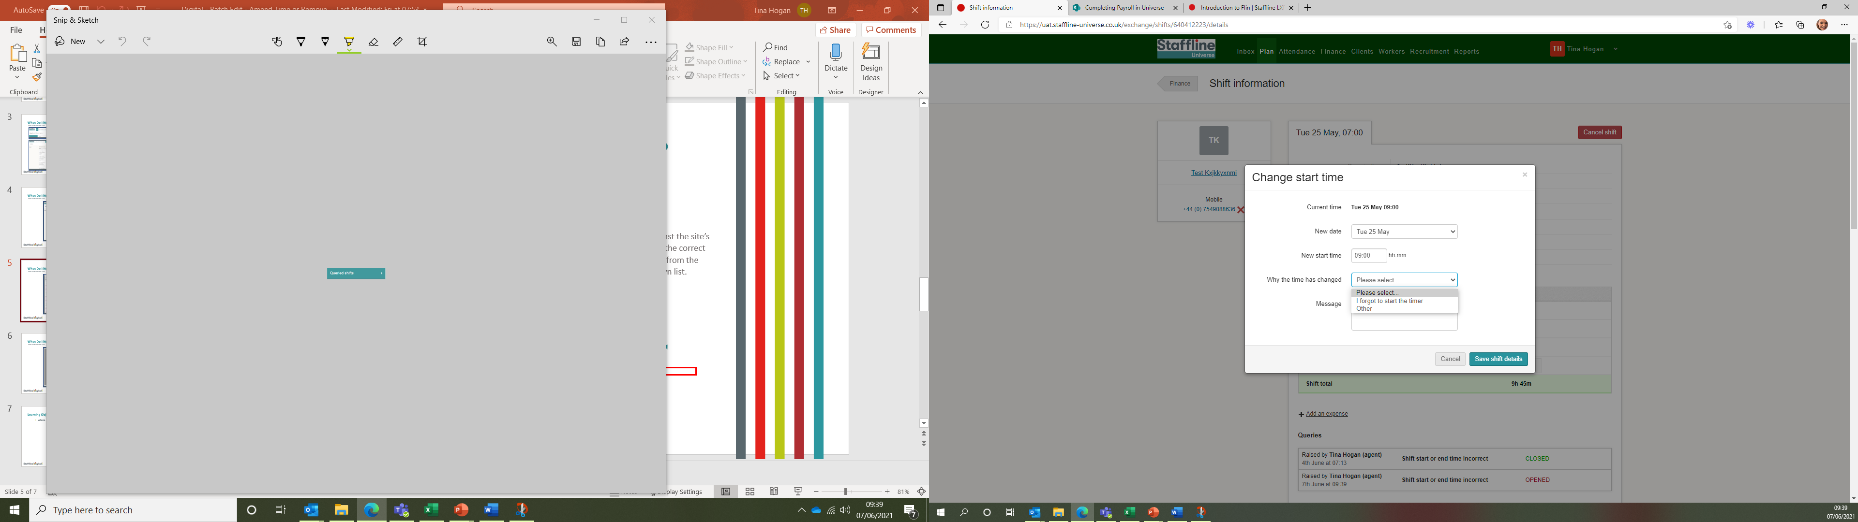
Where To Change The Time And Add Reason?
Add in the new time and use the dropdown to add in the reason. If required add a message for the worker. You will get a pop up advising on the start time, was the worker late. Click 'No' Unless they were late.
Once completed press:

Slide 17
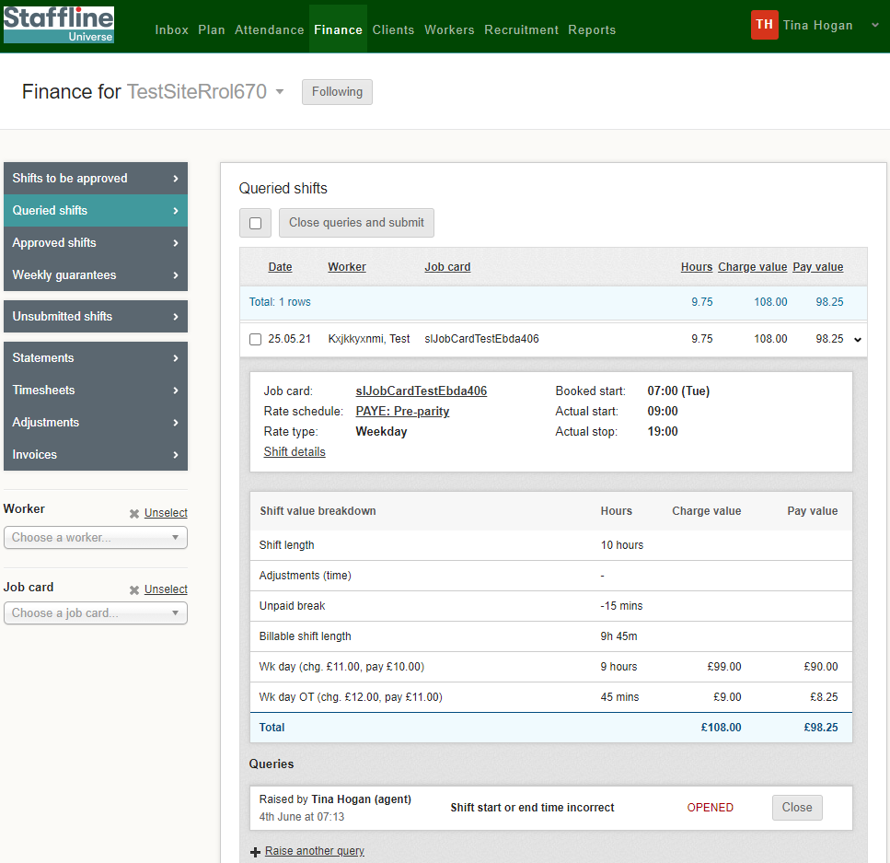
How To Close The Query?
There are two ways you can close a query under queries.
At the top of the page close queries and submit
Or close - if you click on close you will then need to resubmit your shift

Slide 18
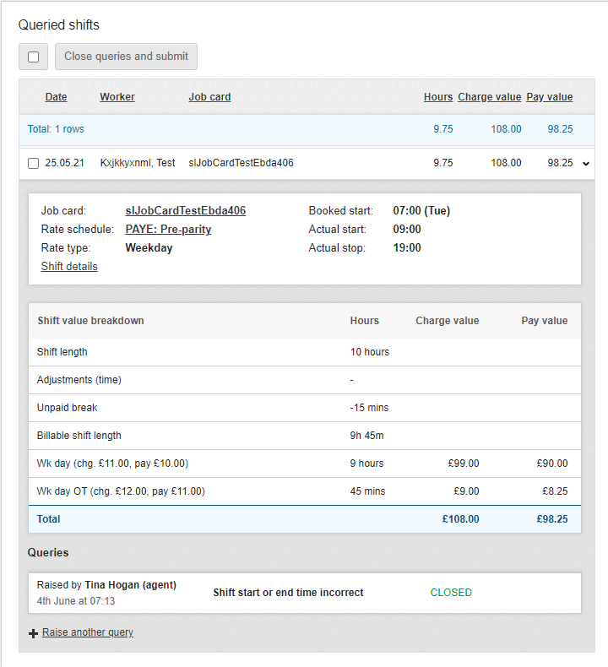
Where To View The Changes?
Once you have completed the changes you can view the closed query on the timesheet.
You have now completed how to amend, view and close a query!

Slide 19
WEEKLY GUARANTEES

Slide 20
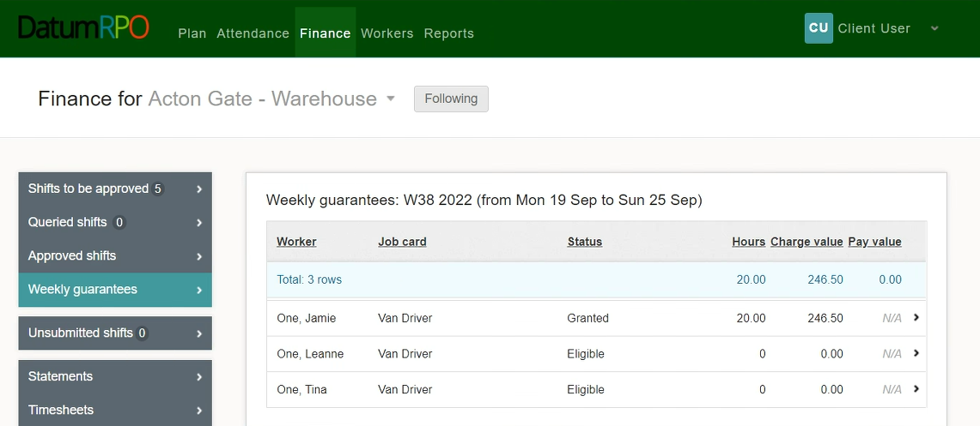
How Do I View & Action Weekly Guarantees?
To view and manage any weekly guarantees you may have, go to the ‘Finance’ tab and select ‘Weekly Guarantees’.
You will now see any workers how are eligible for weekly guarantees.

Slide 21
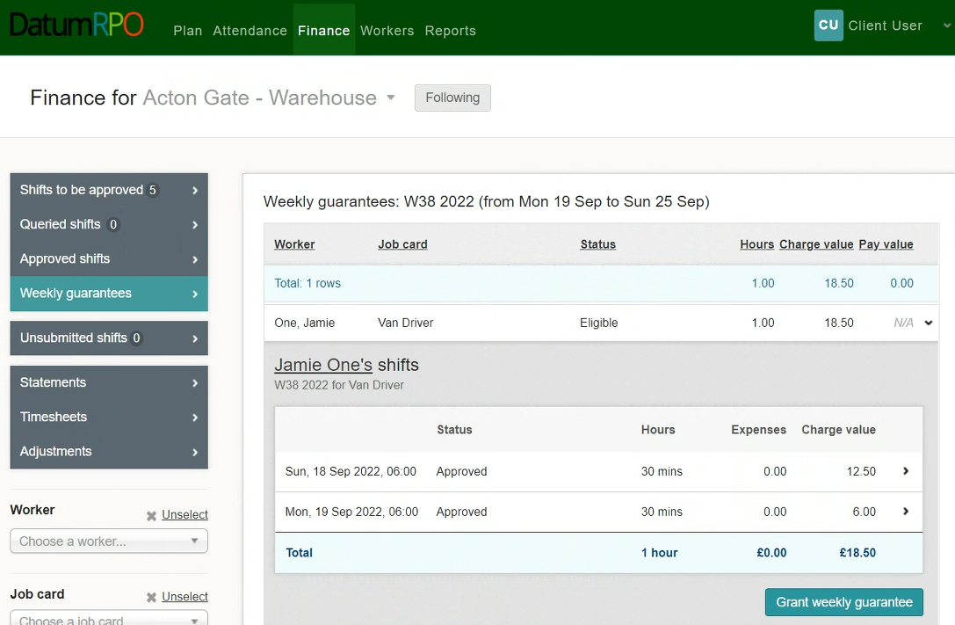
How Do I View & Action Weekly Guarantees?
To grant a workers weekly guarantees, click on the eligible workers banner to view the detail and then click
‘Grant Weekly Guarantees’.

Slide 22
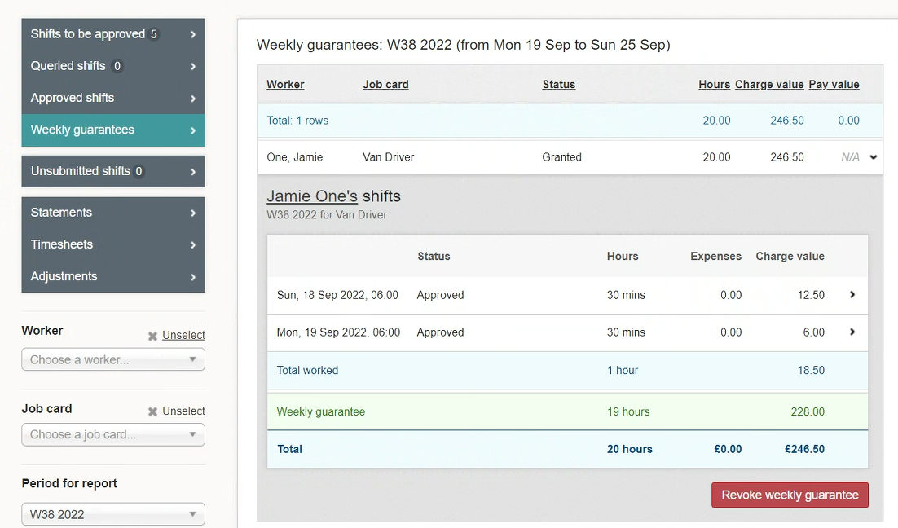
How Do I View & Action Weekly Guarantees?
Once the weekly guarantees have been granted, you will be able to view the details of the weekly guarantee and see the hours and charge value.

Slide 23
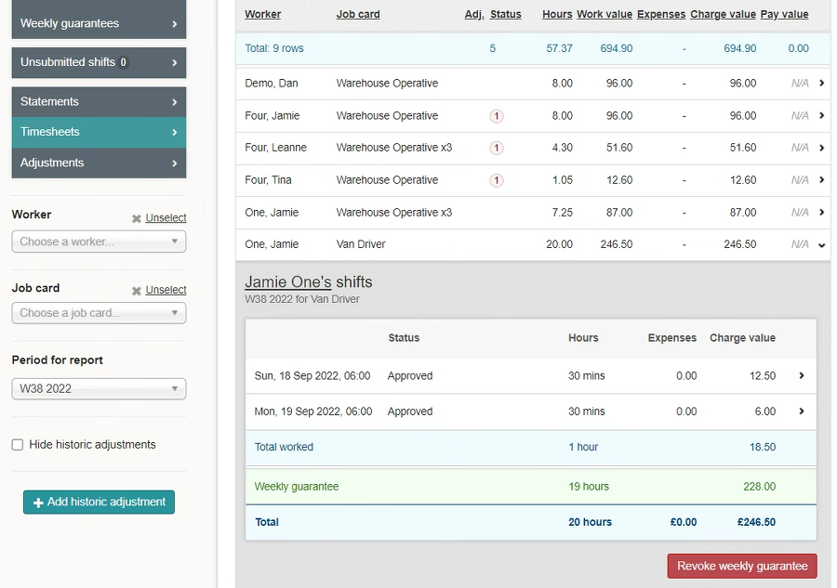
How Do I View & Action Weekly Guarantees?
If a weekly guarantee has been granted in error, you will be able to remove it by clicking ‘Revoke Weekly Guarantee. This will remove the weekly guarantee & restore the timesheet to its original state.

Slide 24
STATEMENTS

Slide 25
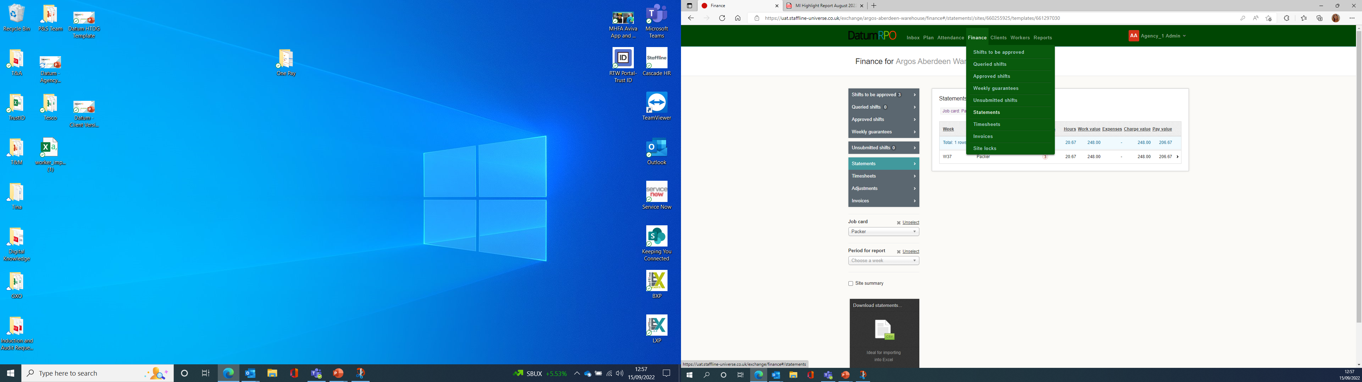
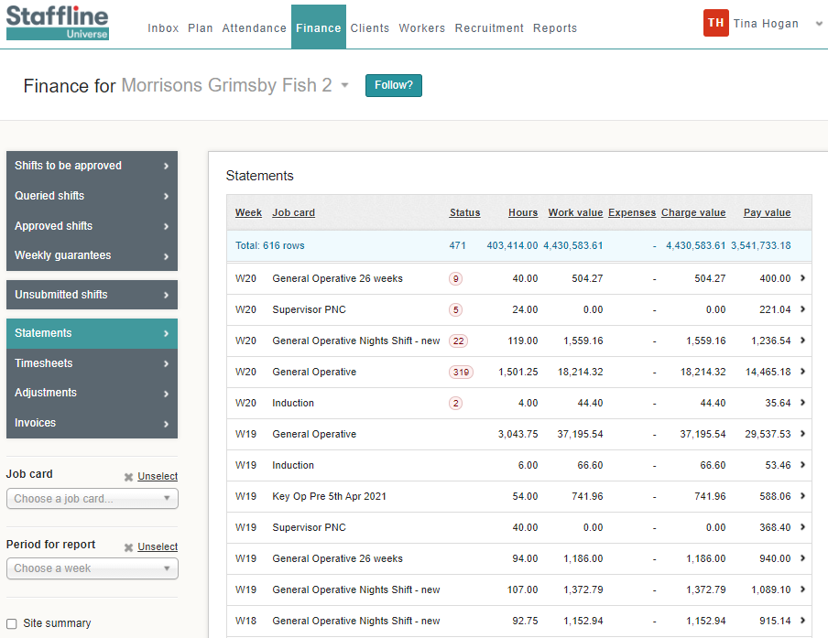
How To Find Statements?
Go to Finance > Statements
This gives you past or present timesheets where you can review hours and costings per job card.

Slide 26
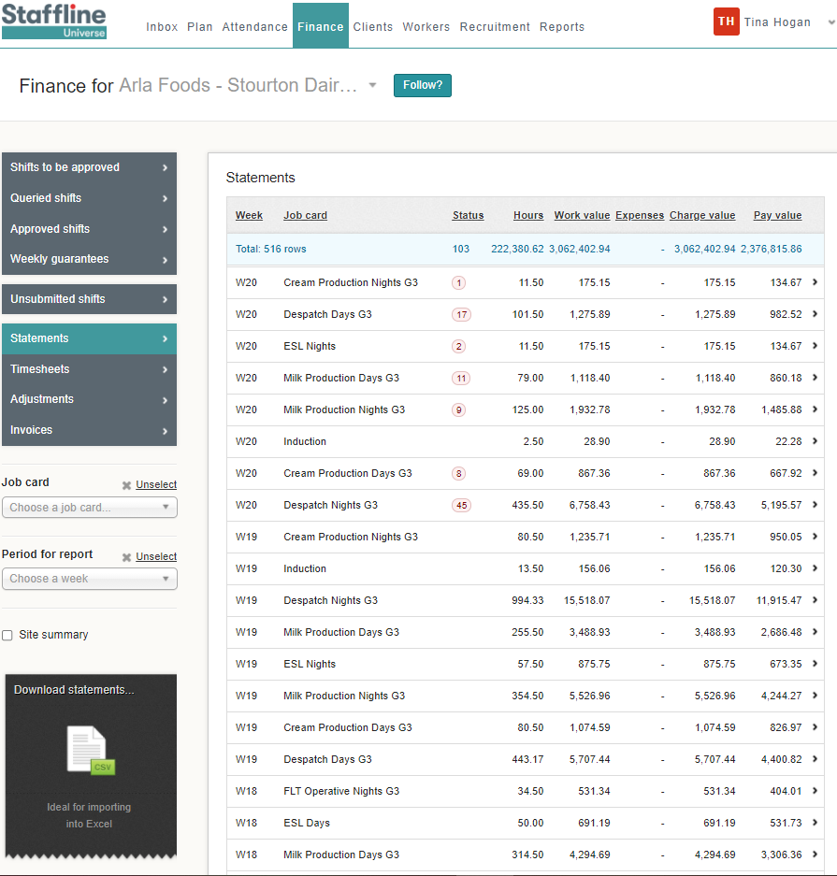
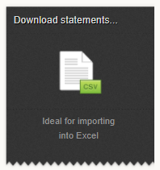
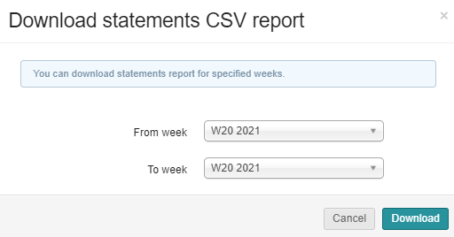
How To View Statements?
You can view a statement by downloading the CSV into excel spreadsheet.
Client on the week or weeks you require and click on download.

Slide 27
INVOICES

Slide 28
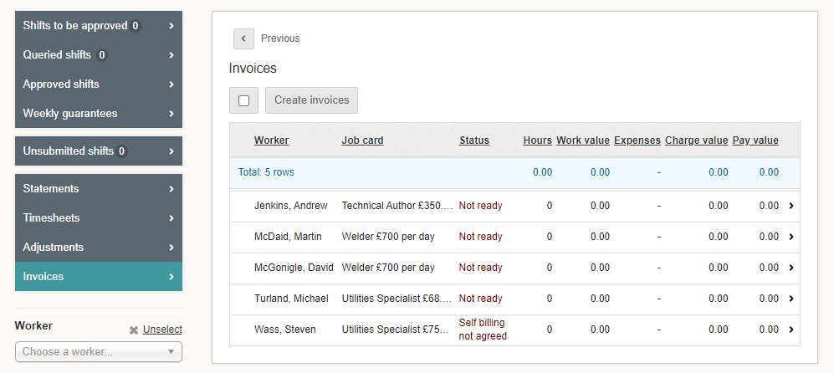
How Do I Create A Invoice?
On your finance page go to your Invoices and once you have processed the hours you need to click on invoices.

Slide 29
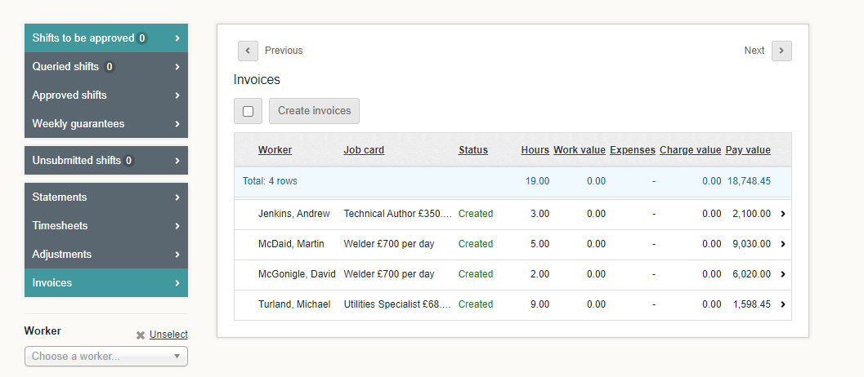
How Do I Create A Invoice?
Once you have created your invoice you will see created on the profile.

Slide 30
MANUAL ADJUSTMENTS -
BONUS

Slide 31
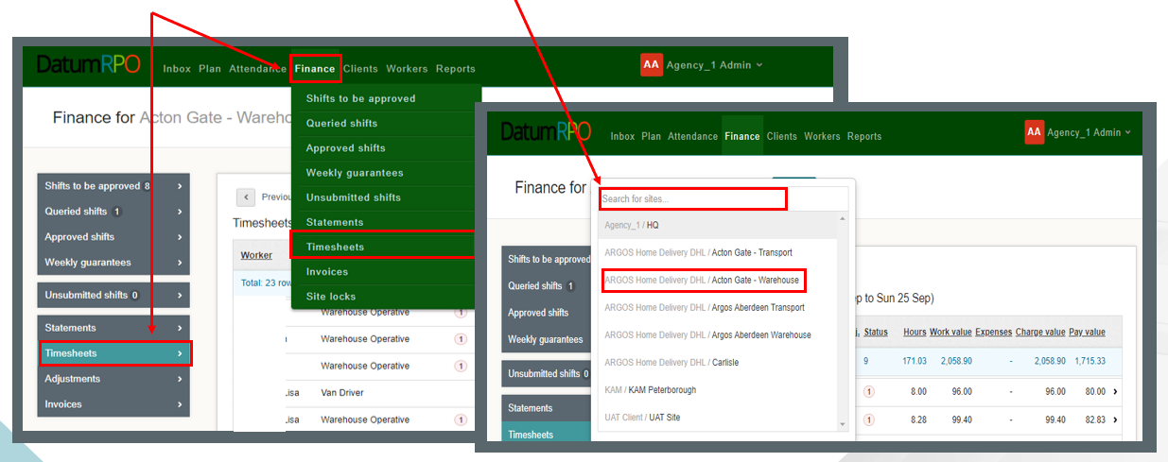
What Is A Manual Adjustment?
A manual adjustment can be entered at any time if there is a timesheet. A manual adjustment is where we need to deduct, refund or pay a shift bonus. The correct way to process this is through a manual adjustment and not an historic adjustment.
Click on Finance > Timesheets and search for your site.

Slide 32
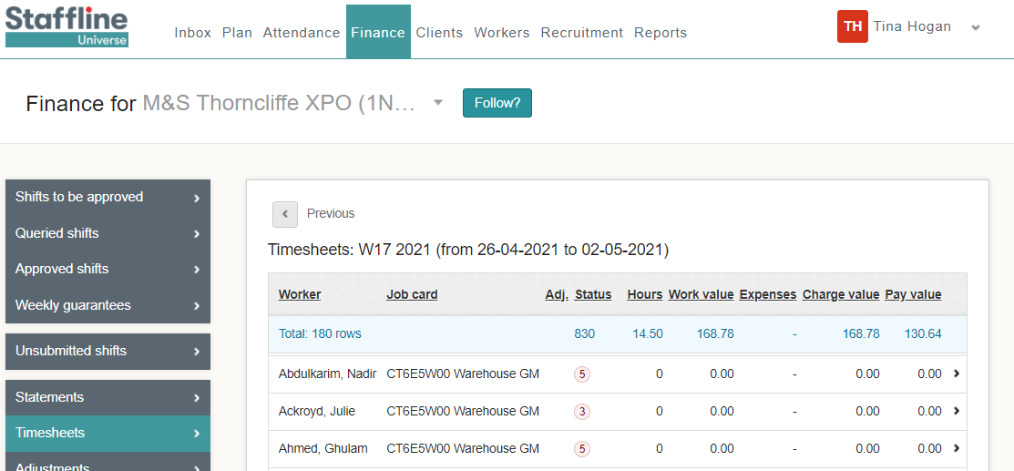
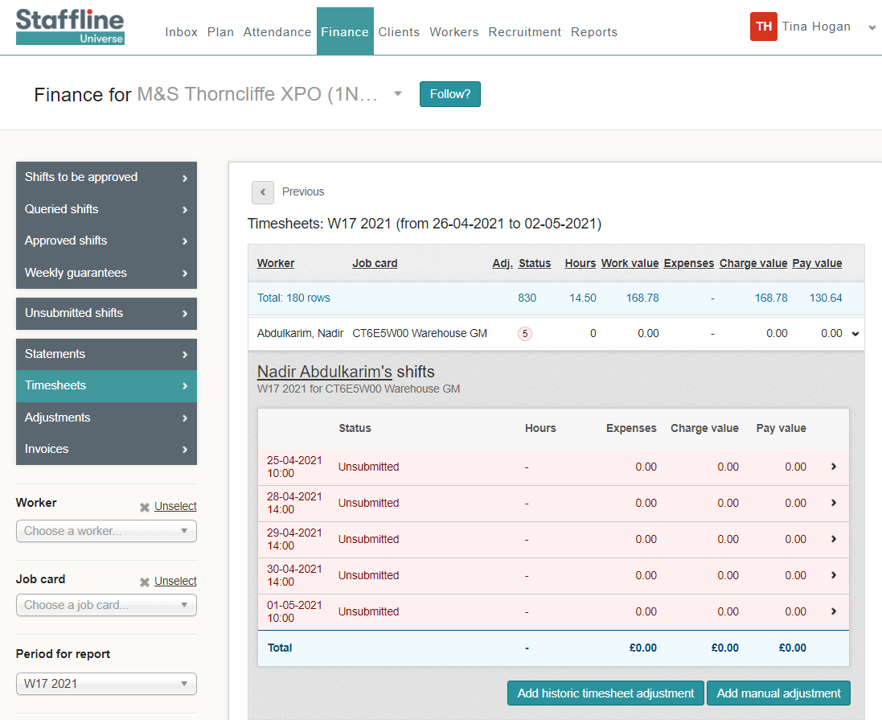
Where To Find Manual Adjustment To Add Shift Bonus?
To add a manual adjustment, click on the worker you require to make the adjustment to and open the timesheet.
cv
Next click on the workers timesheet

Slide 33
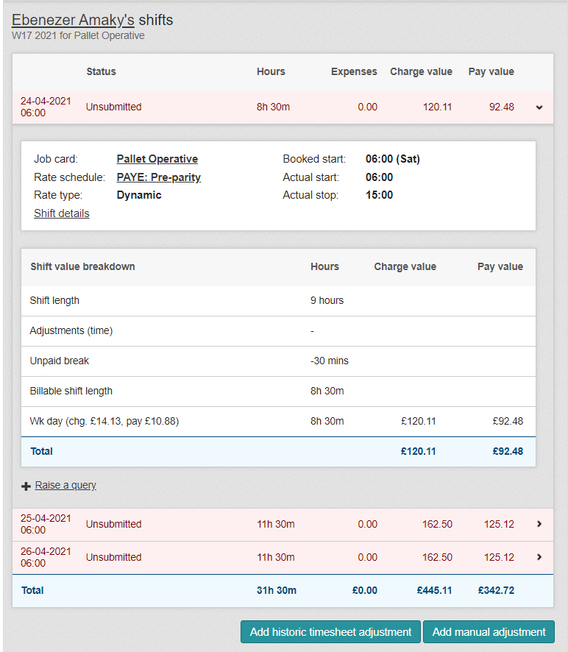
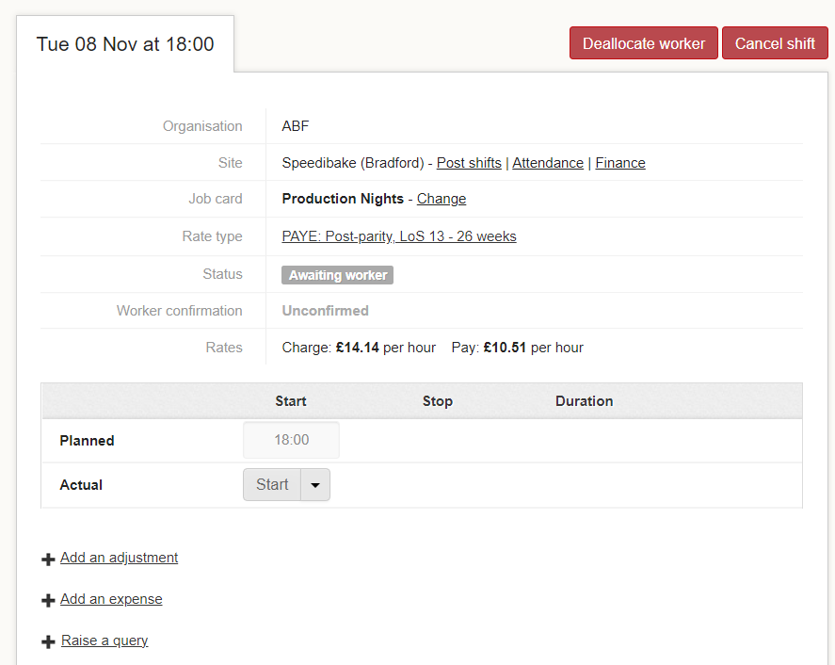
How Do I Add A Bonus?
Click on Shift details to open the workers detail to add your bonus.
Now you have opened the Shift detail page click on Add an Adjustment

Slide 34

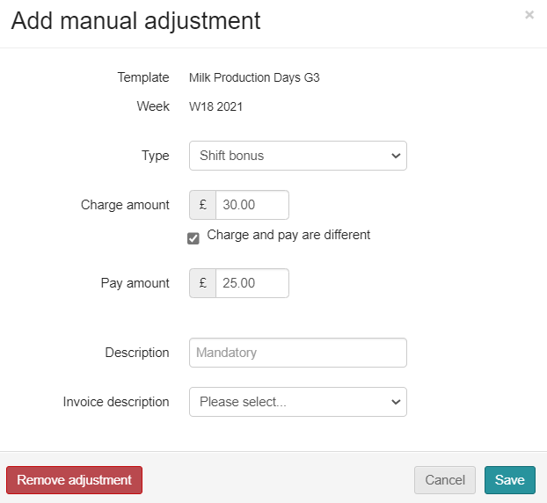
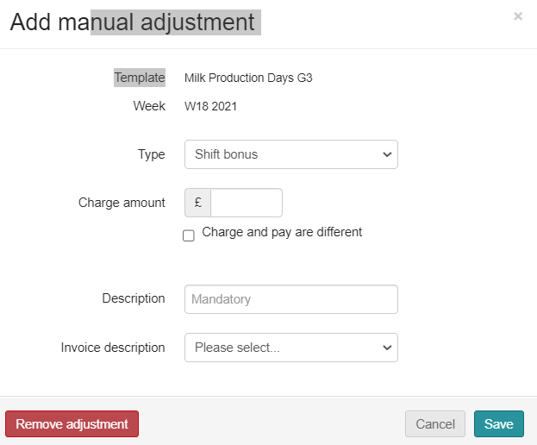

How To Add A Manual Shift Bonus Adjustment?
The manual adjustment can be entered at any time, if there is a timesheet.
Shift bonus payments are for any extra pay that is a bonus, and the worker doesn’t accrue holiday pay. This means it doesn’t go through the shift allocation but is done as a manual adjustment or a download adjustment.
Go to type and click in the box.
You will then see your drop down and click on shift bonus.
Next click on the charge amount then add the payment amount click on the
box and add amount.

Slide 35
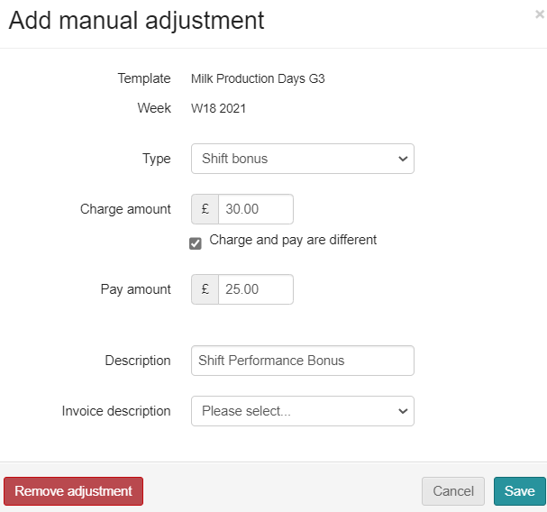
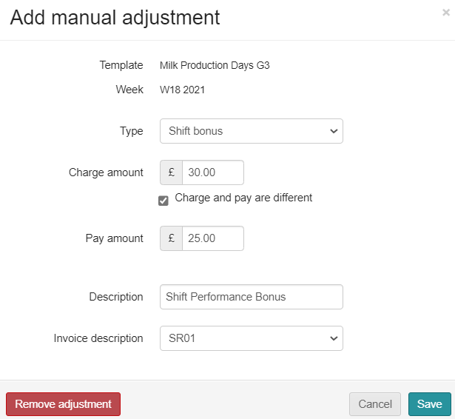
How To Add A Manual Shift Bonus Adjustment?
Next you need to add your description and invoice description.
Go to Description, click in the box and type in what it is for.
Last thing is to click on invoice description and select SR01 from the drop down.
If shift bonus is for supervisor check in don’t add charge amount, add in description 'Supervisor Check In'.

Slide 36
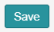
How To Complete A Manual Shift Bonus Adjustment?
Finally do your check list before saving.
Correct Type ✓
Correct Charge amount ✓
Correct Pay amount ✓
Correct Description ✓
Correct Invoice description ✓
Then click on

Slide 37
HISTORIC ADJUSTED
RATES

Slide 38
What Is A Historic Adjustment?
A historic adjustment is where we have missed payment for a worker. It might be basic hours, overtime or backpay. This is the correct way to process missing payments and not through manual adjustments.
Click on Finance > Timesheets and then search for your site.

Slide 39

How To Add An Historic Adjustment?
To add an historic adjustment, click on the worker you require to make the adjustment to and open the timesheet.
cv
Next click on

Slide 40
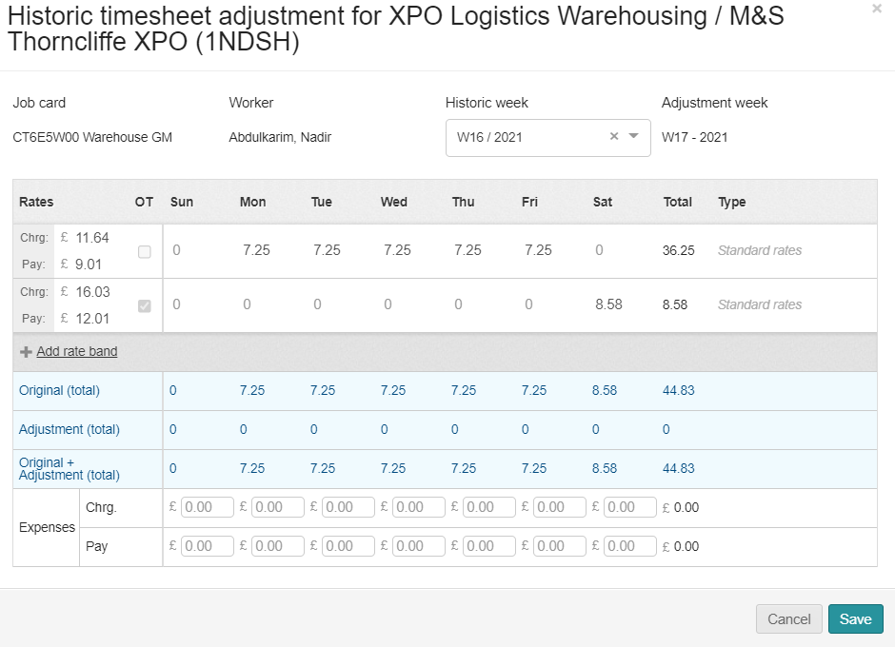
How To Add An Adjustment To The Relevant Week?
When adding an adjustment for a historic week you must ensure you are on the week you need to pay and the week the payment was missing from.
Adjustment week is the current week that you are payrolling.
Historic week is the week you need to pay the worker.
Click on the relevant week for the Historic Adjustment.

Slide 41
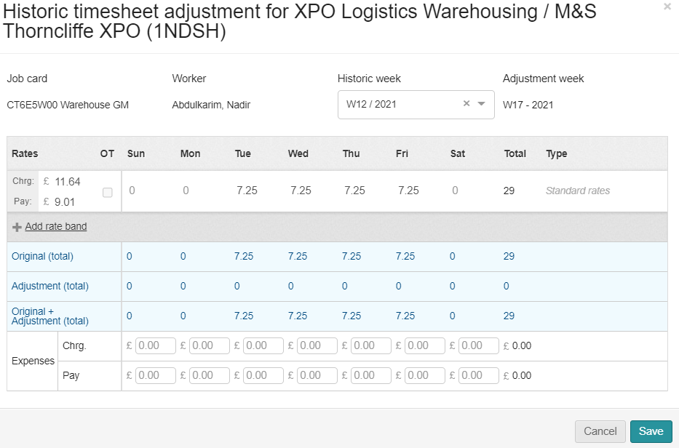
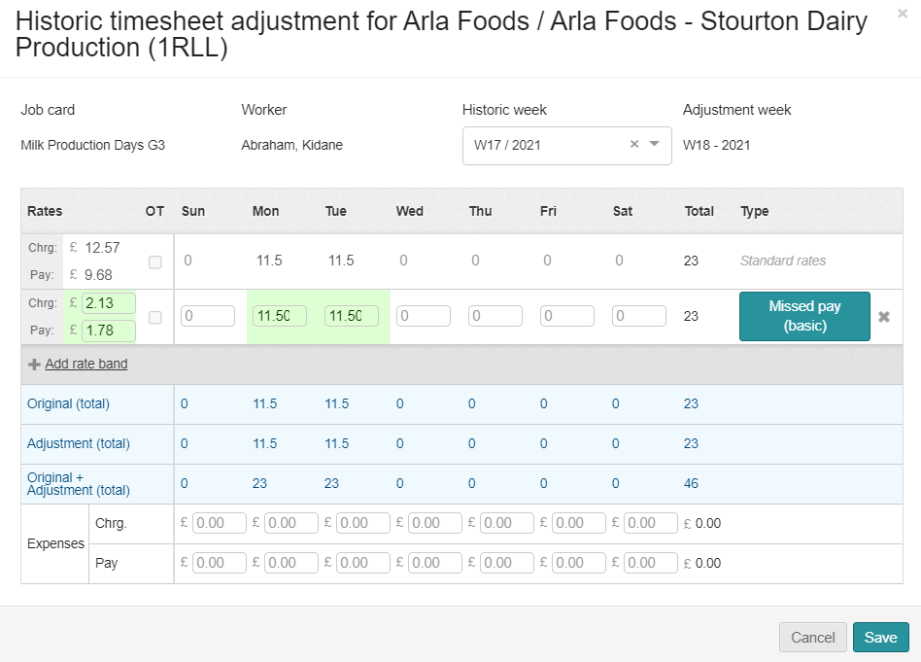
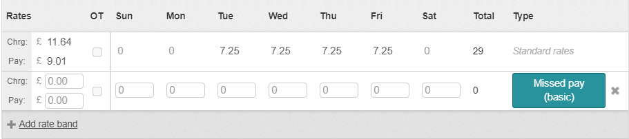
How To Add In The Charge And Pay Rate Difference?
Next, we need to add the rate band which will bring up charge rate and the pay rate for processing the hours.
You must ensure a charge rate is processed and not just a pay only.
Now add the difference of the charge rate and the pay rate. You can work this out by the difference between the New Pay Rate and Old Pay Rate. Then do the same with the charge rate.

Slide 42
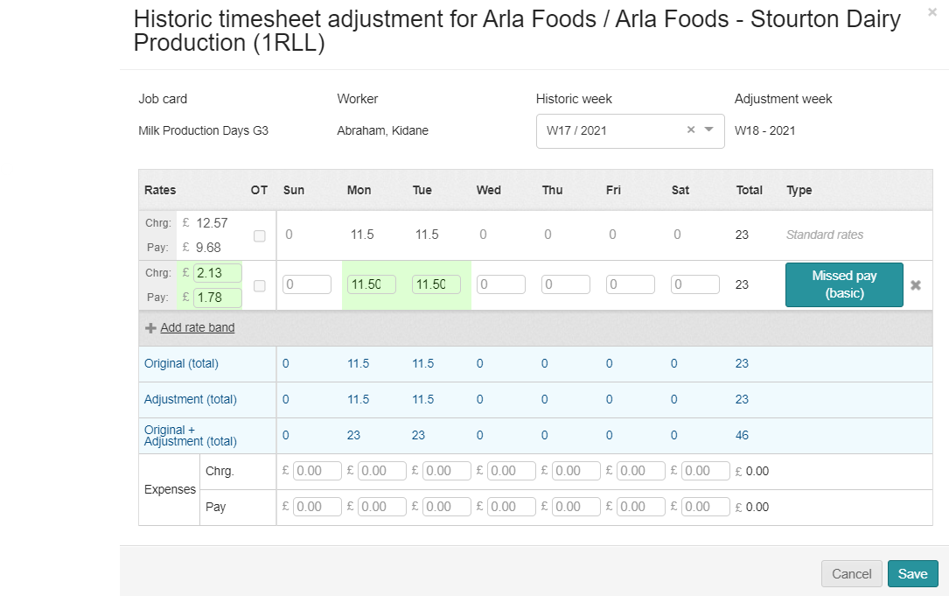
How To Add In The Hours?
Now we have added the charge and pay rate difference, we now need to add the hours in the correct day of which the hours need to be the same as the hours for the week you are adjusting.

Slide 43
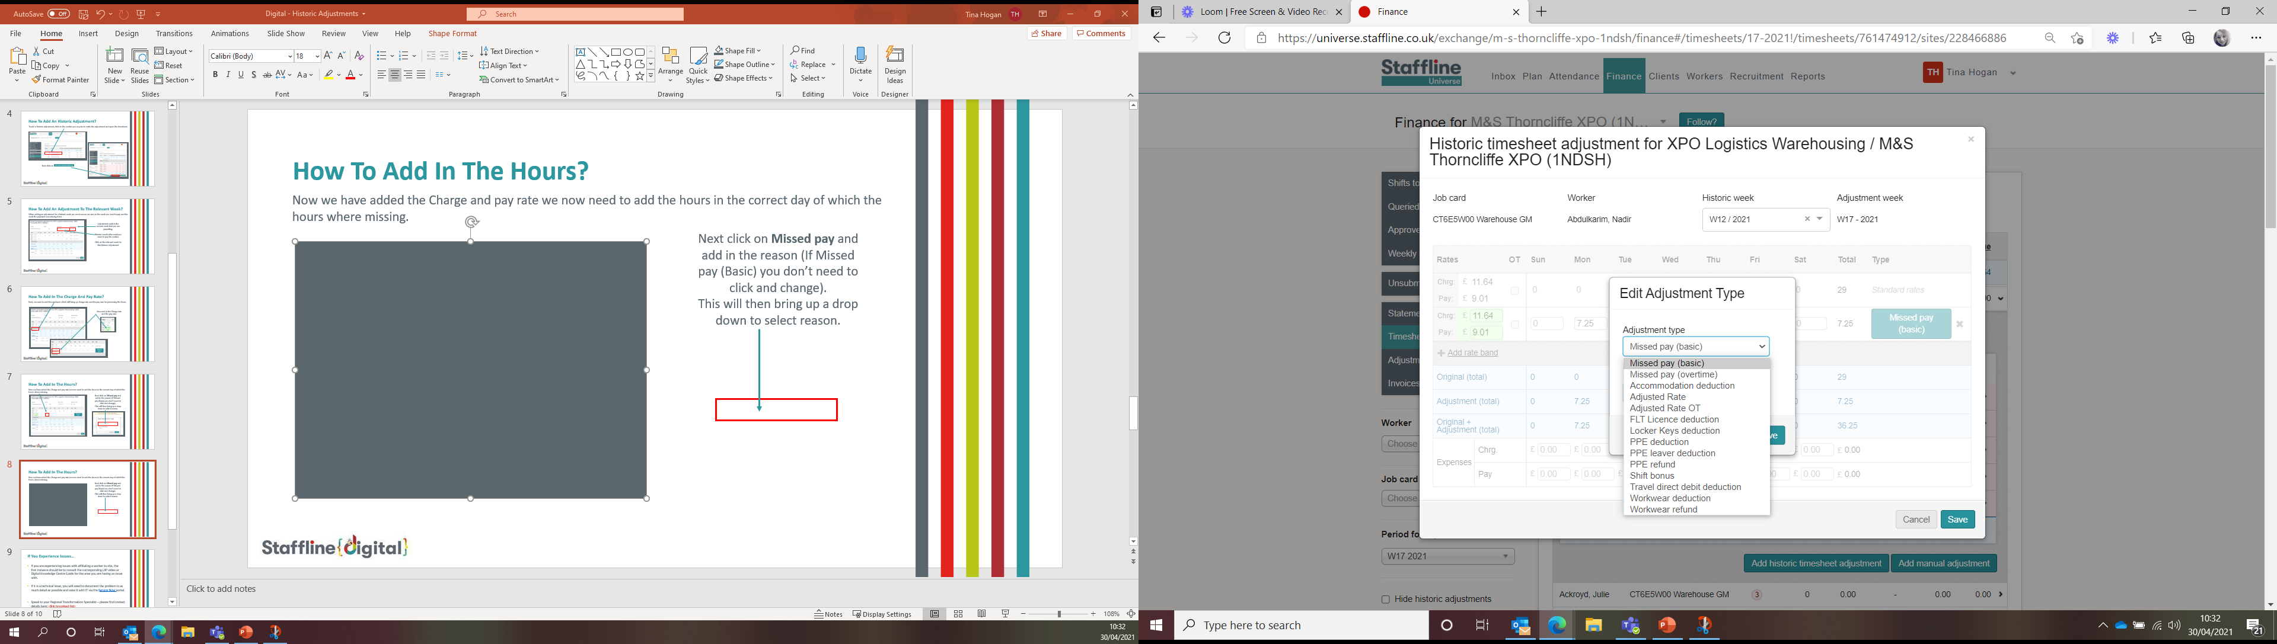
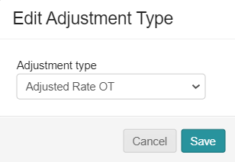

How To Add In Standard Rate Information?
Once with have opened the edit adjustment section, you need to select either Missed pay (basic), Missed pay (overtime),
Adjustment rate or Adjustment Rate Overtime ONLY.
Next click on Adjusted Rate or if overtime adjustment click Adjusted Rate OT.
This will be on your drop down.
Next click on the reason and

Slide 44
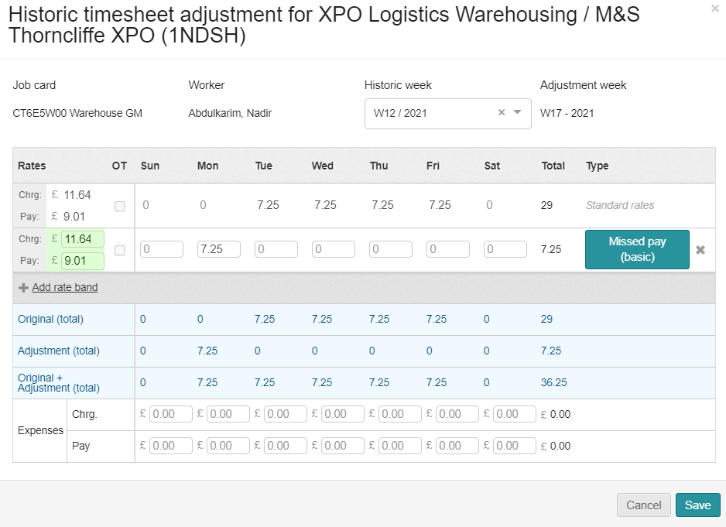
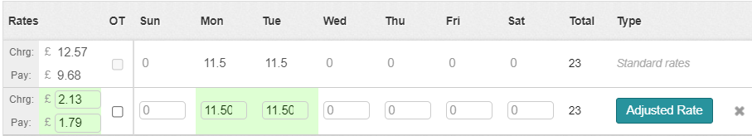

How To Check Before Saving?
We have now added all the information to save the adjustment. Next, we need to check to ensure the information is correct.
Correct Adjustment week of payment ✓
Correct Historic week of payment ✓
Correct Charge & Pay Rate Difference ✓
Correct Hours✓
Correct reason✓
Then click on
If you have inputted anything incorrect you will see the below message appear.

Slide 45




How To View The Adjustment In Timesheets?
The Adjustment has now been processed and there are two ways of finding the adjustment.
The first one is allocated on the timesheet
When you open the timesheet, you will see the adjustment.

Slide 46



How To View The Adjustment In Adjustments?
The second way is to go to timesheets and on the left side you will see adjustments.
When you open the timesheet, you will see the adjustment. If required, you can adjust from here by clicking

Slide 47
HISTORIC ADJUSTED
MISSING HOURS

Slide 48


What Is An Historic Adjustment?
An historic adjustment is where we have missed payment for a worker. It might be basic hours, overtime or backpay. This is the correct way to process missing payments and not through manual adjustment.
Click on Finance > Timesheets and then search for your site.

Slide 49
How To Add An Historic Adjustment?
To add an historic adjustment, click on the worker you require to make the adjustment to and open the timesheet.
cv
Next click on

Slide 50
How To Add An Adjustment To The Relevant Week?
When adding an adjustment for a historic week you must ensure you are on the week you need to pay and the week the payment was missing from.
Adjustment week is the current week that you are payrolling.
Historic week is the week you need to pay the worker.
Click on the relevant week for the Historic Adjustment.

Slide 51

How To Add In The Charge And Pay Rate?
Next, we need to add the rate band which will bring up charge rate and the pay rate for processing the hours.
You must ensure a charge rate is processed and not just a pay only.
Now add in the charge rate and the pay rate.

Slide 52

How To Add In The Hours?
Now we have added the charge and pay rate we now need to add the hours in the correct day of which the hours were missing.
Next, click on Missed pay and add in the reason (if missed pay (basic) you don’t need to click and change).
This will then bring up a drop down to select reason.

Slide 53

How To Add In Standard Rate Information?
Once you have opened the Edit Adjustment you need to select either Missed pay (basic), Missed pay (overtime),
Adjustment Rate or Adjustment Rate Overtime ONLY.
Next click on the reason and

Slide 54
How To Check Before Saving?
We have now added all the information to save the adjustment. Next, we need to check to ensure the information is correct.
Correct Adjustment week of payment ✓
Correct Historic week of payment ✓
Correct Charge & Pay Rate ✓
Correct Hours✓
Correct reason✓
Then click on
If you have inputted anything incorrect you will see the below message appear.

Slide 55
How To View The Adjustment In Timesheets?
The Adjustment has now been processed and there are two ways of finding the adjustment.
The first one is allocated on the timesheet
When you open the timesheet, you will see the adjustment.

Slide 56
How To View The Adjustment In Adjustments?
The second way is to go to timesheets and on the left side you will see adjustments.
When you open the timesheet, you will see the adjustment. If required, you can adjust here by clicking

Slide 57
SITE LOCKS

Slide 58
When Is The Deadline For Locking Sites?
DEADLINE FOR LOCKING SITES IS:
MONDAY
2PM
If you don’t lock or advise of an issue the site will be locked for you which will result in receive a complete and correct invoice

Slide 59


What Do I Need To Check Before I Lock Site?
Site Locks is the final process before you complete payroll. Once you lock the site you are not able to do anything if you find something wrong. It is important that you do your checks before finalising.
Go to Finance and back to your timesheet page.
You need to check your hours and charge rates match.

Slide 60



Where To Find Period (Week), Division And Client?
Next you will need to add your Period. This is the week of payroll you are processing, division which your client sits under and then find your client.

Slide 61

Where To Generate Your Lock Report?
Click on get report and this will then generate a CSV report.
The report will show you
Worker, Workers ID, Job Card, Hours, Pay Rate, Charge Rate, Total Pay and Total Charge.
This will enable you to do a final check before locking your payroll.

Slide 62


How To Lock Your Site?
You are now ready to lock your site. The final stage is to add in PO if required. There are also options to add to job card or worker.
You can now lock your site.
The site will go from lock to unlock.
It is forbidden to unlock a site and will not allow you to do so.

Slide 63
WORKER OVERVIEW

Slide 64
MANAGE WORKER

Slide 65


How To Fill Out The Workers Details?
Enter the worker's type. You need to select worker here.
Select the role from the dropdown.

Slide 66

How To Fill Out The Workers Details?
Enter the candidate’s name here. ‘First name’ and ‘Last name’ must be completed, but ‘Middle name’ is optional.
Enter gender here.

Slide 67

How To Fill Out The Workers Details?
Enter their mobile number.
If Non-UK mobile number, please tick the box.
If you required to add any notes add in the First Note section
Finally press on the right hand
corner to create new worker.

Slide 68


How Do I Fill Out The Workers Details?
Next, we need to complete the about you section, add date of birth and nationality.
Under notes on the top right, you will notice a message stating
'Onboarding email sent'.

Slide 69

How To Reduce Incomplete Profile?
Once a section is completed, the profile percentage will start to decrease until it reaches 100%. Underneath the profile percentage, it will also show issues that are outstanding with the profile.
The following sections will need to be completed so that the registration percentage reaches 100%, this way the worker can then be made compliant.

Slide 70

How To Complete Contact Details?
Contact details need to be verified, this will be through email and text message. If the worker doesn’t confirm email address, you can skip for 30 days while you get the worker to confirm.

Slide 71

How To Complete Your Address?
To complete the address, you can manually add in all the information or add in the post code which will give you a drop down to find the number of the house/road.
Once the address has been found press enter and this will fill out all the slots.
The worker can also be added to – Do you want to work in another location,
click 'Yes' or 'No'.

Slide 72



How To Complete Licence?
Go to Licence, Tacho and CPC on the left-hand side of the worker's profile.
Please fill in the following information:
Add in the country of issue. Follow the UK guidelines for licenses. If other use the dropdown to select the country.
Entre the full name on the Licence.
Enter the Licence number on the driving Licence card
Enter the issue number.
Date of Issue.
Date of Expiry.

Slide 73


How To Complete Licence Categories?
To add a category, click on to the category that appears on the licence.
Then enter the valid date from and to.
Click on save changes.

Slide 74


How To Complete Licence Endorsements?
If a worker has any endorsements on their licence, you need to make sure you add them to Universe. To find your endorsement click on the drop-down arrow to review the dropdown list.
Once you have entered the reason you will need to fill out the dates of offence.

Slide 75

How To Complete Licence Endorsements?
Add the date of the offence
The points issued
If required add any additional endorsements.
Once completed press save change.

Slide 76


How To Complete Your Tacho?
Now we need to complete the Tacho part, if required click 'Yes'.
Next, we need to add in the Tacho number and expiry date.
Once completed press save changes.

Slide 77


How To Complete Your CPC/DQC?
Now we need to complete the CPC/DQC part if required click on 'Yes'.
Add in the DQC number and expiry date.
Once completed press save changes.

Slide 78



How To Complete Validations For Licence And Tacho?
To validate the workers Licence And Tacho, you will need to click onto each one and validate.
Click on update.
Pass the worker.
If you click fail the worker will not be able to be placed out into work. This would be a decline in the interview process.
Add any comments.
Click on
'Create
Validation record'.
Repeat the process on the
Tacho Card.
You will now see both sections have been updated and status is Pass.

Slide 79


How To Upload Driving Licenses And Checks?
The next section to complete is the scanned document section.
Click on the section you would like to upload DVLA checks.
You can either drag and drop the file or upload from your desktop.
Click on the section and take the expiry date from the passport/ID card.
Once you have pressed upload this file, you will see a padlock next to the selected box. This means the worker cannot delete the file.

Slide 80


How To Complete Skills And Experience?
To complete Skill’s first select a primary skill.
If you don’t have a primary skill, click on the roles that they have experience on in their previous work history. You can also select other skills and sub-skills.
Once added press save changes.

Slide 81



How To Complete Skills And Experience?
To complete professional qualifications, select whether you have an FLT license or not.
If yes is selected, an additional box will appear with FLT qualification provider and FLT qualification date.
Insert the license from the drop down and input the most recent qualification date or refresher date.
Once added press save changes.

Slide 82


How To Complete Validations For Skills?
To validate the skills section of a worker's profile, you will need to click on each one to validate.
Add any comments
Click on
'Create
Validation record'.
Pass the worker.
If you click fail the worker will not be able to be placed out into work. This would be a decline in the interview process.
Repeat the process on the work positions.
You will now see both sections have been updated and the status is Pass.

Slide 83


How To Validate The Workers Personal Information And Employment Status?
This is the same process as validating the skills section, but you will have to do your check list before you click pass.
Click on update for
personal information and
employment status.
When confirming the validation of the worker you are confirming the following.
One happy, you can pass the worker, add a comment and then select 'Create validation record'.

Slide 84




How To Make The Worker Compliant?
The last requirement to enable you to place the worker onto an Induction is to confirm if the right to work check outcome adheres to company policy.
Once you have click on 'Yes' you will see at the top of the page the worker will turn compliant.
If you click on 'No' you will see at the top of the page the worker will have failed compliant.

Slide 85
LINKING A WORKER TO A JOB CARD

Slide 86


How To Search For A Worker?
Open Universe go to workers and then search for your worker in the search bar.
Once you have searched for your worker click on their name to open.

Slide 87

How To Add And Link Job Card?
Click on add another job card.

Slide 88




How To Link A Worker To Job Card In sections?
Click on organisation and add your site. Next click on Site.
Next allocate the job card.
Finally click link to add the job card.

Slide 89

How To View The Linked Job Card?
You can now see your job card is linked to the worker. Click on add another job card to repeat the process if required.
You can also repeat this process on the workers profile!

Slide 90
UNLINKING A WORKER

Slide 91
How To Search For A Worker To Unlink?
Open Universe go to workers and then search for your worker in the search bar.
Once you have searched for your worker click on their name to open.

Slide 92


How To Link A Worker To A Job Card?
You can either go into the workers profile or click on the linked job cards.
On the left of the workers profile, select 'Linked job cards’.
Otherwise you can remove from this page.

Slide 93




How To Unlink A Worker From Job Card?
Click on the arrow.
It will then drop down to show you
Click on the 'Unlink job card'.

Slide 94


How To Complete The Unlinking Of The Worker?
Click on the unlink and it will remove the linked job card.
This should be completed every time you stop using a worker or you make them a leaver.

Slide 95
WORKING TIME

Slide 96

How Do I View Working Time?
Go to Workers>Working Time

Slide 97

How Do I Navigate Around Working Time?
You can type in the workers name and search
You can view from 2 to 16 days
Workers Names

Slide 98
How Do I Navigate Around Working Time?
Find Your Client
Total hours for the days you have showing
Days/Dates
Hours for the day

Slide 99
AGENCY WORKER REGULATION

Slide 100

Where To Go To Find Agency Worker Regulations?
Go to Workers > Agency worker regulations.

Slide 101

How To View Your Sites AWR?
At the top of the page, you will see a colour chart, which gives you the reason for the colour. You can also download a CSV report from here.

Slide 102
How To View Your Sites AWR?
As we go from left to right you have 2 tick boxes where you can hide inactive or hide qualified. You can add the week you want to view, organisation and site.

Slide 103
How To View Your Sites AWR?
Next you can search for a worker, and you can also view the weeks of employment. The tab at the side will move you back or forward a week.

Slide 104
How To View Your Sites AWR?
Here you can use the arrow up (A-Z) or down (Z-A). 'ES' will show your employed status workers and 'Cur' is current qualified workers.

Slide 105

How To View Your Sites AWR?
Below you can see we have blue and pink lines. The blue lines mean they were in their qualifying period and once qualified they move to pink.
The salmon pink shows when their clock would reset if they didn’t work.

Slide 106
REPORTS OVERVIEW

