Slide 1

AGENCY
“HOW TO DO GUIDE”

Slide 2


ATTENDANCE
OVERVIEW

Slide 3
CANCEL A SHIFT THROUGH BATCH EDIT

Slide 4
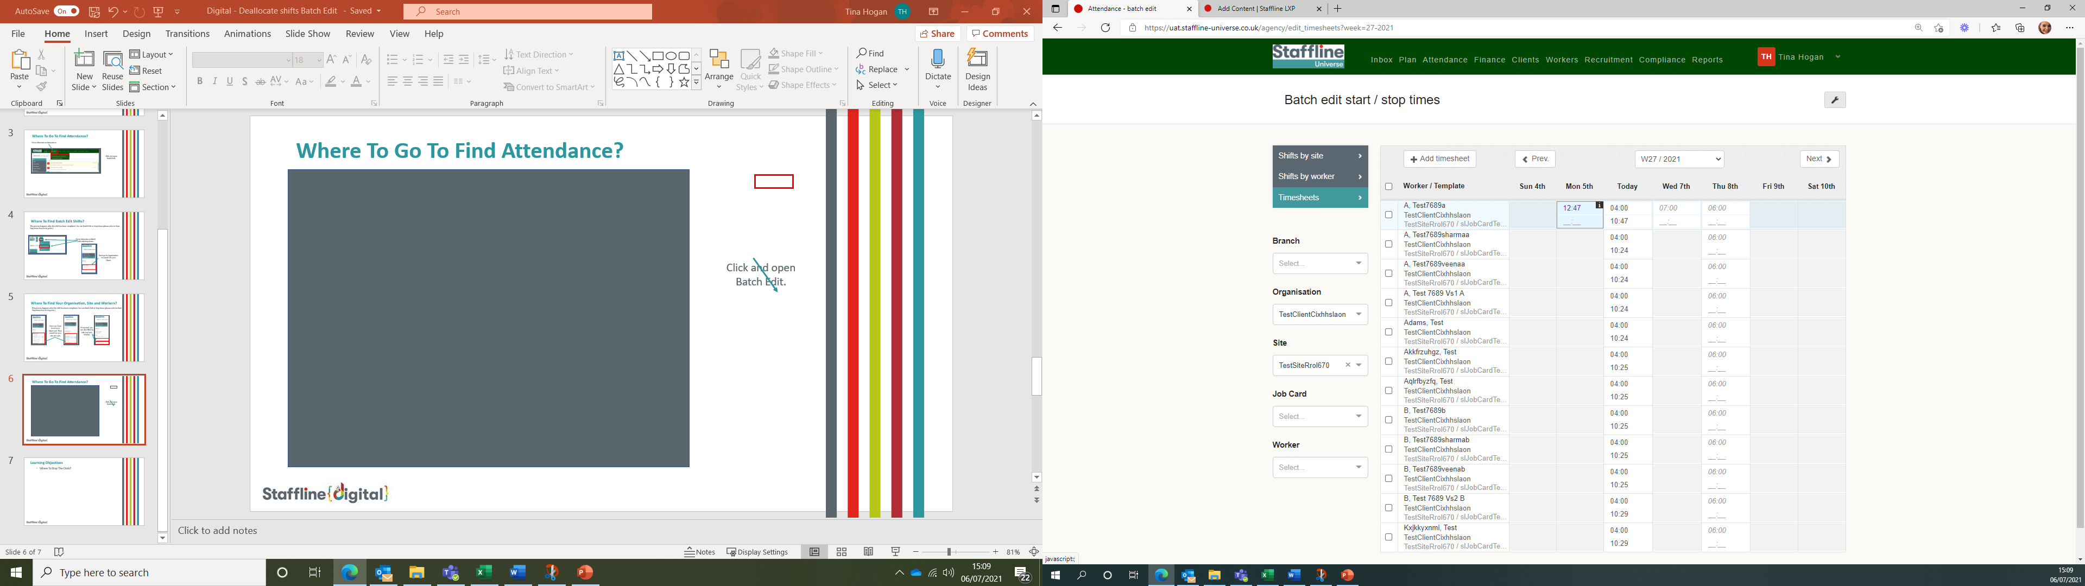

How To Open The Shift?
Click on the to open the shift.

Slide 5
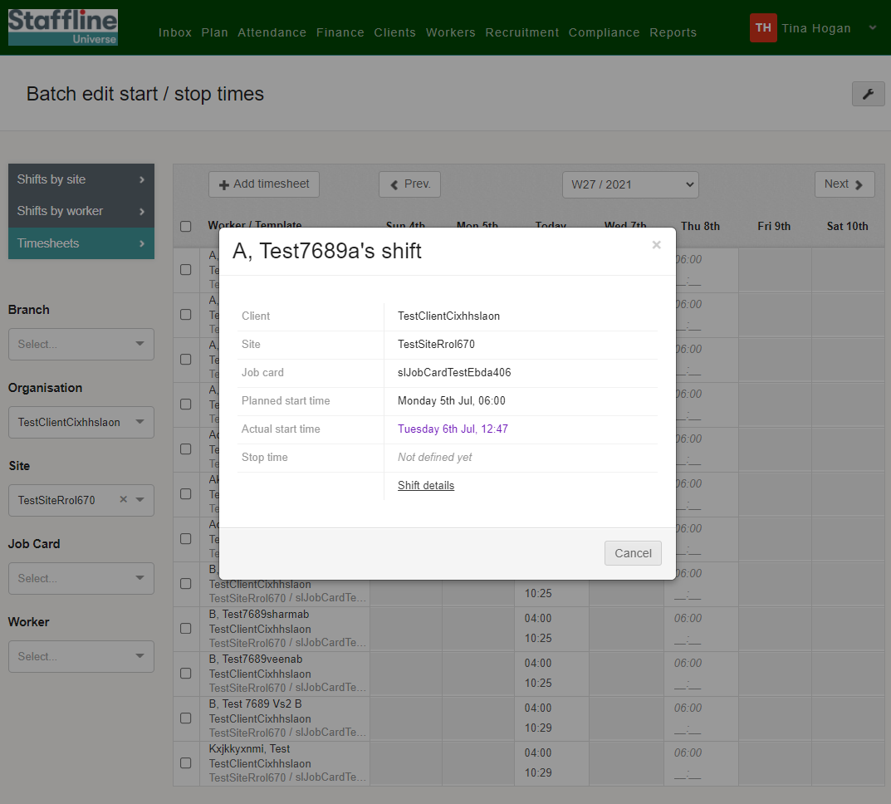
How To Open The Shift Details?
Click here to open the shift details.

Slide 6
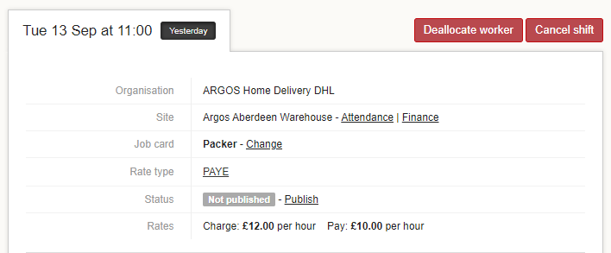

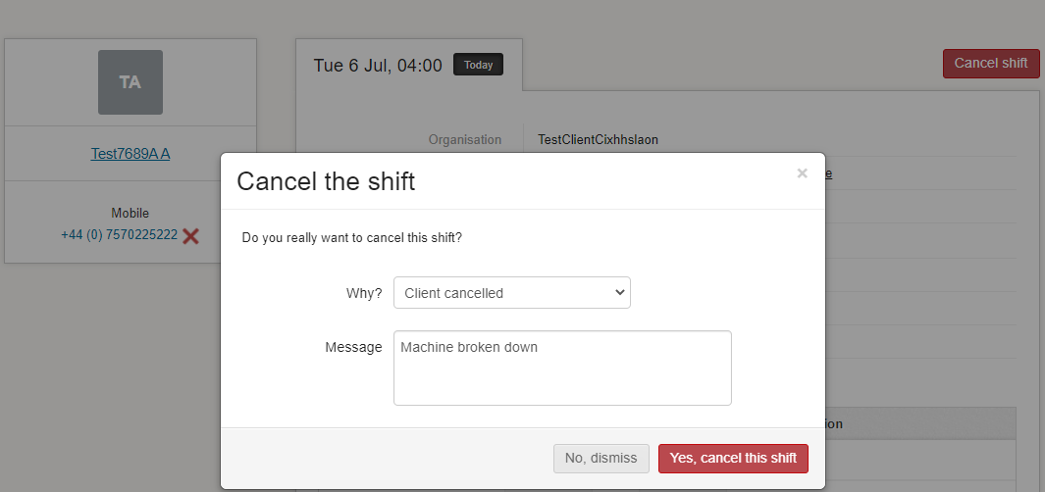
How To Cancel The Shift?
Click on cancel shift.
Add in the reason why?
Once complete click 'Yes cancel the shift'.

Slide 7
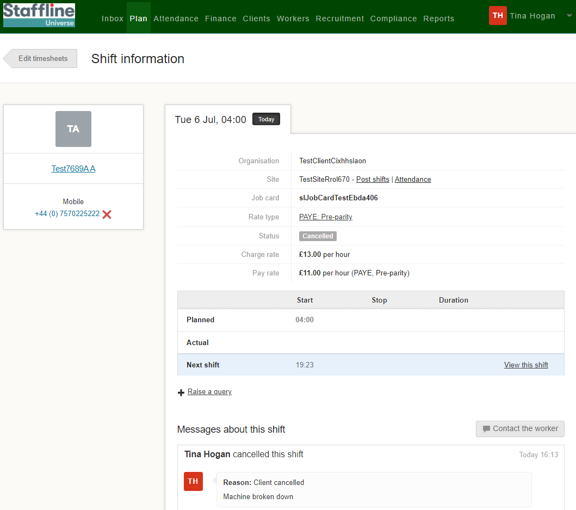
How To View The Cancelled Shift?
You will now see the cancelled shift has been removed and a comment added to the cancelled shift information.
Once complete click on Edit timesheets button to go back to the Batch Edit page.

Slide 8
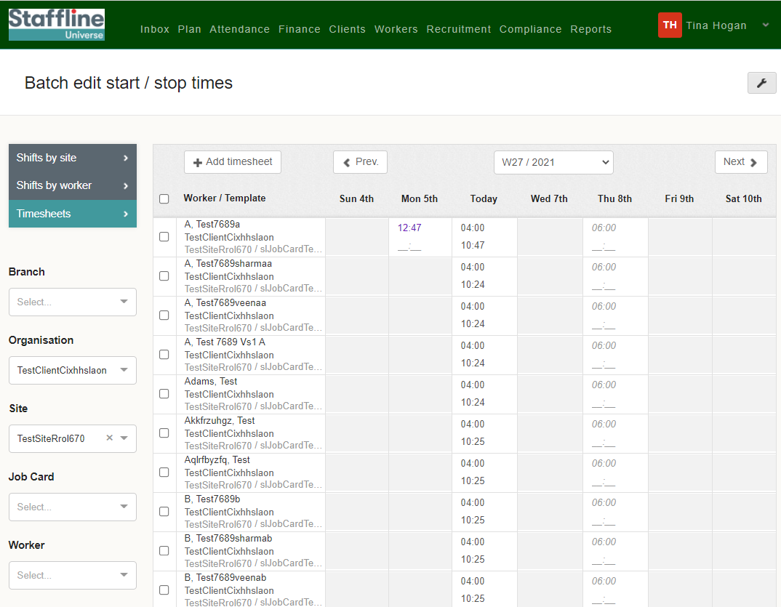
How To View Batch Edit Once Completed?
The shift has now been removed.
Repeat the process if you are deallocating a worker from the list. Only difference is reasons why.

