Slide 1

AGENCY
“HOW TO DO GUIDE”

Slide 2


SPREADSHEET
UPLOAD

Slide 3
HOW TO DOWNLOAD
YOUR WORKERS THROUGH A CSV UPLOAD

Slide 4
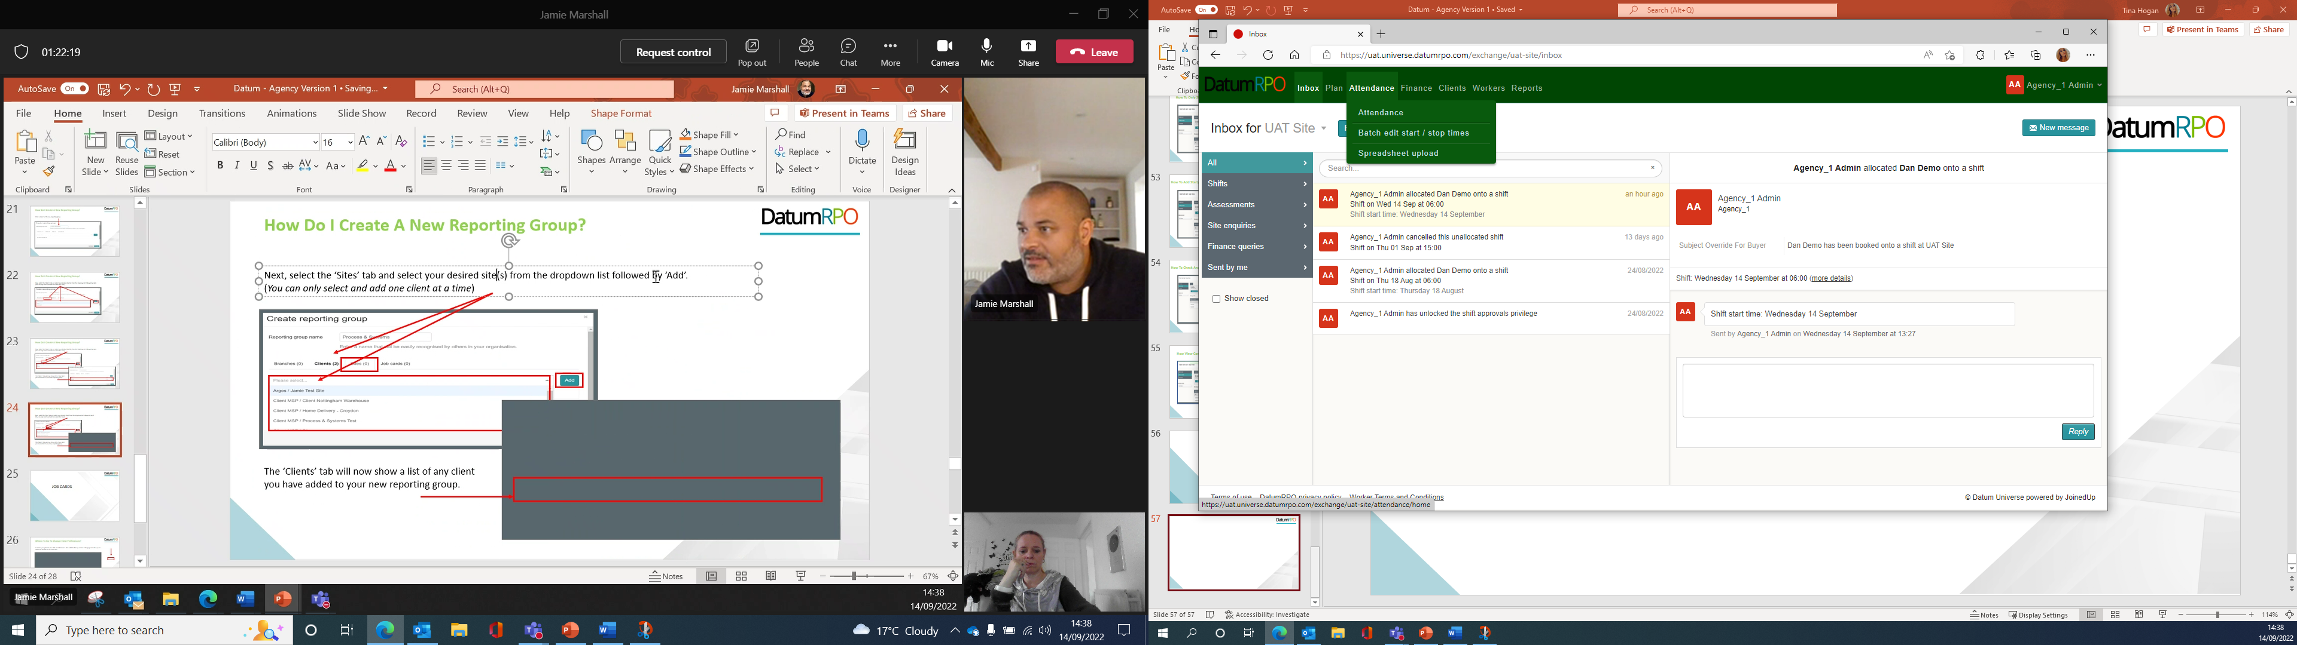
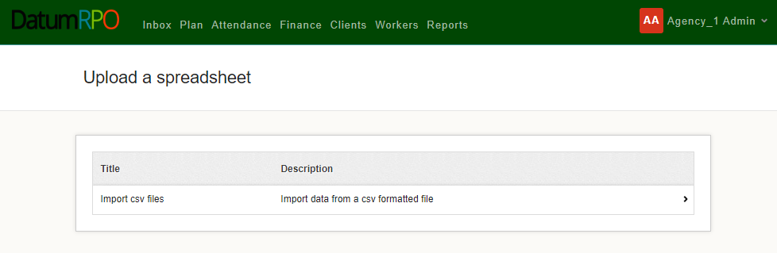
How Download Workers Into Universe?
Go To Attendance>Spreadsheet Upload
Next, click on Import CSV Files and the arrow

Slide 5
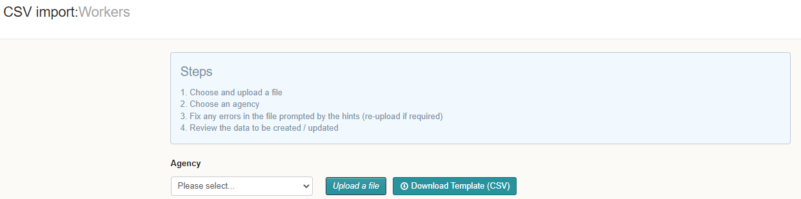
How Download Workers Into Universe?
Click on the download Template to upload all your workers information. Once you download the template file out the information as required

Slide 6
How I Fill Out The Template?
Below shows the mandatory fields that need to be completed. Please ensure you complete the highlighted section to ensure our system doesn’t contact your workers
First name | Surname | Email | NI number | Is driver role | Preferred site ID | Employment status | Skip email confirmation until | Enable email comms | Enable SMS comms
Upload | Test6 | upload@test6.com | NA233333A | N | 6.01E+08 | PAYE | 20/12/2022 | N | N
Upload | Test7 | upload@test7.com | SS663526C | N | 6.01E+08 | PAYE |  | Y | Y
Upload | Test8 | omeradm2016@gmail.com | NA233335A | N | 6.01E+08 | PAYE |  | Y | N
First Name
Last Name
Email Address
NI Number
Is driver role (Y or N)
Preferred Site ID (the ID of a site the worker will work at, which can be find in the client page)
Employment Type (PAYE, LTD_Company, Umbrella)
Enable email comms = N
Enable SMS comms = N

Slide 7
How I Fill Out The Template?
You can also populate the 'Skip email confirmation until' column which will mean they don't need to manually skip the email to use the profile. They provide a date (e.g., 20/12/2022) and the email will be skipped until that point
If an email address or NI number exists anywhere in DatumRPO (not just that agency) the profile will not be created. You need to use a different email or NI number
If you don't put N for email/SMS comms, there is a risk that a worker will receive comms from the system.
Only a user for the agency can uploader the workers for that agency. Eg Datum cannot upload for Bob's Recruitment and Bob's Recruitment cannot upload for Jeremy's Recruitment
Whilst the uploader only requires the details stated. The created profile cannot be linked to a job card until the following as been completed;
Mobile Number
Date of Birth
Nationality
Address
The personal and employment status validations must have been passed (by clicking the buttons at the bottom of the personal information page). For each profile you would need to manually validation (clicking those buttons) after the upload has happened

Slide 8
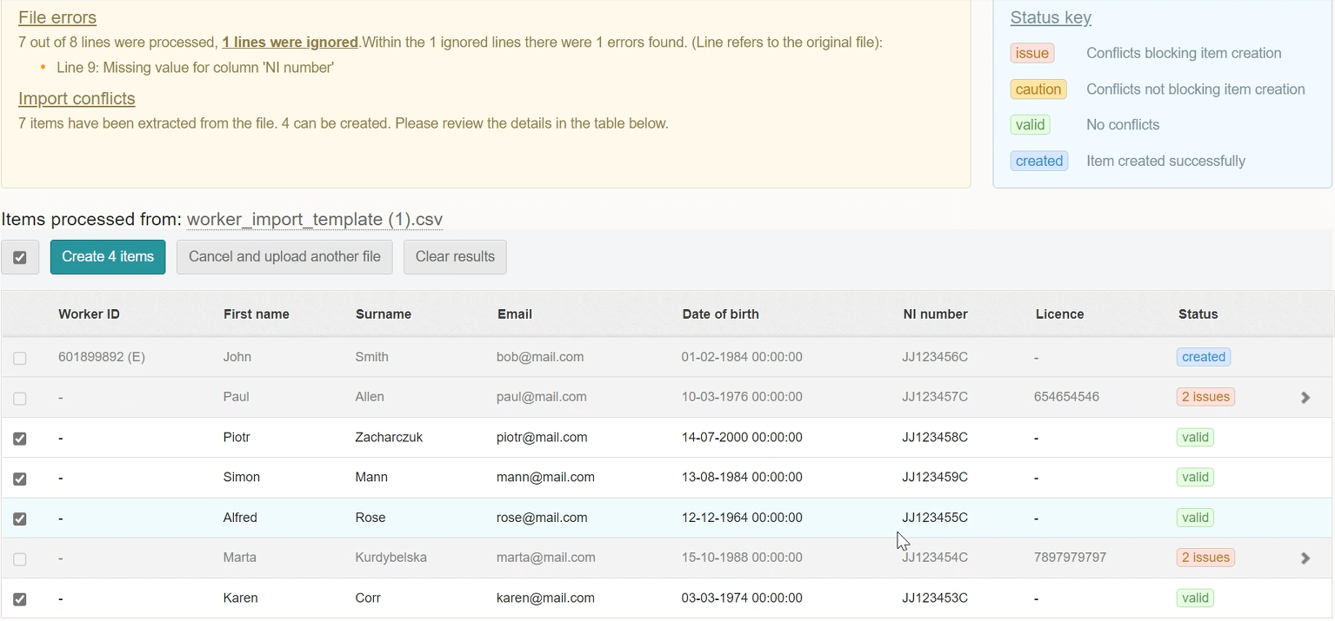
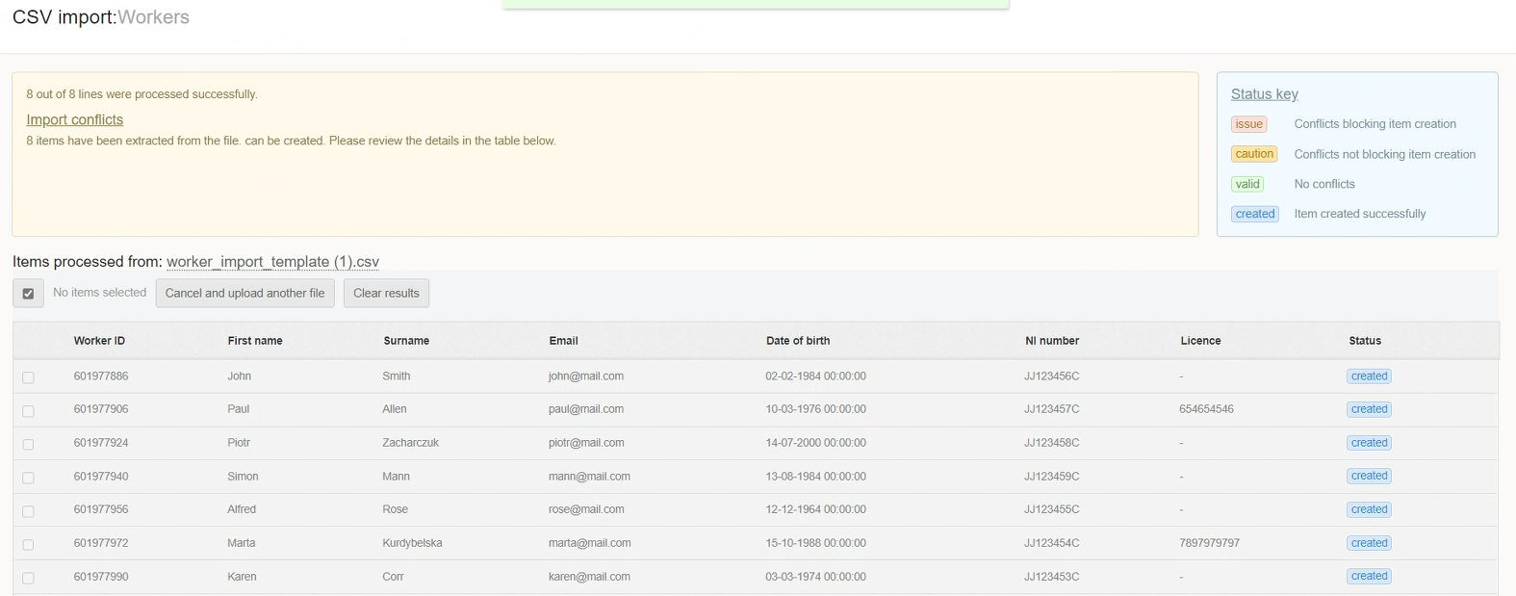
How To Download Workers Into Universe?
Now we have downloaded the report, we can now see who has no conflicts and who has conflicts blocking items creation.
Any worker that is not valid, will now show an issue and how many issues.

Slide 9
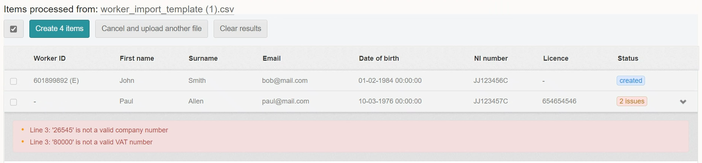
How To Download Workers Into Universe?
When you click on the arrow it will dropdown the reasons of the issue and also which line from the report it is from for you to be able to rectify. Once amend re upload the report.

Slide 10
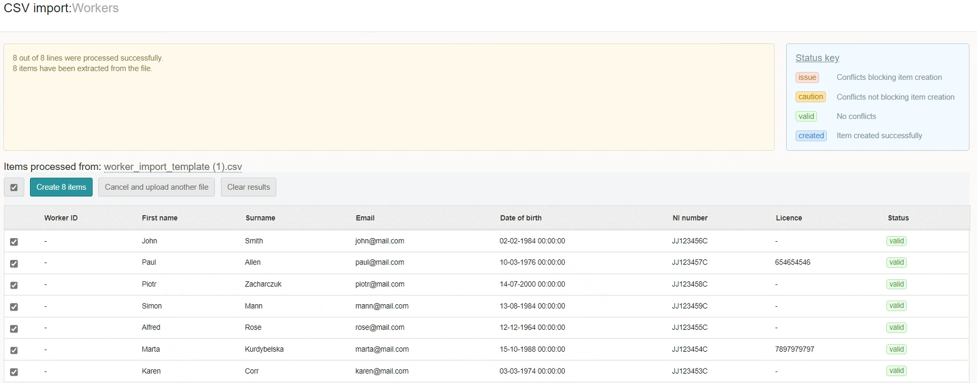
How To Download Workers Into Universe?
Once the upload has been completed again you will now see Valid on the right hand side. You can now create 8 items.

Slide 11
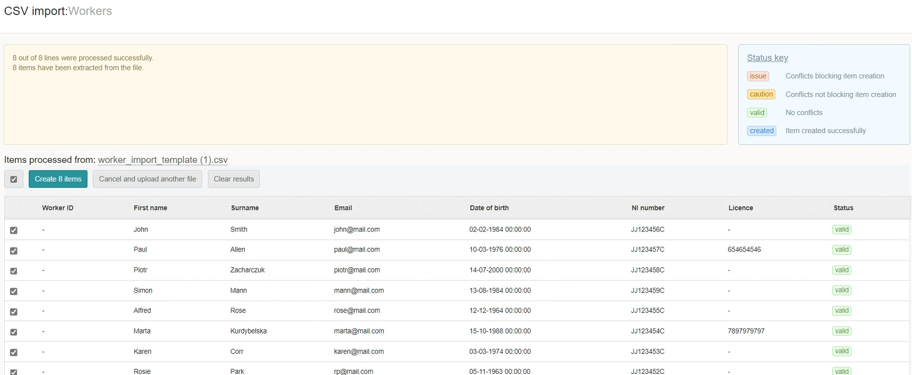
How To Download Workers Into Universe?
Next, click on Create 8 Items and select all.
Top Tip
You can only create 50 at a time. Once you have created 50 select all again and repeat the process

Slide 12
How To Download Workers Into Universe?
Once the system has created the items you will see conformation on the right side as created.
Once completed search for your worker and double check the details.

