Slide 1

AGENCY
“HOW TO DO GUIDE”

Slide 2


ATTENDANCE
OVERVIEW

Slide 3
BATCH EDIT SHIFTS
AMEND TIME
​

Slide 4
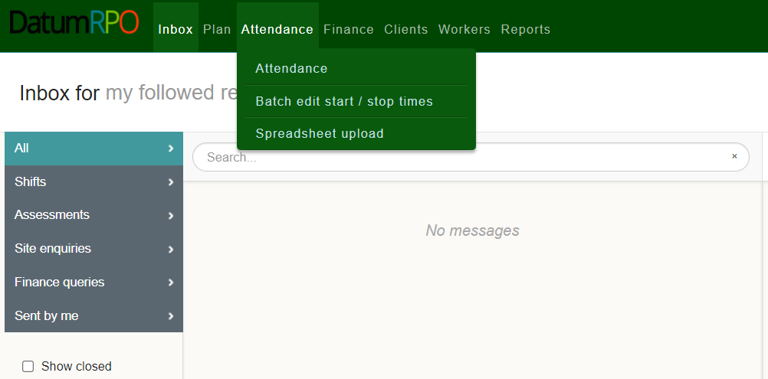
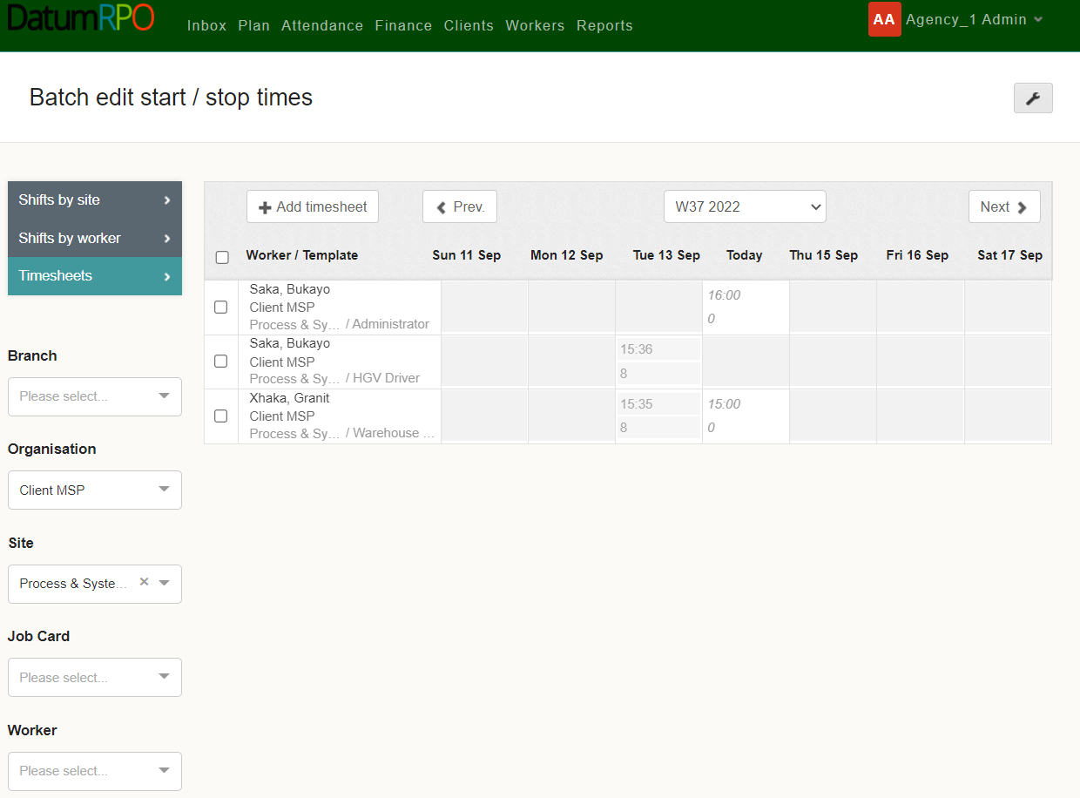
Where To Find Batch Edit Shifts?
This process happens after the shift has been completed. You can Batch Edit or Stop times (please refer to Start Stop times how to do guide on this process.)
Go to Attendance>Batch edit start/stop times.
Next go to Organisation to search for your Client.

Slide 5
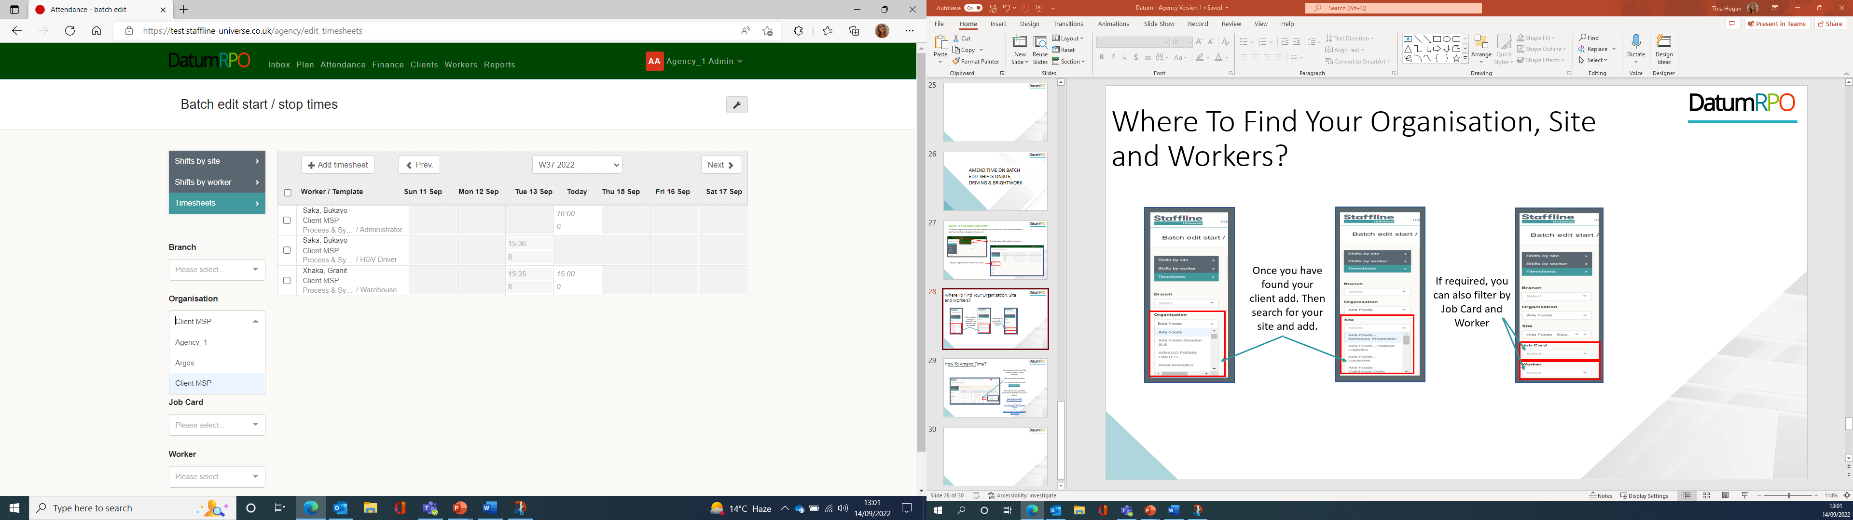
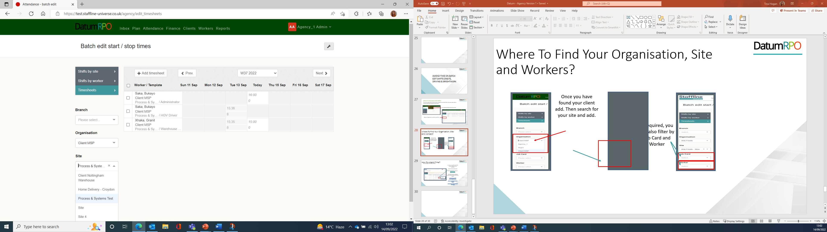
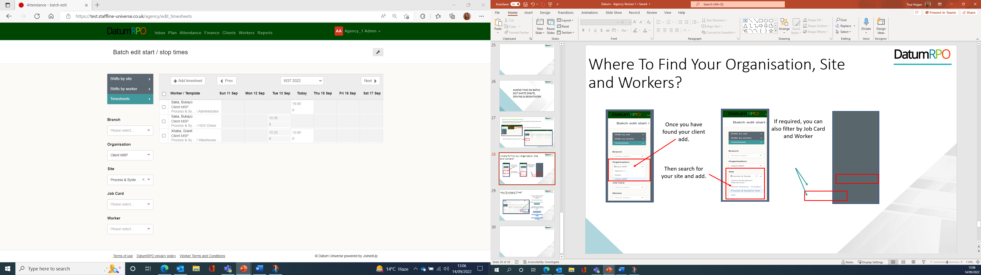
Where To Find Your Organisation, Site and Workers?
Once you have found your client add.
If required, you can also filter by Job Card and Worker.
Then search for your site and add.

Slide 6
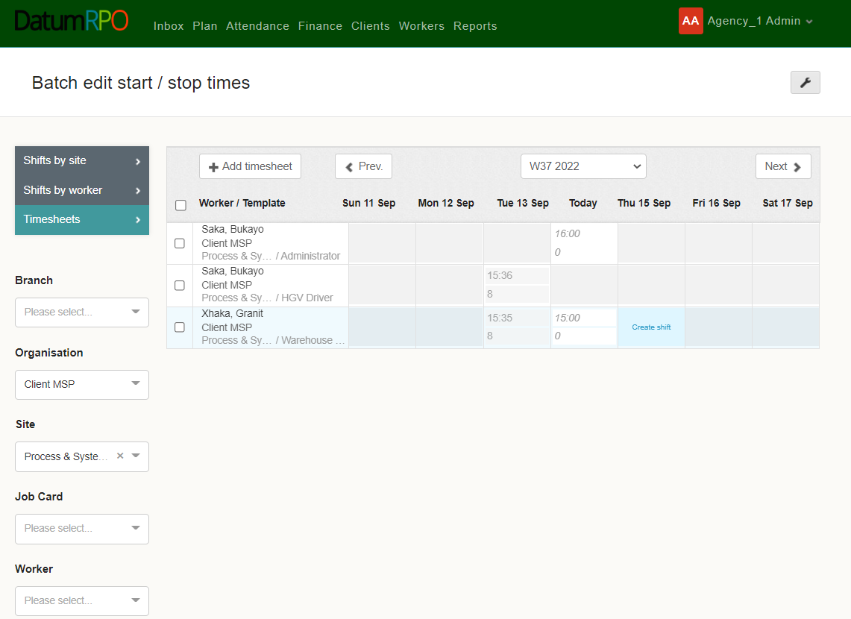

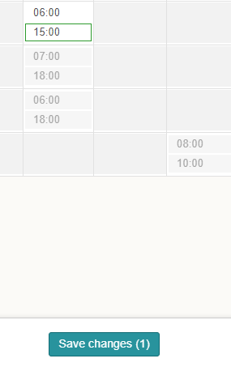
How To Amend Time?
Go to the day you would like to amend.
It is easy to amend the time if the workers shift hasn’t been submitted.
Click on the time and amend.
Once amended then click save.

Slide 7
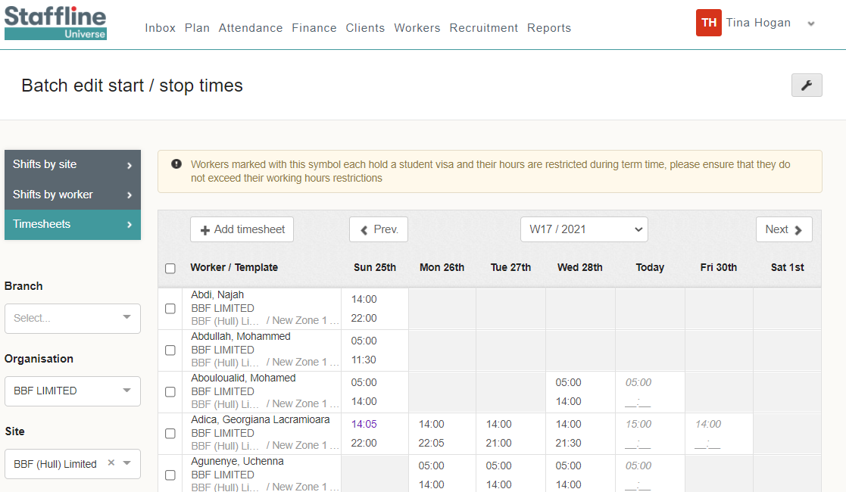


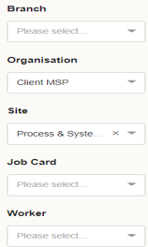

How To Add Finish Time?
The next part is to add the finish time or hours.
We are going to start with finish times and input the end time.
You can see we have already processed the finish time.
Add your finish time working on a 24-hour clock.
Once added click on the button.
A notification will pop up if you have a student working with restricted hours.

Slide 8
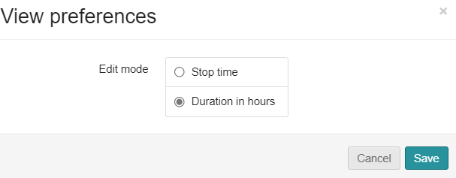
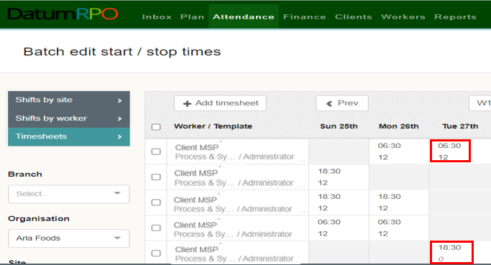

How To Add Finish Hours?
This is the same process as before; however, we are going to change the view preferences from Stop time to Duration time. To do this click on the to change and save.
Add your finish time working on a 24-hour clock. This can also be done on a 100 decimal.
Once added click on the button.

