Slide 1

AGENCY
“HOW TO DO GUIDE”

Slide 2


INVITING A CLIENT USER

Slide 3
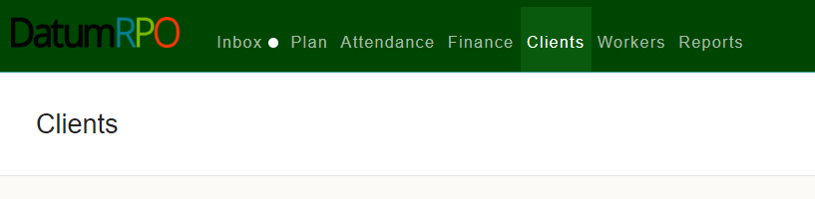
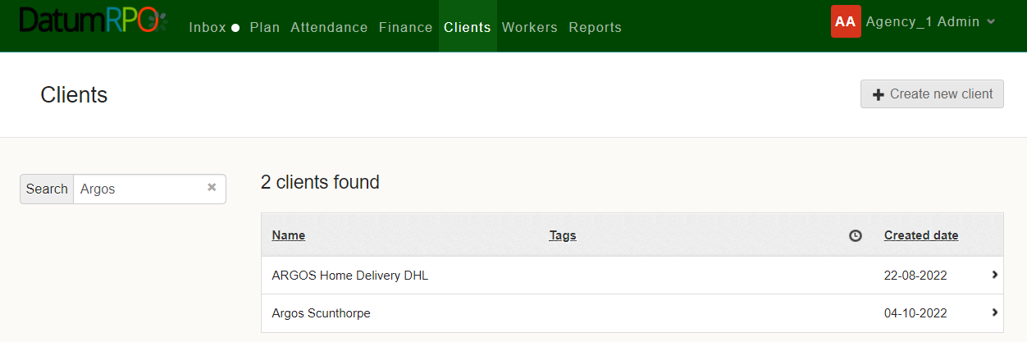
How Do I Invite A Client As A User?
Firstly, you need to get your client email address which need to be a work email not personal. Once received go to Client page.
Now search for your client, by adding the name in the search bar and clicking enter

Slide 4
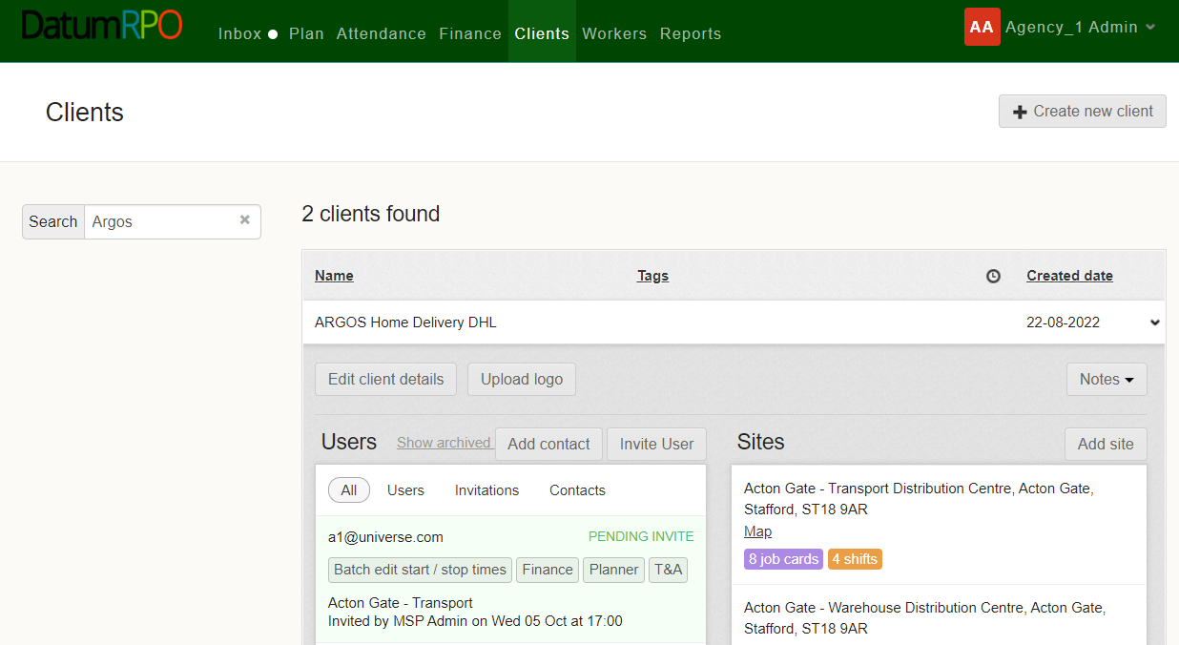
How Do I Invite A Client As A User?
Nex click on the organisation name .
Now click on invite User

Slide 5
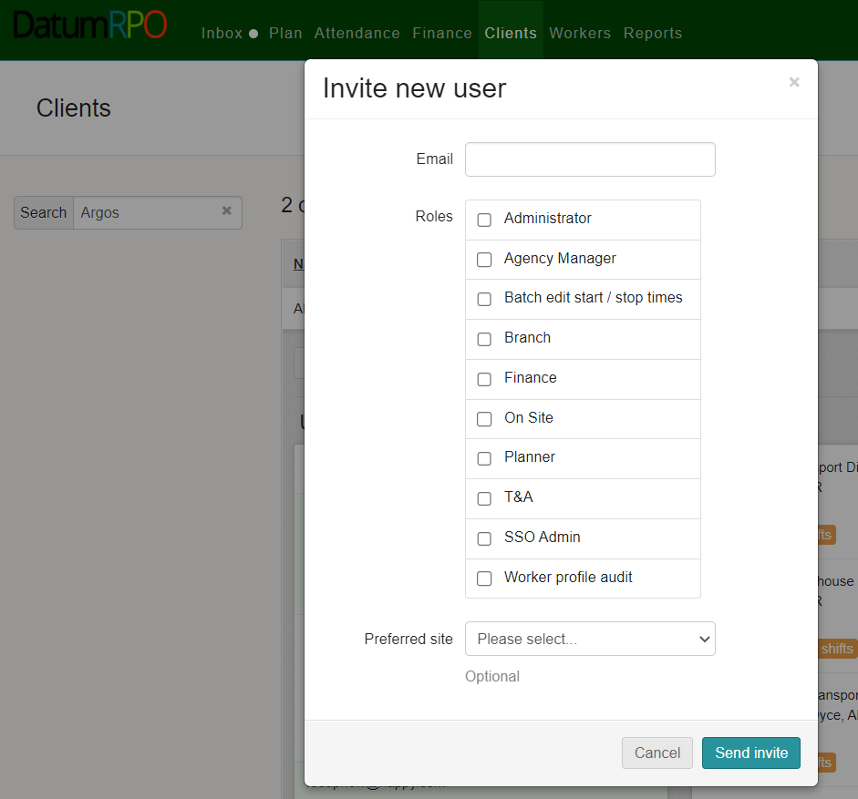
How Do I Invite A Client As A User?
Add in their work email address
For full access tick on
Administrator
Batch Edit start/stop times
Finance
Planner
T&A
Now Click on Preferred site and send invite

Slide 6
What's Next?
Your client will receive an email to log into DatumRPO
Able to create a password
They will only see the client you have put them under
Your client then will be able to access the “How to do guides” & videos from the DatumRPO portal

