Slide 1

CLIENT
“HOW TO DO GUIDE”

Slide 2


HOW TO LOG INTO UNIVERSE

Slide 3
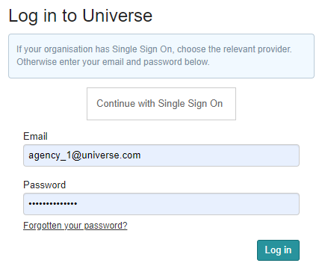
Signing In To Universe?
Open your web browser and go to Universe (universe.datum.co.uk). You will have already received your email address and password from IT.
The Universe application has been modified to allow users to use their normal network password for access. All other users will experience no change to the password they use.
On the first screen, every user is required to enter in their email address and password, then to click the Log in button.​
TOP TIP - save Universe to your favourites tab in your browser so you can locate it quicker!

Slide 4
POST SHIFTS OVERVIEW

Slide 5
POST SHIFTS

Slide 6
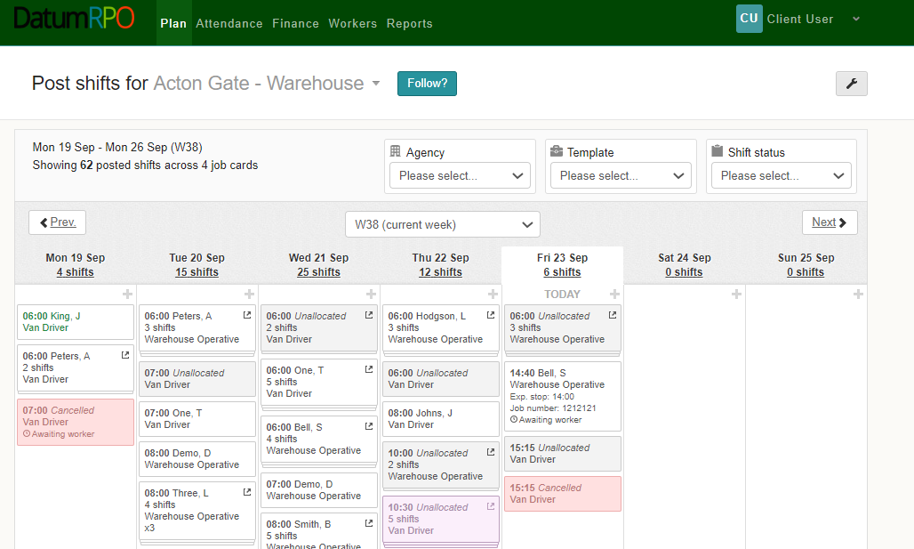

Where Do I Go To Post Shifts?
To create and post shifts, go to ‘Plan’ and ‘Post Shifts’.

Slide 7

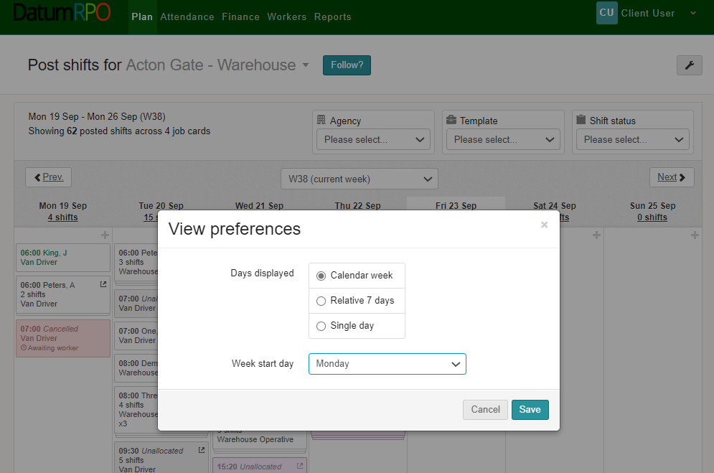
How Do I Change My View Preferences?
You can change your view preferences by clicking on the wrench icon at the top of the page.

Slide 8
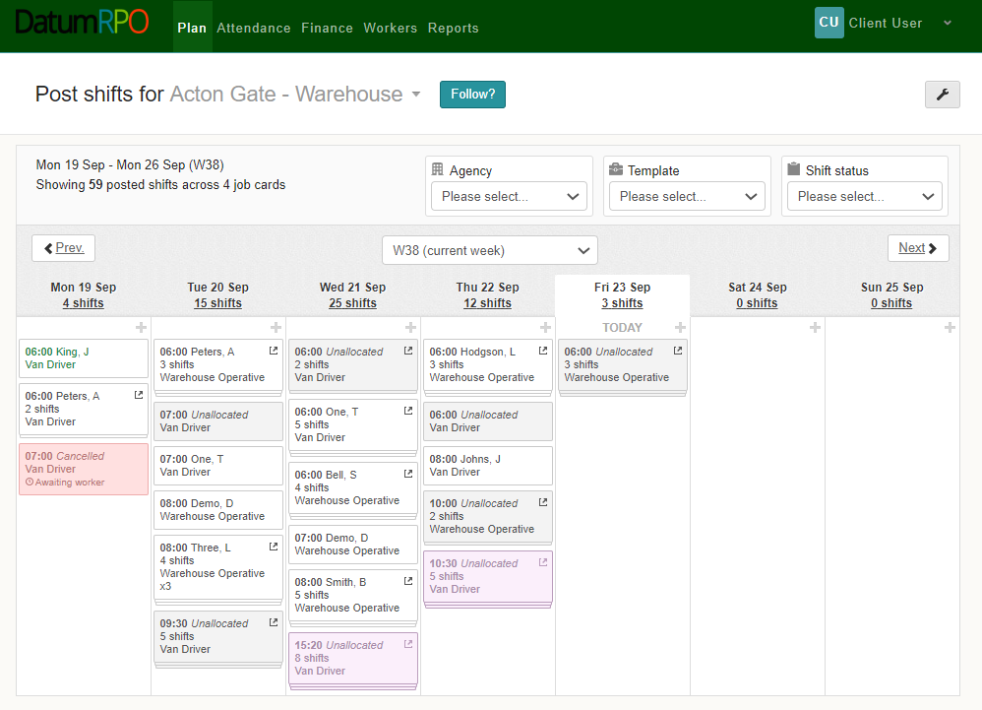
How Do I Filter My Plan?
You can filter your plan to view your booking by ‘Agency’, ‘Order Template’ or ‘Shift Status’ using the dropdowns.

Slide 9


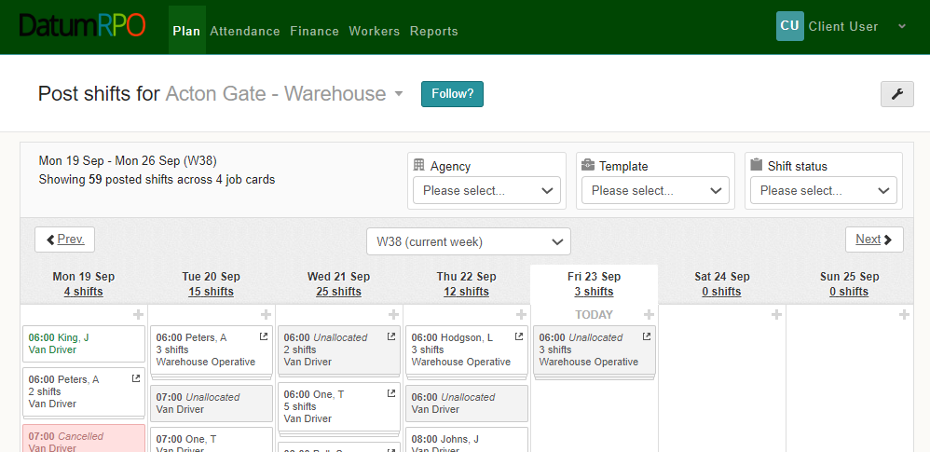
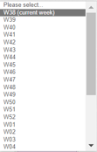
How Do I Change My Plan Week?
You can change your plan week by selecting an alternative week from the dropdown box, you can also move or forward one week at time by using the buttons.

Slide 10
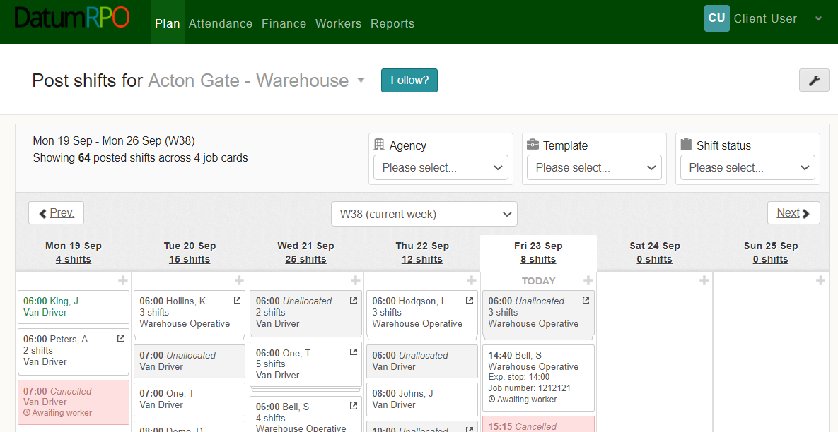
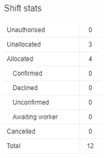
How Do I View The Shift Stats?
Clicking on the number of shifts will reveal the shifts stats for the day.

Slide 11
Where Do I See My Shifts?
You can see the days & dates of the week with the number of shifts below.

Slide 12

How Do I Create New Shifts?
To create a new shift, click on the in the day you want to create the shifts on.

Slide 13
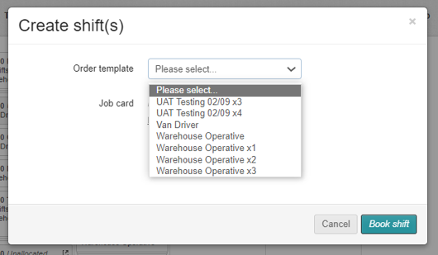
How Do I Create New Shifts?
Next, select the order template you wish to create your new shifts for by selecting it from the dropdown box.

Slide 14
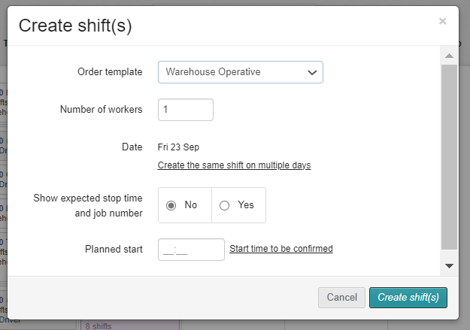
How To Book The Numbers Required?
Enter the number of workers you require and the planned start time of the shift.
You can also create the same shift on multiple days by clicking on the hyperlink.

Slide 15
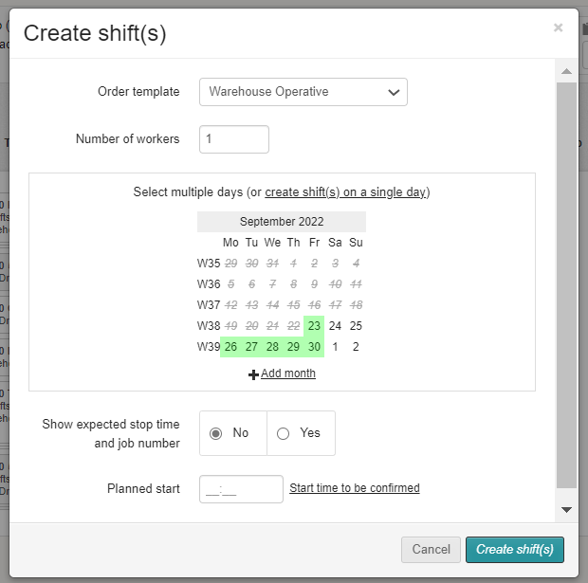
How Do I Select Multiple Days?
If you choose to create the same shift on multiple days by clicking on the hyperlink, you will see a calendar view where you will be able to select multiple days to create the same shift. The dates will turn green when selected and white when de-selected.
You can also add additional months to allow you to create the same shift well into the future.

Slide 16
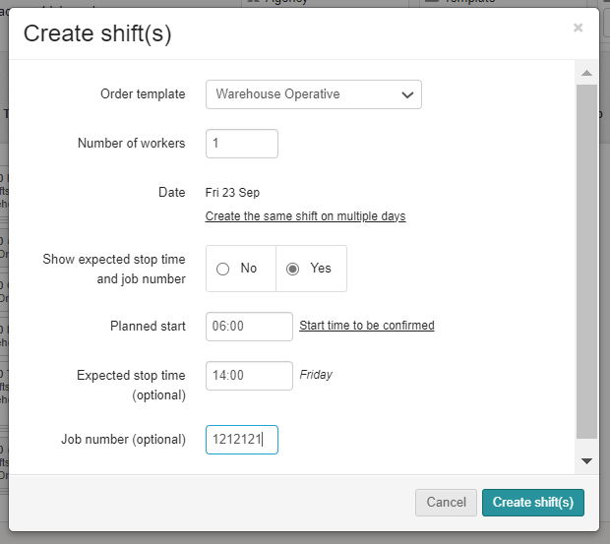

How Do I Add Stop & Start Time Required For The Shift?
You also have the option to show the expected stop time and job number of the shift.
If you select ‘Yes’, here.
When you are ready to create your shifts – click

Slide 17
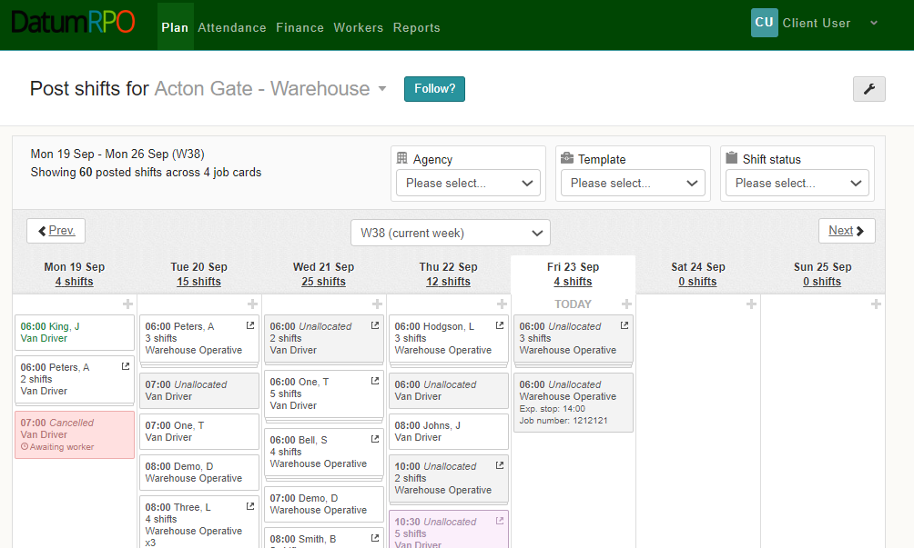
How Do I See They Have Been Posted?
You will now be able to see your Posted shift in the plan waiting to be actioned by Datum RPO.

Slide 18
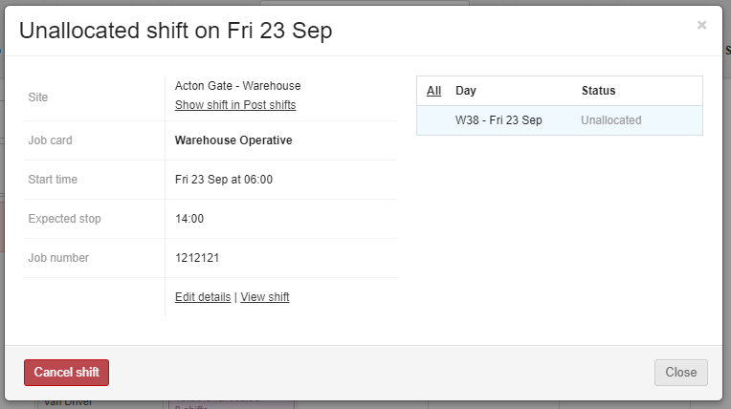
How Do I Edit Shift Details If Incorrect Or Need Cancelling?
You can ‘Edit’ or ‘Cancel’ unallocated shifts by clicking on the shift and selecting ‘Edit Details’ or ‘Cancel’ shift.

Slide 19
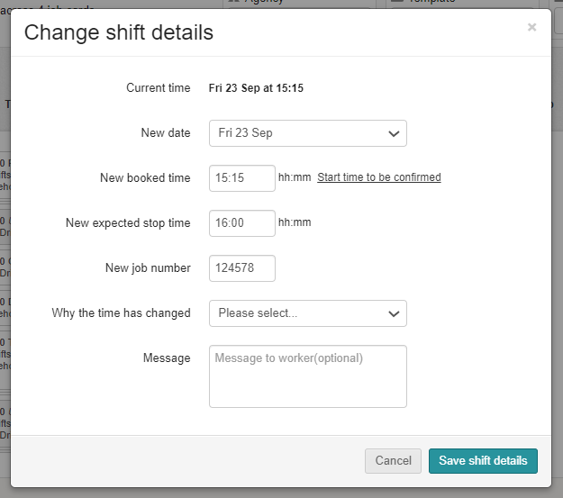

What Is The Reason The Time Has Changed?
When changing a shift time, you will need to add a reason for the time change using the dropdown box followed by saving.

Slide 20
POST SHIFTS BOOKINGS SENT TO DATUMRPO – DATUMRPO SHARED SHIFTS WITH AGENCIES

Slide 21
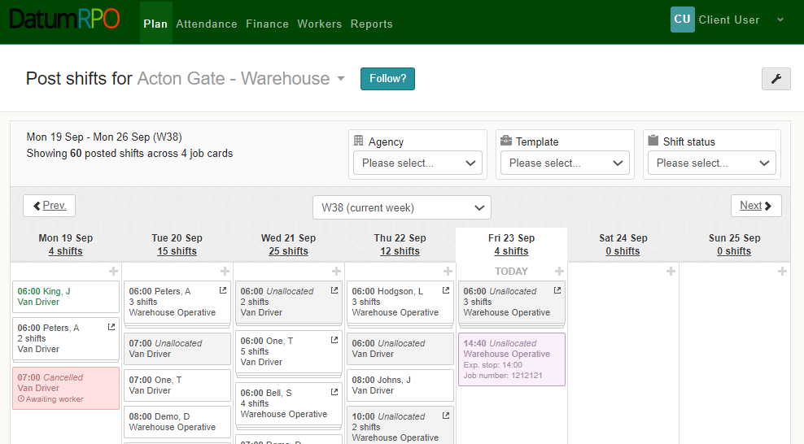
What Colour Does It Go When The Order Has Been Sent To DatumRPO?
When your booking has been sent out to the agencies, you will see it turn pink in your plan.

Slide 22
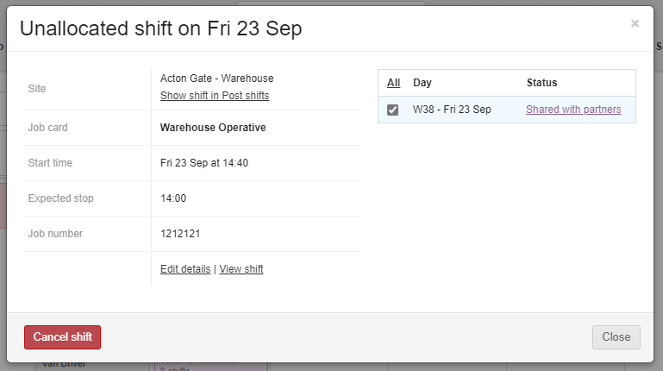
How Does It Show When The Orders Have Been Sent To Agency?
If you click on your actioned booking – you will now see that the status shows ‘Shared With Partners’

Slide 23
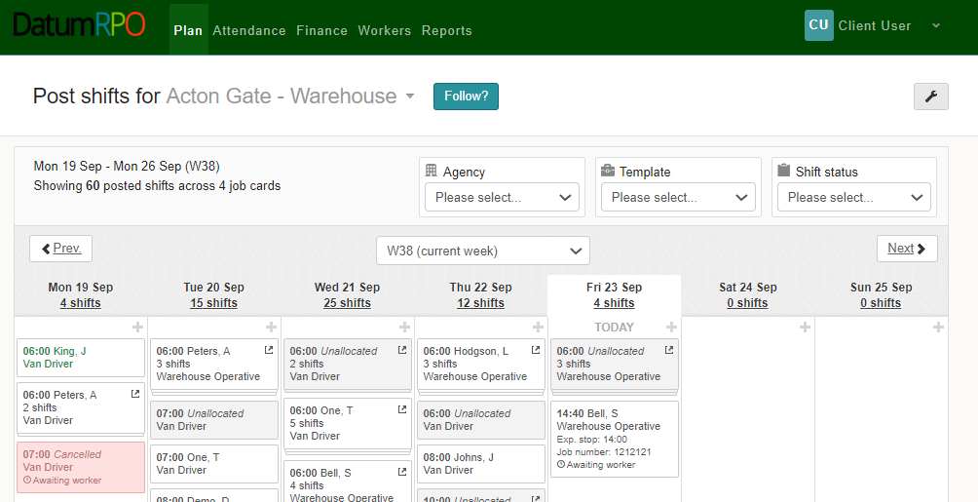
How Do I Know When The Agency Have Filled The Orders?
When workers start to be allocated to your booking, it will change to white in your plan.

Slide 24
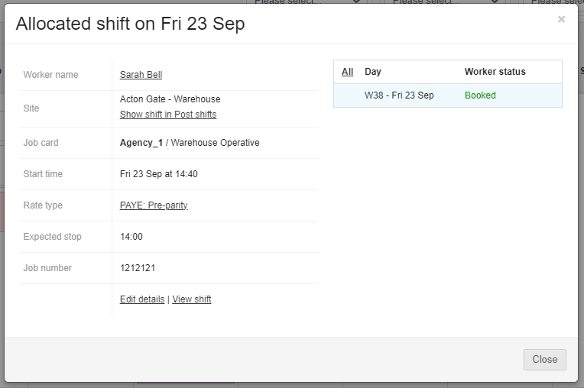
How Do I See The Worker Status Has Changed?
Words go here
If you click on your allocated booking – you will now see that the status shows ‘Booked’

Slide 25
POST SHIFTS
VIEW FILLED SHIFTS

Slide 26
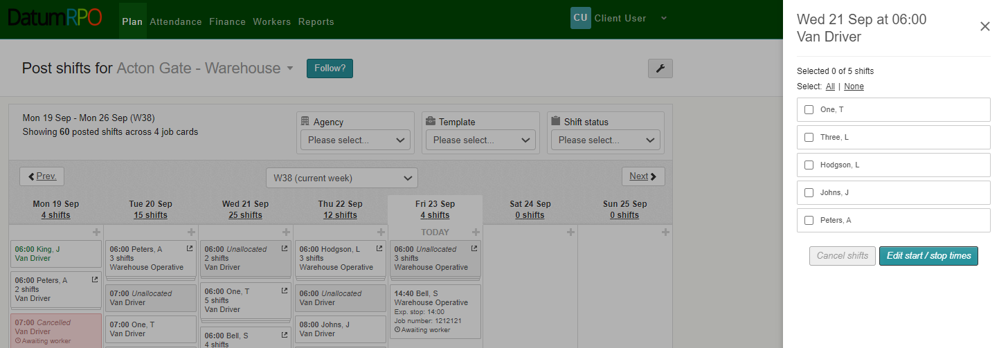
How Do I View My Filled Shifts?
To view the workers that have been allocated to your shifts, click on the booking and you will see a list of the workers who have been allocated as well as any unallocated shifts

Slide 27
POST SHIFTS
CANCELLED SHIFTS

Slide 28
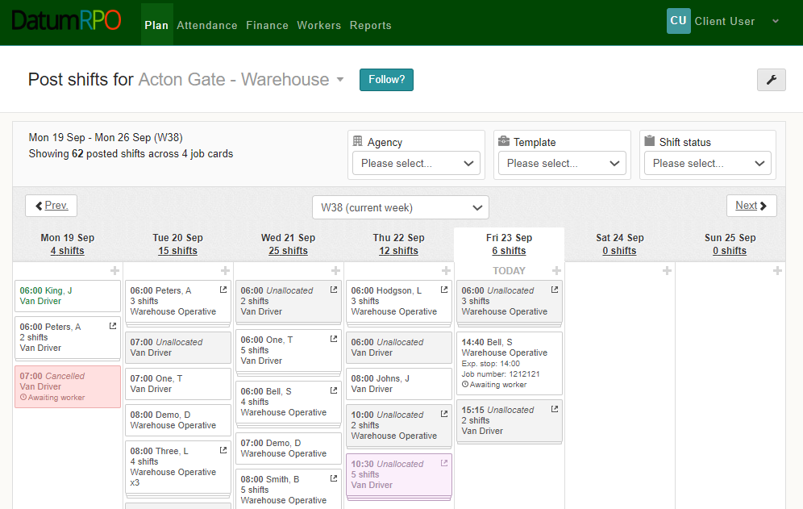
How Do I See Unallocated Shifts?
To cancel any unallocated shifts, click on the booking.

Slide 29
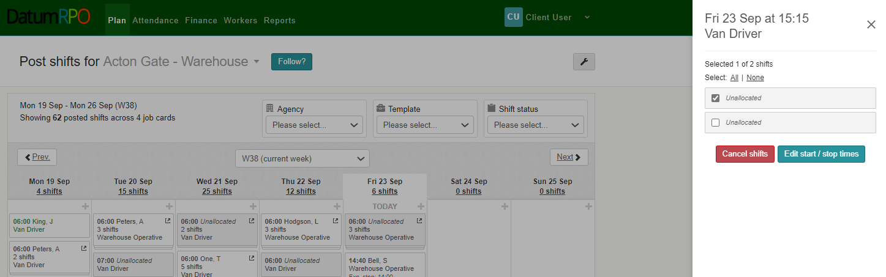
How Do I Cancel Shifts?
When cancelling shifts, you can cancel all or just one or more.
This section shows the unallocated shift.
Click on Cancel shift to complete

Slide 30
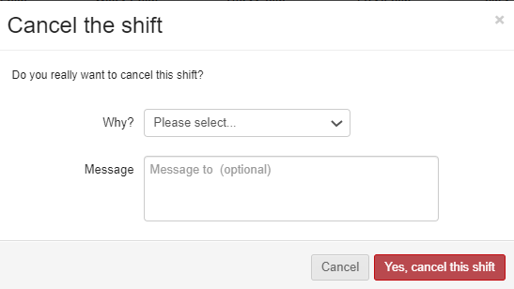

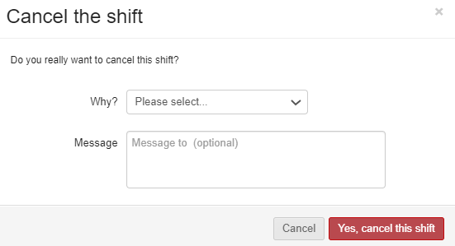
How Do I Advise Why The Shift Has Been Cancelled?
To add the reason why go to the dropdown section
Was it cancelled to incorrect planning – Planned in error
Or was a delivery late – Client Cancelled
If required, you can add a reason to why the shift has been cancelled

Slide 31
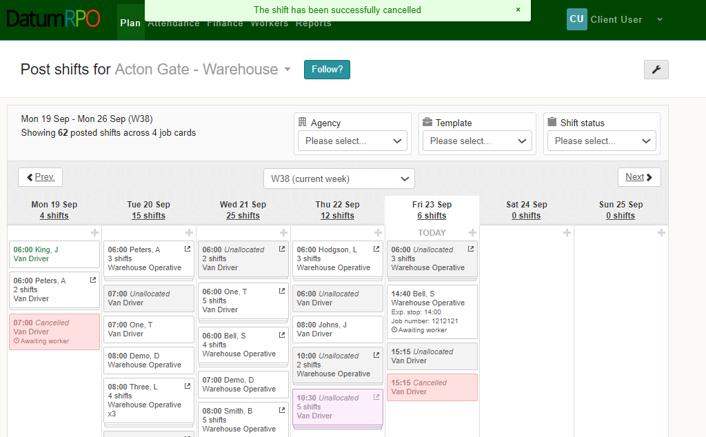
How Do I View The Cancelled Shift?
Once you have cancelled the shift you will get a notification on the top of the page
Also, the cancelled shift will turn pink

Slide 32
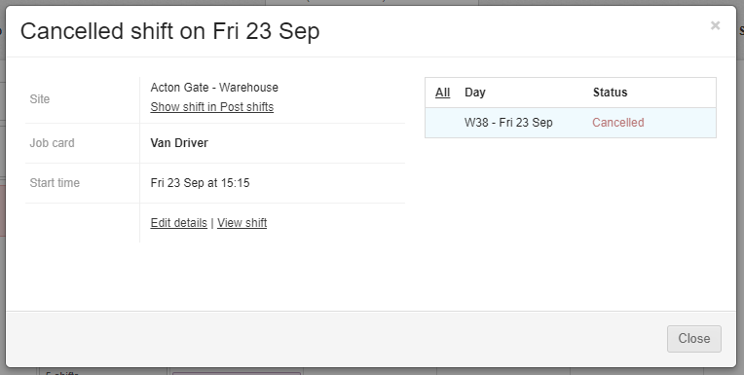
How Do I View The Cancelled Shift?
In the Status section you can see the order has now been cancelled for the Van Driver only

Slide 33
JOB CARDS

Slide 34
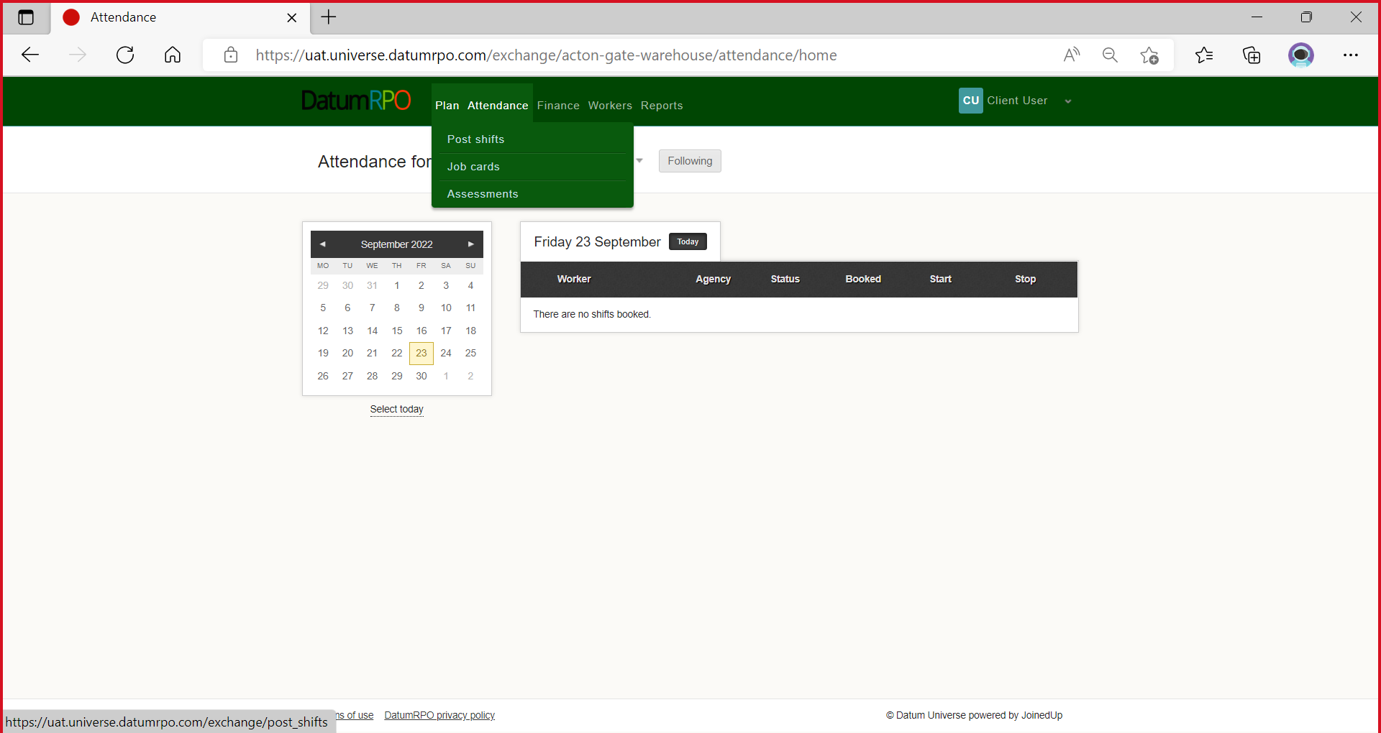
Where Do I Find Job Cards?
To view you job cards and order templates, go to ‘Plan’ and select ‘Job Cards’.

Slide 35
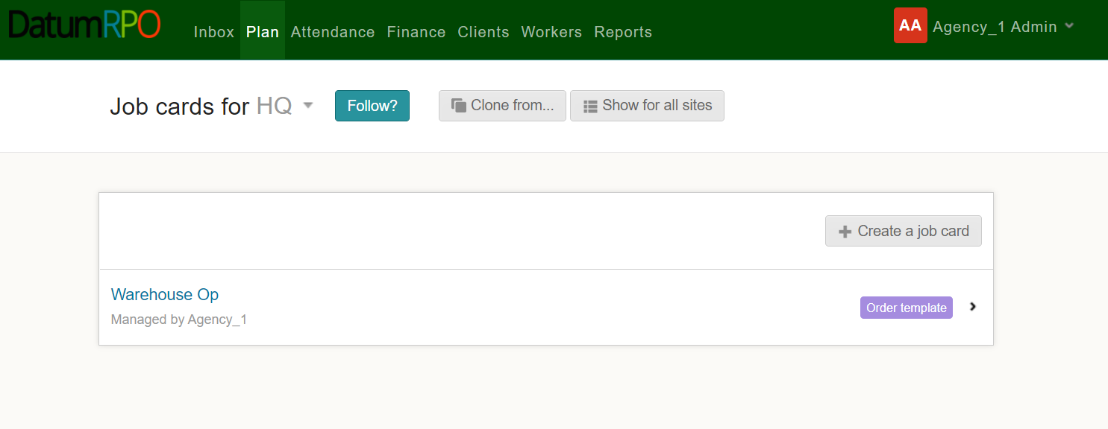
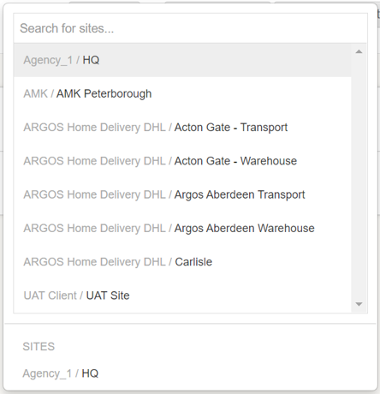
How Do I Find Job Cards For My Site?
Select the site for the ‘Job Cards’ you want to view using the dropdown box.

Slide 36
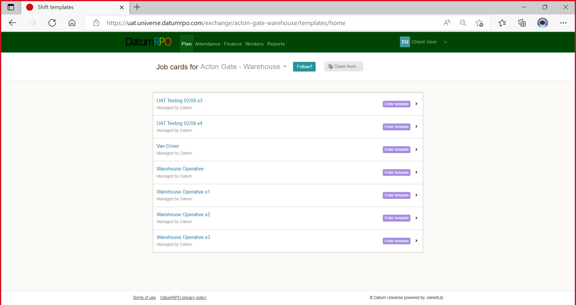
How Do I Find Job Cards For My Site?
You will now see a list of the job cards (Order Templates) for your chosen site.

Slide 37

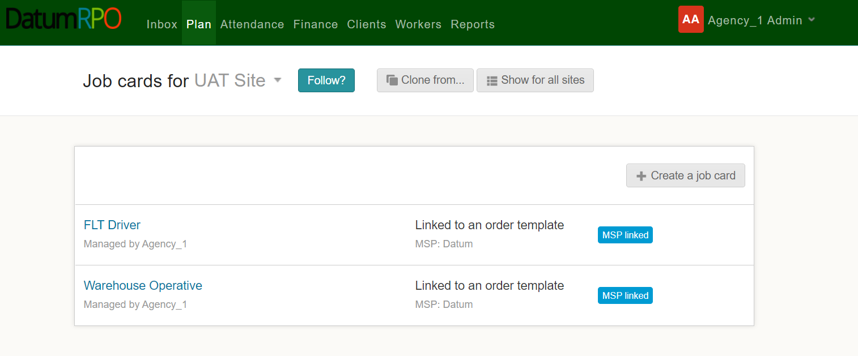
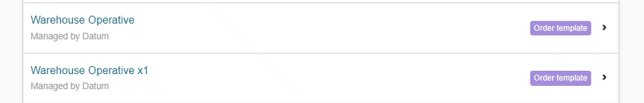
How Do I Follow My Site?
You can ‘Follow’ or ‘Unfollow a site by clicking

Slide 38
How Do I View The Job Card Details?
To view the job card details – click on the job card you want to see the details of.

Slide 39
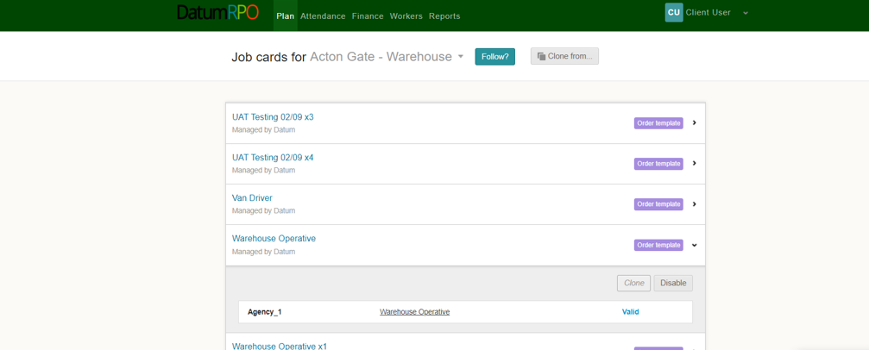
How Do I View The Job Card Details?
Then click on the hyperlinked name of the job card.

Slide 40
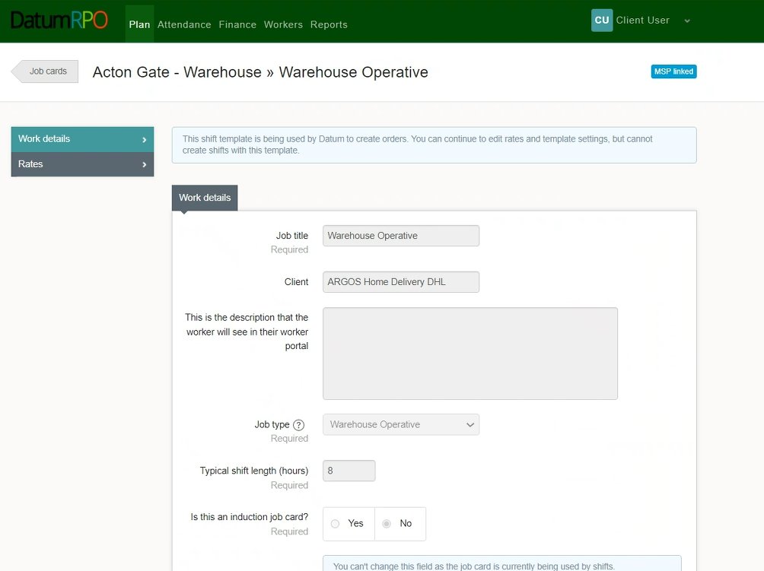
How Do I View The Job Card Details?
You will then be taken into the job card where you will be able to view the ‘Work Details’, ‘Rates’, ‘Advanced Settings’ and details of any ‘Template Changes’

Slide 41
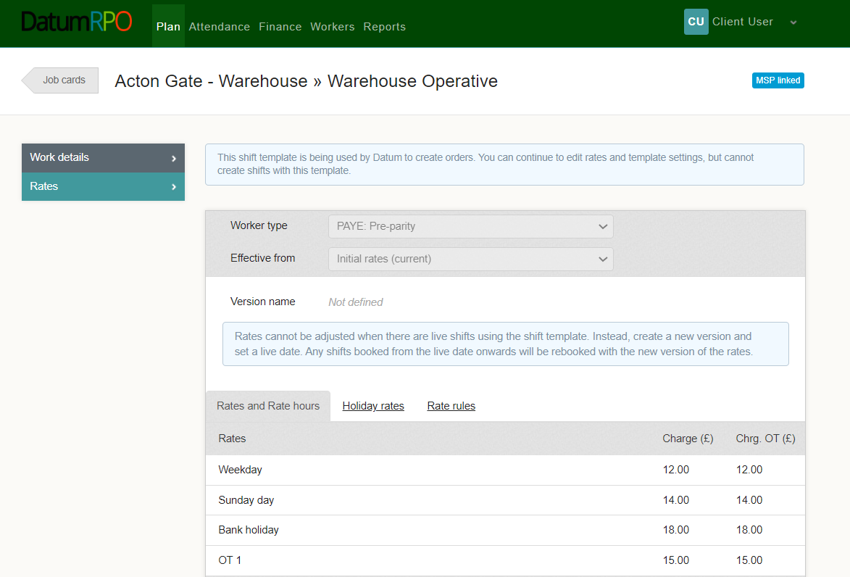
How Do I View The Job Card Details?
Rates – This section is the agreed rates per job card

Slide 42
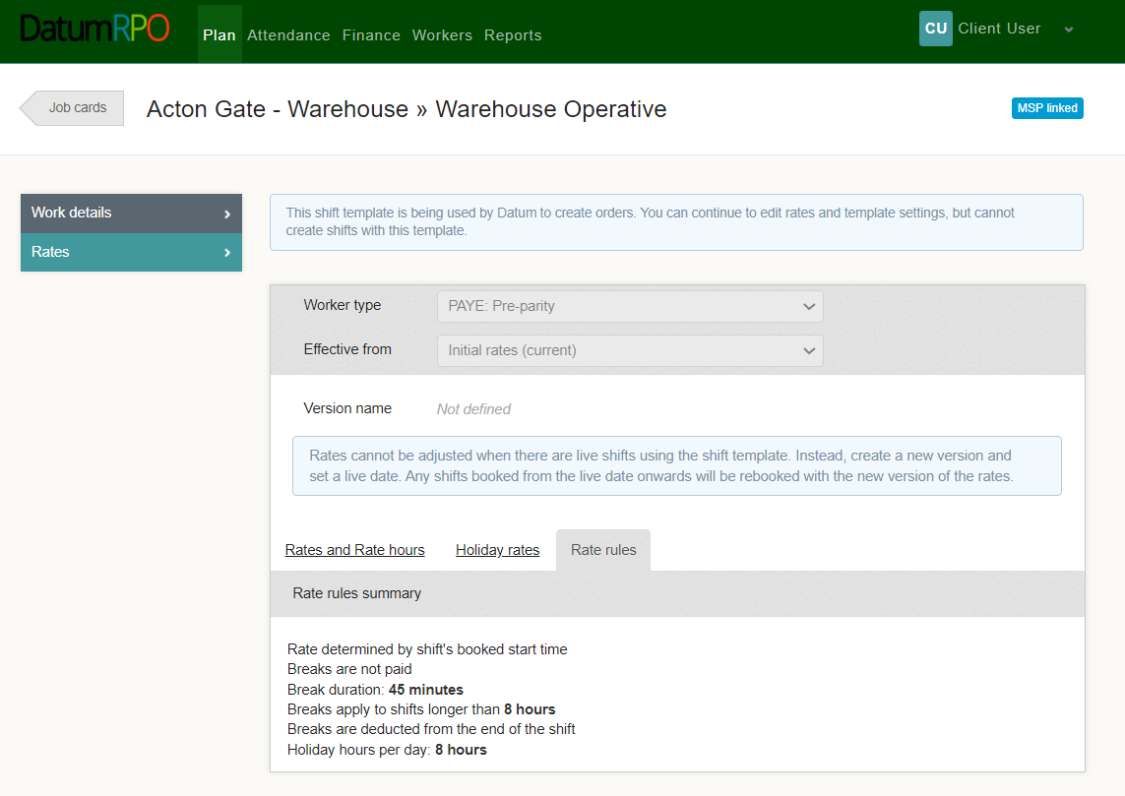
How Do I View The Job Card Details?
Rate Rules – This is the rules around payments and breaks and holiday hours per day.

Slide 43
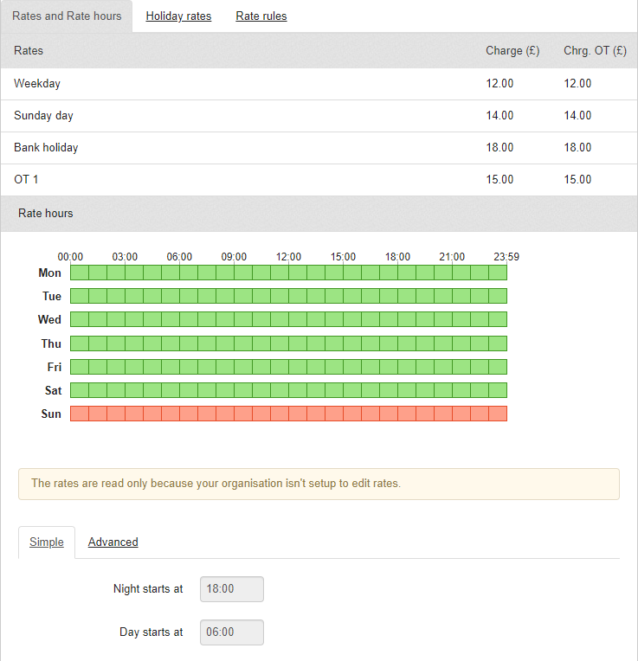
How Do I View The Job Card Details?
This section shows the hours and the rates in colour paid. As you can see from below there is a Sunday rate which is highlighted in red.
This section shows you the start times for Days/Nights

Slide 44
ASSESSMENTS

Slide 45
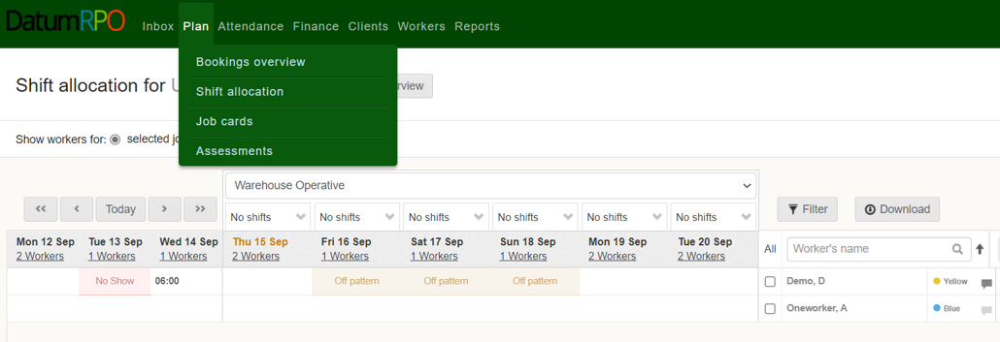
Where To Go To Book Assessments?
To view or create assessments, go to ’Plan’ and select ‘Assessments’

Slide 46
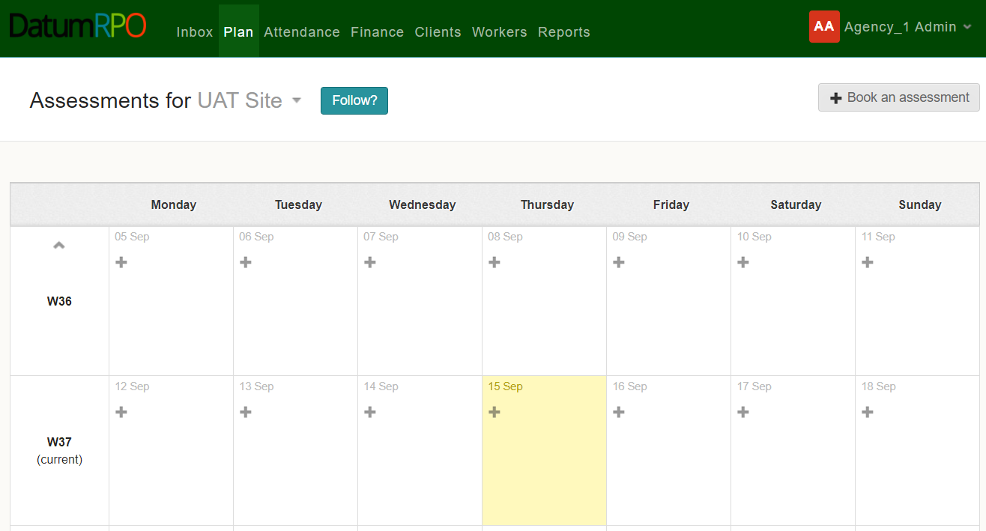
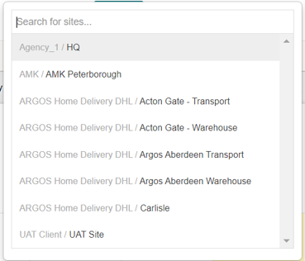
Where To Go To Book Assessments?
Next, use the dropdown box to select the site you wish to create or view assessments for.

Slide 47

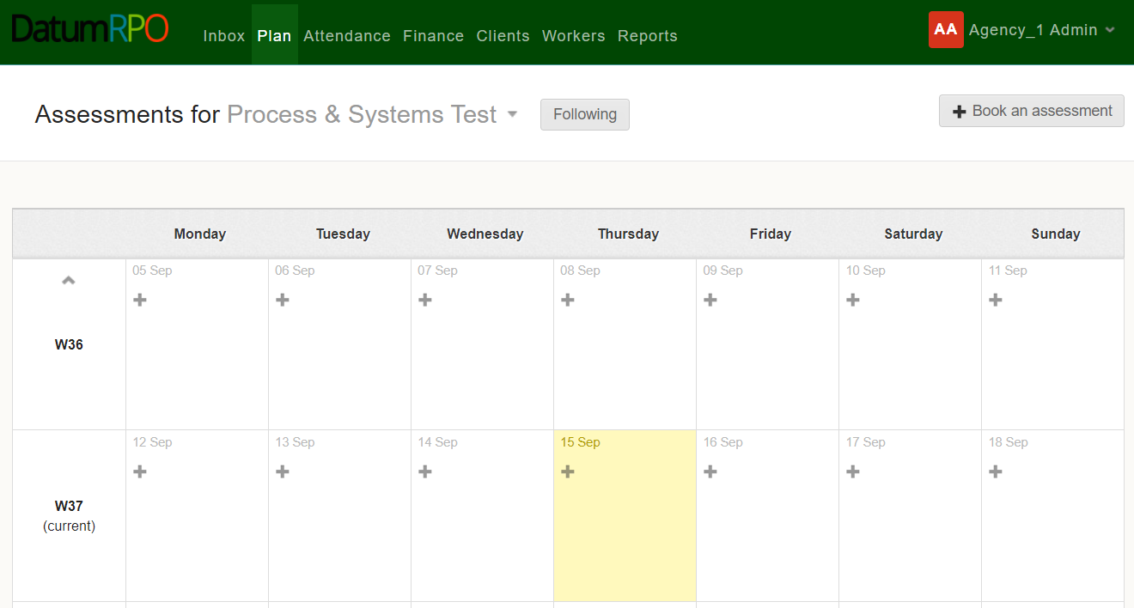


Where To Go To Book Assessments?
Click the on the date you wish to create the assessment, or you can click

Slide 48

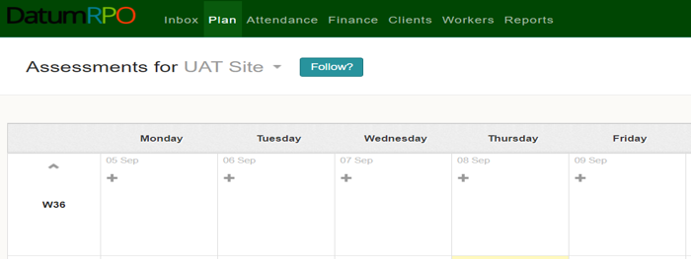
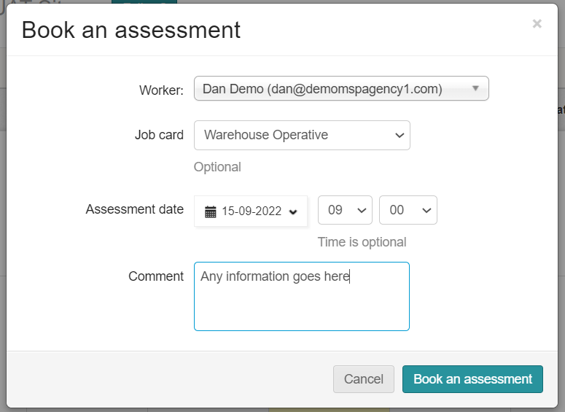
Where To Go To Book Assessments?
In the pop-up box, enter the workers name, the job card the assessment will be for, the assessment date and time (time is optional) along with any other relevant information – then click

Slide 49

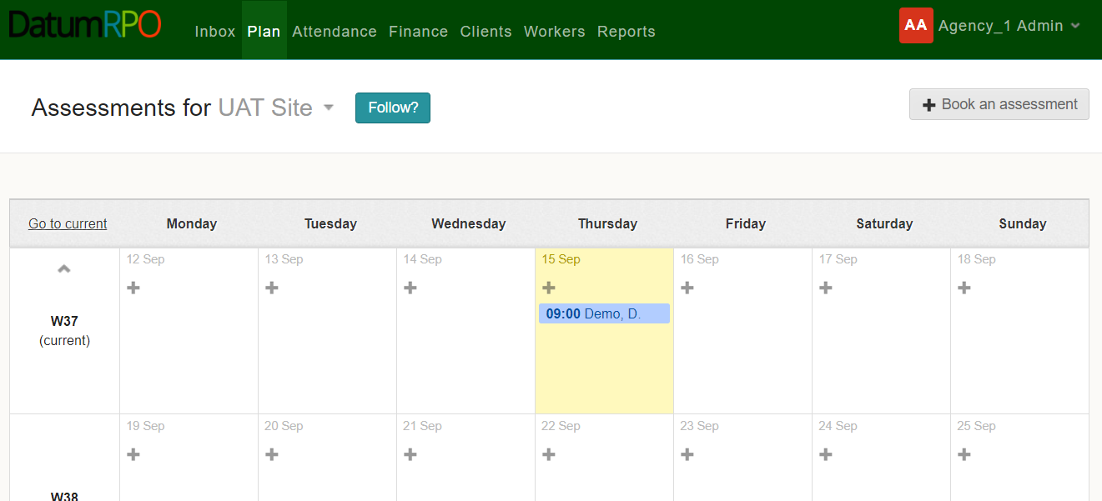
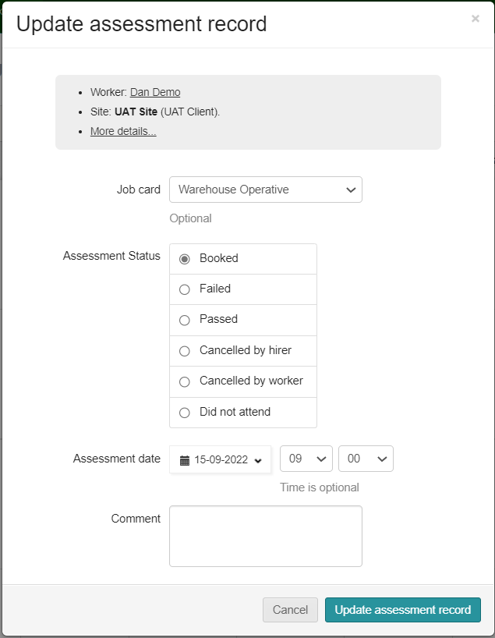
Where To Go To Book Assessments?
You will now see the assessment on the day you selected. Clicking on the assessment will allow you to update the assessment record in the pop-up box. To complete the update click

Slide 50
ATTENDANCE OVERVIEW

Slide 51
ATTENDANCE

Slide 52
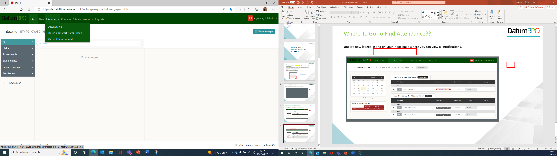
Where Do I Go To Find Attendance?
Go To Attendance > Attendance

Slide 53
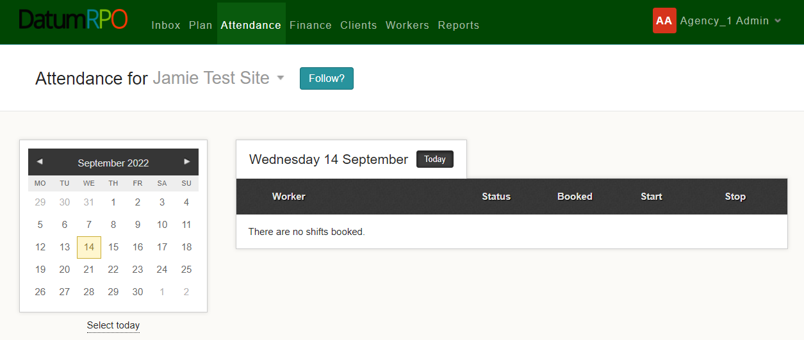
How To View Your Attendance?
Page view shows calendar and no shifts booked. You Also need to make sure you are on the correct site page if you have more than one client

Slide 54
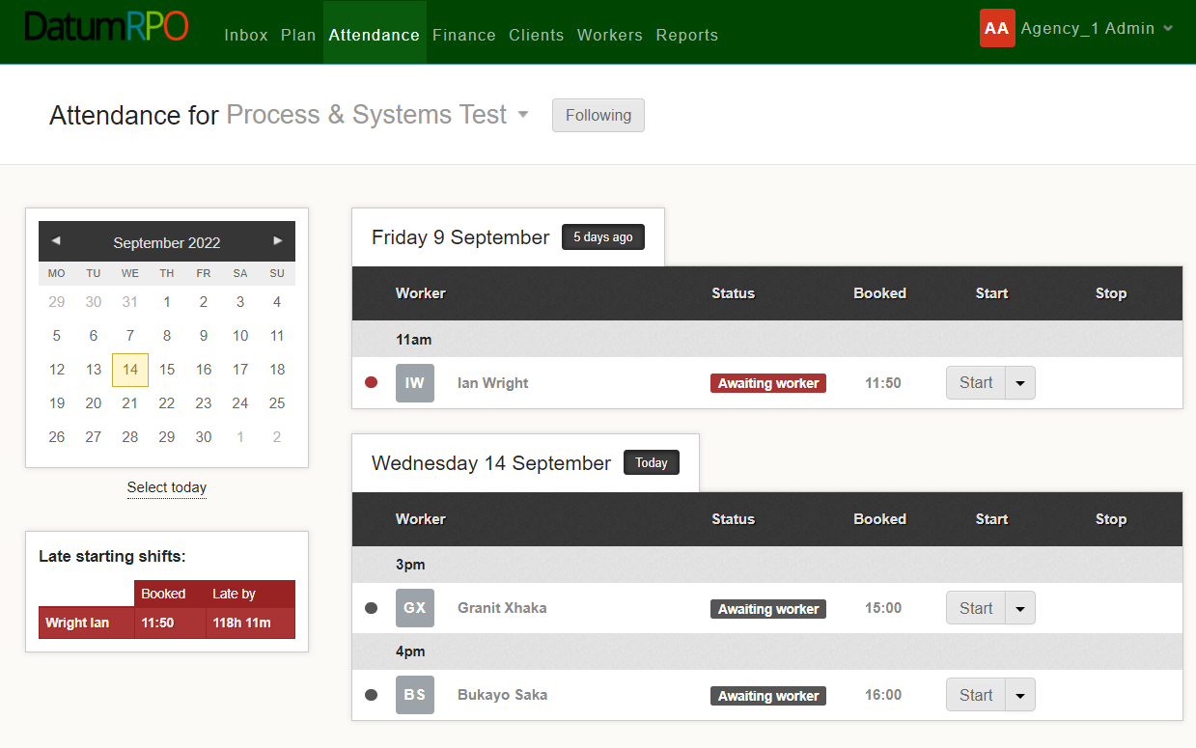
Where To Start The Clock For A Worker?
From the Attendance page you can start and stop times.
Next click on 'Start'.

Slide 55
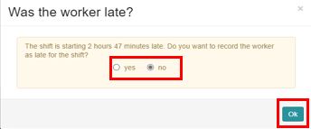
Where To Start The Clock For A Worker?
If you don’t start the clock on time or the worker is late, you will be asked if they are late. Click “Yes” or “No”.
Next click on 'Ok'.

Slide 56

Where To Start The Clock For A Worker?
At the top of your page, you will see the worker has been recorded as late.
You can now see the worker is in progress and you can see when the shift has started.
For anyone late or a no show, the clock will keep running.

Slide 57


Where To Start The Clock For A Worker?
We are now going to start the clocks. You can either start as 'Start shift' or 'Start shift at booked time'.
If you select start shift it will ask if the worker is late if after the start time.

Slide 58
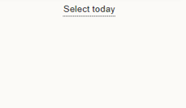

What To Do If A Worker Is Late?
You can now see the workers are in progress.
Next, we will stop the clock.

Slide 59

What To Do If A Worker Is Late?
Now we can stop the clock by clicking either 'Stop shift' or 'Stop for night out'.
Click on 'Stop Shift'.

Slide 60

Where To Stop The Clock For A Worker?
You can edit the stop date and time by clicking on 'Edit'.
Add in any unplanned breaks into this section.
If the worker is guaranteed hours select 'yes' here.
From this section you can also add any expenses.
You can choose yes or no here if there were any issues or if the worker is starting a night out. See the next slide for what appears if you select yes.

Slide 61

Where To Stop The Clock For A Worker?
If you choose yes for both questions, you will see the below box appear where you will need to add additional details.
Once you are happy that all the details are correct, click 'Stop timer'.

Slide 62
What It Shows When You Have Added The Stop Time?
When you have added the stop time you will see the status change to 'Complete'.

Slide 63

How Do I Amend The Time?
To amend the time, click on the 'x' to open the page.

Slide 64


Where To Amend The Clock?
Enter in the new time, why the time has changed and a message if applicable.
If the worker is guaranteed hours click 'yes' and save the shift details.

Slide 65
Where To Restart The Clock?
You can also rest the clock if required by clicking on the start time. This will bring up an 'x'.
Click on the 'x' to open the page.

Slide 66


Where To Reset Shift Stop Timer?
Next click on the 'Yes, reset' button to continue.

Slide 67

How To View And Add Guaranteed Hours?
If your worker is guaranteed hours, then you will need to click on 'yes' to guarantee the payment is correct and then click on 'Stop timer'.

Slide 68
How To View Once Completed?
You can now see the workers are all completed.

Slide 69
BATCH EDIT START / STOP TIMES

Slide 70
BATCH EDIT SHIFTS
AMEND TIME
​

Slide 71


Where To Find Batch Edit Shifts?
This process happens after the shift has been completed. You can Batch Edit or Stop times (please refer to Start Stop times how to do guide on this process.)
Go to Attendance>Batch edit start/stop times.
Next go to Organisation to search for your Client.

Slide 72



Where To Find Your Organisation, Site and Workers?
Once you have found your client add.
If required, you can also filter by Job Card and Worker.
Then search for your site and add.

Slide 73



How To Amend Time?
Go to the day you would like to amend.
It is easy to amend the time if the workers shift hasn’t been submitted.
Click on the time and amend.
Once amended then click save.

Slide 74





How To Add Finish Time?
The next part is to add the finish time or hours.
We are going to start with finish times and input the end time.
You can see we have already processed the finish time.
Add your finish time working on a 24-hour clock.
Once added click on the button.
A notification will pop up if you have a student working with restricted hours.

Slide 75



How To Add Finish Hours?
This is the same process as before; however, we are going to change the view preferences from Stop time to Duration time. To do this click on the to change and save.
Add your finish time working on a 24-hour clock. This can also be done on a 100 decimal.
Once added click on the button.

Slide 76
HOW TO VIEW
SHIFT DETAILS

Slide 77

How To Open Shift Details?
Next click on the to open the shift details.

Slide 78

How To Open Shift Details?
Next click on here to open the shift details.

Slide 79

How To View Shift Details?
You have now opened shift details and are able to view job card information, start and finish time, hours worked, Adjustments, Expenses and are able to query a shift from here.
It also shows you who booked or cancelled a worker.

Slide 80
HOW TO VIEW
SHIFTS BY SITE

Slide 81

Where Do I Go To Open Shifts By Site?
Next click on 'Shifts by site'.

Slide 82


How To Only Show Shifts Without Start Times?
Search for your site in the dropdown box.
You can view the workers who have not got start times.
Click on only show these shifts.
You can manually add the start and stop times or add all by clicking on add start/stop times.

Slide 83

How To Only Show Shifts Without Stop Times?
You can view the workers who have not got stop times.
Click on only show these shifts.
You can manually add the start and stop times or add all by clicking on add start/stop times.

Slide 84
How To Add Start/Stop Times?
Now we have viewed who has start or stop times we can now add those who haven't.
Click on Add Start/Stop Times.

Slide 85

How To Check And Complete Start/Stop Times?
This function will input the start/stop times for you.
Next click on save shift times.
You can either amend times now or you can save and go back and amend.
It is quicker to amend before saving.

Slide 86

How View Complete Start/Stop Times?
You can now see the start and stop times are greyed out and it is now showing no shifts without start or stop times.
You have now completed how to view shifts by site and complete start/stop times!

Slide 87
HOW TO VIEW
SHIFTS BY WORKER

Slide 88
Where To Go To Open Shifts By Worker?
Next click on 'Shifts by worker'.

Slide 89

Where To Go To Select The Worker?
Next, search and select the worker you would like to view.

Slide 90

How To Only Show Shifts Without Start Times?
You can view the shifts of the worker that don't have start times.
Click on only show these shifts.
You can manually add the start and stop times or add all by clicking on add start/stop times.

Slide 91
How To Only Show Shifts Without Stop Times?
You can view the shifts of the worker that don't have stop times.
Click on only show these shifts.
You can manually add the start and stop times or add all by clicking on add start/stop times.

Slide 92
How To Add Start/Stop Times?
Now we have viewed the shifts that don't have start or stop times we can now add those in.
Click on Add Start/Stop Times.
This will add in both start and finish times which is taken from the job cards.

Slide 93

How To Check And Complete Start/Stop Times?
This function will input the start/stop times for you.
Next click on save shift times.
You can either amend times now or you can save and go back and amend.
It is quicker to amend before saving.

Slide 94

How View Complete Start/Stop Times?
You will also notice at the top of the page when you save it will advise if it has saved properly
You can now see the start and stop times are greyed out and it is now showing no shifts without start or stop times.

Slide 95
FINANCE OVERVIEW

Slide 96
TIMESHEETS

Slide 97

Where To Find Timesheets?
Timesheets are the start and finish times you have processed through either Stop/Start or Batch Edit Shifts.
Each day is processed as a timesheet, and you will be able to find them on each worker.

Slide 98



What's On The Timesheets?
Below is some information on the timesheets represented by different columns.
Status of open timesheets and unsubmitted
Total value to client for all workers
Total charge to client with adjustments for all workers
How many timesheets
Total pay for all workers
Total hours processed for all workers

Slide 99
What's On The Timesheets?
Further information on the timesheets represented by different columns.
Job card which the worker is being pay rolled on
Total value to client
Total pay to worker
Worker's name
Total charge to client with adjustments
Total hours processed

Slide 100

How To View Timesheets?
The timesheets represent each day the worker has worked, including hours processed
with charge and pay totals for each day.
Timesheets which have been created for the worker, that haven't yet been submitted and are highlighted pink

Slide 101

What Information Is On Each Timesheet?
Click on the day you would like to view. Each section represents the job card rules and hours processed.
The first part is information that has been placed on the job card.
You can also go to the job card from this section by either
clicking on:
Job Card
Rate schedule
Shift details

Slide 102
What Information Is On Each Timesheet?
The second part of the timesheet is the shift value breakdown.
This part shows the shift length, any adjustments, unpaid breaks and the total shift length billable to the client

Slide 103
What Information Is On Each Timesheet?
The last part of the timesheet is the total costs.
The final part is the charge rate, pay rate, hours, charge value and pay value

Slide 104
What Are Historic And Manual Adjustments?
These are for any missing payments or adjusted rates.
Please see the How To Guide on historic and manual adjustments
for more information.

Slide 105
UNSUBMITTED SHIFTS

Slide 106

What Is An Unsubmitted shift?
An Unsubmitted Shifts are timesheets that have been created and are waiting to be processed for payroll.
This is where you can check the hours and costing for each job card before submitting the Unsubmitted Shifts.
Go to Finance > Unsubmitted Shifts.

Slide 107


How To Submit Your Unsubmitted Shift?
You will be able to view all workers with hours on Universe.
When submitting unsubmitted shifts you are on your way to locking lines.
You can either submit all workers at a time or one by one.
For all workers you need to click on:
To submit worker's individually, click one box at a time.

Slide 108
QUERY SHIFTS

Slide 109


Where To Query A Shift?
A query is where you have processed hours, approved the shifts and then noticed they are overpaid or underpaid due to incorrect start/stop times.
Click on the worker where you need to
raise a query.

Slide 110



How To Raise The Query?
Open the timesheet you need to make the changes to.
Click on the 1 shift at the top
Click on Raise a qu this then will enable you to make changes.

Slide 111


How To Complete The Query?
Open the query and select from the dropdown the reason for the query.
You can also add notes to message the worker regarding the query.

Slide 112


Where To Open And View Shift Details To Amend?
Go to Finance > Queried shifts.
Open the query you have created and click on shift details.

Slide 113

Where To Change The Time?
Click on the actual start time and change the start time to the correct time.

Slide 114



Where To Change The Time And Add Reason?
Add in the new time and use the dropdown to add in the reason. If required add a message for the worker. You will get a pop up advising on the start time, was the worker late. Click 'No' Unless they were late.
Once completed press:

Slide 115

How To Close The Query?
There are two ways you can close a query under queries.
At the top of the page close queries and submit
Or close - if you click on close you will then need to resubmit your shift

Slide 116

Where To View The Changes?
Once you have completed the changes you can view the closed query on the timesheet.
You have now completed how to amend, view and close a query!

Slide 117
WEEKLY GUARANTEES

Slide 118

How Do I View & Action Weekly Guarantees?
To view and manage any weekly guarantees you may have, go to the ‘Finance’ tab and select ‘Weekly Guarantees’.
You will now see any workers how are eligible for weekly guarantees.

Slide 119

How Do I View & Action Weekly Guarantees?
To grant a workers weekly guarantees, click on the eligible workers banner to view the detail and then click
‘Grant Weekly Guarantees’.

Slide 120

How Do I View & Action Weekly Guarantees?
Once the weekly guarantees have been granted, you will be able to view the details of the weekly guarantee and see the hours and charge value.

Slide 121

How Do I View & Action Weekly Guarantees?
If a weekly guarantee has been granted in error, you will be able to remove it by clicking ‘Revoke Weekly Guarantee. This will remove the weekly guarantee & restore the timesheet to its original state.

Slide 122
STATEMENTS

Slide 123


How To Find Statements?
Go to Finance > Statements
This gives you past or present timesheets where you can review hours and costings per job card.

Slide 124



How To View Statements?
You can view a statement by downloading the CSV into excel spreadsheet.
Client on the week or weeks you require and click on download.

Slide 125
MANUAL ADJUSTMENTS -
BONUS

Slide 126

What Is A Manual Adjustment?
A manual adjustment can be entered at any time if there is a timesheet. A manual adjustment is where we need to deduct, refund or pay a shift bonus. The correct way to process this is through a manual adjustment and not an historic adjustment.
Click on Finance > Timesheets and search for your site.

Slide 127


Where To Find Manual Adjustment To Add Shift Bonus?
To add a manual adjustment, click on the worker you require to make the adjustment to and open the timesheet.
cv
Next click on

Slide 128




How To Add A Manual Shift Bonus Adjustment?
The manual adjustment can be entered at any time, if there is a timesheet.
Shift bonus payments are for any extra pay that is a bonus, and the worker doesn’t accrue holiday pay. This means it doesn’t go through the shift allocation but is done as a manual adjustment or a download adjustment.
Go to type and click in the box.
You will then see your drop down and click on shift bonus.
Next click on the charge amount then add the payment amount click on the
box and add amount.

Slide 129


How To Add A Manual Shift Bonus Adjustment?
Next you need to add your description and invoice description.
Go to Description, click in the box and type in what it is for.
Last thing is to click on invoice description and select SR01 from the drop down.
If shift bonus is for supervisor check in don’t add charge amount, add in description 'Supervisor Check In'.

Slide 130

How To Complete A Manual Shift Bonus Adjustment?
Finally do your check list before saving.
Correct Type ✓
Correct Charge amount ✓
Correct Pay amount ✓
Correct Description ✓
Correct Invoice description ✓
Then click on

Slide 131
HISTORIC ADJUSTMENTS
RATES

Slide 132
What Is A Historic Adjustment?
A historic adjustment is where we have missed payment for a worker. It might be basic hours, overtime or backpay. This is the correct way to process missing payments and not through manual adjustments.
Click on Finance > Timesheets and then search for your site.

Slide 133

How To Add An Historic Adjustment?
To add an historic adjustment, click on the worker you require to make the adjustment to and open the timesheet.
cv
Next click on

Slide 134

How To Add An Adjustment To The Relevant Week?
When adding an adjustment for a historic week you must ensure you are on the week you need to pay and the week the payment was missing from.
Adjustment week is the current week that you are payrolling.
Historic week is the week you need to pay the worker.
Click on the relevant week for the Historic Adjustment.

Slide 135



How To Add In The Charge And Pay Rate Difference?
Next, we need to add the rate band which will bring up charge rate and the pay rate for processing the hours.
You must ensure a charge rate is processed and not just a pay only.
Now add the difference of the charge rate and the pay rate. You can work this out by the difference between the New Pay Rate and Old Pay Rate. Then do the same with the charge rate.

Slide 136

How To Add In The Hours?
Now we have added the charge and pay rate difference, we now need to add the hours in the correct day of which the hours need to be the same as the hours for the week you are adjusting.

Slide 137



How To Add In Standard Rate Information?
Once with have opened the edit adjustment section, you need to select either Missed pay (basic), Missed pay (overtime),
Adjustment rate or Adjustment Rate Overtime ONLY.
Next click on Adjusted Rate or if overtime adjustment click Adjusted Rate OT.
This will be on your drop down.
Next click on the reason and

Slide 138



How To Check Before Saving?
We have now added all the information to save the adjustment. Next, we need to check to ensure the information is correct.
Correct Adjustment week of payment ✓
Correct Historic week of payment ✓
Correct Charge & Pay Rate Difference ✓
Correct Hours✓
Correct reason✓
Then click on
If you have inputted anything incorrect you will see the below message appear.

Slide 139




How To View The Adjustment In Timesheets?
The Adjustment has now been processed and there are two ways of finding the adjustment.
The first one is allocated on the timesheet
When you open the timesheet, you will see the adjustment.

Slide 140



How To View The Adjustment In Adjustments?
The second way is to go to timesheets and on the left side you will see adjustments.
When you open the timesheet, you will see the adjustment. If required, you can adjust from here by clicking

Slide 141
HISTORIC ADJUSTMENTS
MISSING HOURS

Slide 142


What Is An Historic Adjustment?
An historic adjustment is where we have missed payment for a worker. It might be basic hours, overtime or backpay. This is the correct way to process missing payments and not through manual adjustment.
Click on Finance > Timesheets and then search for your site.

Slide 143
How To Add An Historic Adjustment?
To add an historic adjustment, click on the worker you require to make the adjustment to and open the timesheet.
cv
Next click on

Slide 144
How To Add An Adjustment To The Relevant Week?
When adding an adjustment for a historic week you must ensure you are on the week you need to pay and the week the payment was missing from.
Adjustment week is the current week that you are payrolling.
Historic week is the week you need to pay the worker.
Click on the relevant week for the Historic Adjustment.

Slide 145

How To Add In The Charge And Pay Rate?
Next, we need to add the rate band which will bring up charge rate and the pay rate for processing the hours.
You must ensure a charge rate is processed and not just a pay only.
Now add in the charge rate and the pay rate.

Slide 146

How To Add In The Hours?
Now we have added the charge and pay rate we now need to add the hours in the correct day of which the hours were missing.
Next, click on Missed pay and add in the reason (if missed pay (basic) you don’t need to click and change).
This will then bring up a drop down to select reason.

Slide 147

How To Add In Standard Rate Information?
Once you have opened the Edit Adjustment you need to select either Missed pay (basic), Missed pay (overtime),
Adjustment Rate or Adjustment Rate Overtime ONLY.
Next click on the reason and

Slide 148
How To Check Before Saving?
We have now added all the information to save the adjustment. Next, we need to check to ensure the information is correct.
Correct Adjustment week of payment ✓
Correct Historic week of payment ✓
Correct Charge & Pay Rate ✓
Correct Hours✓
Correct reason✓
Then click on
If you have inputted anything incorrect you will see the below message appear.

Slide 149
How To View The Adjustment In Timesheets?
The Adjustment has now been processed and there are two ways of finding the adjustment.
The first one is allocated on the timesheet
When you open the timesheet, you will see the adjustment.

Slide 150
How To View The Adjustment In Adjustments?
The second way is to go to timesheets and on the left side you will see adjustments.
When you open the timesheet, you will see the adjustment. If required, you can adjust here by clicking

Slide 151
APPROVED SHIFTS
CLIENT PROCESS

Slide 152
How To Approve Shifts?
Approved shifts need to either be completed daily or weekly. Deadline for hours daily is agreed with your agency.
Weekly needs to be approved 12 noon Monday (with the exception of bank holidays ie Christmas and Easter)

Slide 153


Where To Find Shifts To Be Approved?
This process happens after the shift has been submitted and continues the process of locking the payroll. The process will need to be completed by your client, find your site, go to Finance > Shifts to be approved.
Next Unlock the shifts to approve.

Slide 154


How To Approve Shifts?
Client can now approve the shifts either individually or select all shifts.
Then a warning sign will pop up, and your client will need to press

Slide 155
WORKERS OVERVIEW

Slide 156
WORKERS SEARCH

Slide 157

How To View Workers Page?
Go to Workers
All – Recently Used Workers
This area shows you -
Name
Region
Registration Status which should be 100%
Agency
Assessment
Clock is where you can add reminders
Which Workers Have Had Assessments

Slide 158
How Do I Search For A Worker?
You can type in the workers name from this section
Add In Your Organisation to filter down the workers
Add In Your Site to reduce the filter down more
Add In Your Agency to reduce the filter

Slide 159
WORKERS PROFILE

Slide 160

How To View A Workers Profile And Each Section?
The worker's profile Information page as limited information for you to view.
The section to message workers is not available
You can see
Name
Surname
DOB
Gender
Nationality
Workers ID Number
This section shows if the workers profile is complete

Slide 161
How To View A Workers Profile And Each Section?
In the section Notes you can click on the icon and add a note to the worker's profile.
Please Note
The notes wont automatically advise the agency

Slide 162

How To View A Workers Profile And Each Section?
This page shows the worker experience. This page will have limited information.
Do they have a FLT qualification Yes/No?
Any documents uploaded

Slide 163

How To View A Workers Profile And Each Section?
Site assessment will show any assessments that have been completed and when

Slide 164

How To View A Workers Profile And Each Section?
Timesheets are any shifts/hours completed by the worker with charge rates.
Here you can download the data

Slide 165

How To View A Workers Profile And Each Section?
Statistics – This information pages shows the workers attendance and absence

Slide 166
REPORTS OVERVIEW

Slide 167
COMING SOON

