Slide 1

CLIENT
“HOW TO DO GUIDE”

Slide 2


WEEKLY GUARANTEES

Slide 3
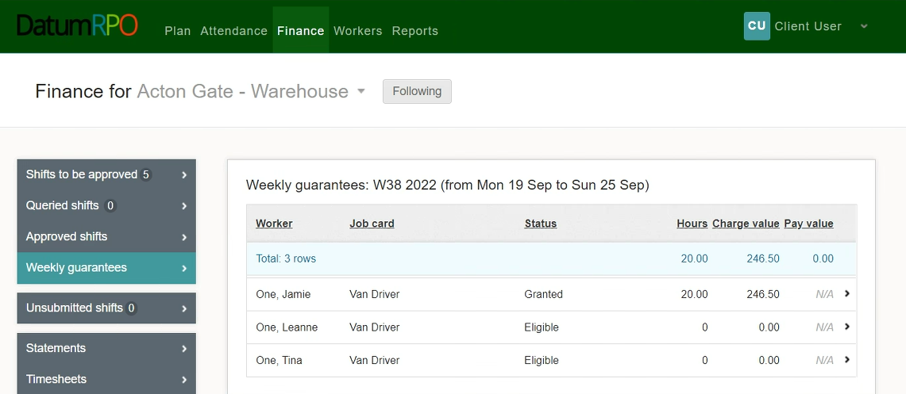
How Do I View & Action Weekly Guarantees?
To view and manage any weekly guarantees you may have, go to the ‘Finance’ tab and select ‘Weekly Guarantees’.
You will now see any workers how are eligible for weekly guarantees.

Slide 4
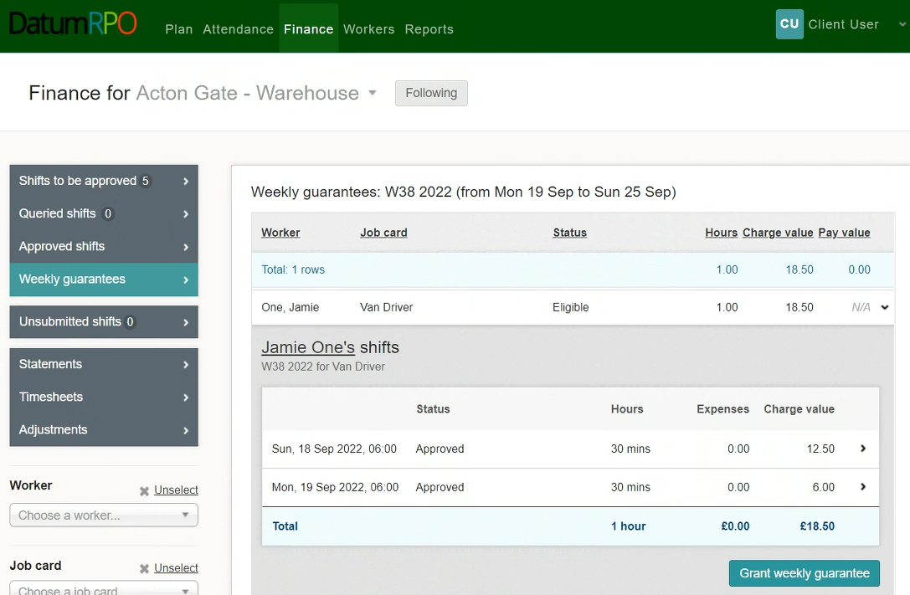
How Do I View & Action Weekly Guarantees?
To grant a workers weekly guarantees, click on the eligible workers banner to view the detail and then click
‘Grant Weekly Guarantees’.

Slide 5
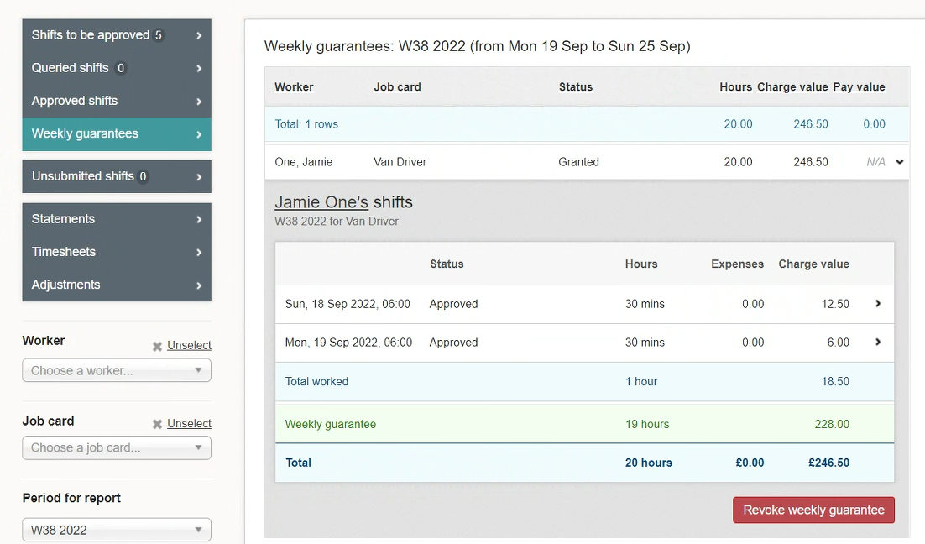
How Do I View & Action Weekly Guarantees?
Once the weekly guarantees have been granted, you will be able to view the details of the weekly guarantee and see the hours and charge value.

Slide 6
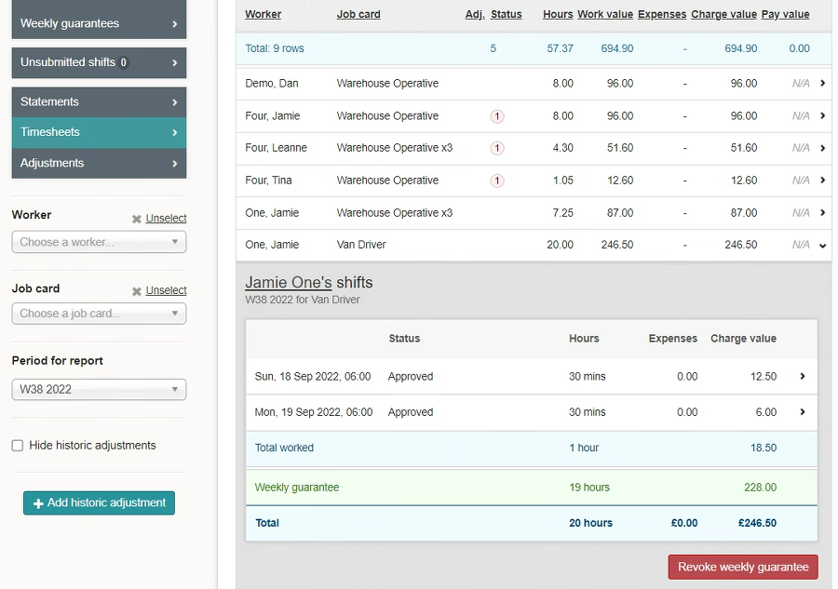
How Do I View & Action Weekly Guarantees?
If a weekly guarantee has been granted in error, you will be able to remove it by clicking ‘Revoke Weekly Guarantee. This will remove the weekly guarantee & restore the timesheet to its original state.

Slide 7
STATEMENTS

Slide 8
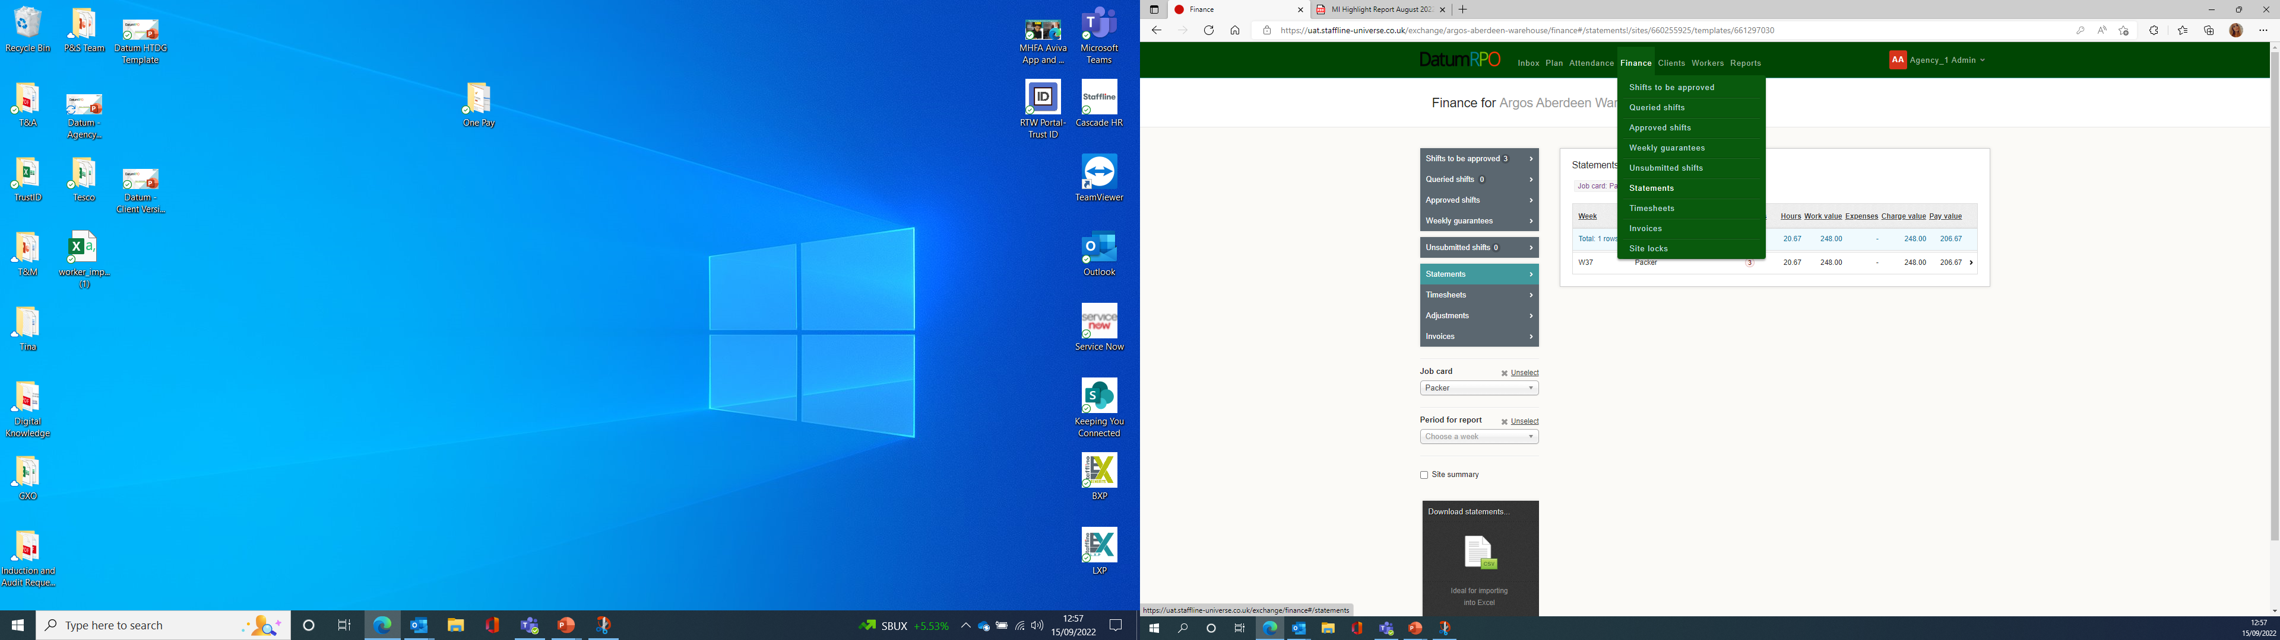
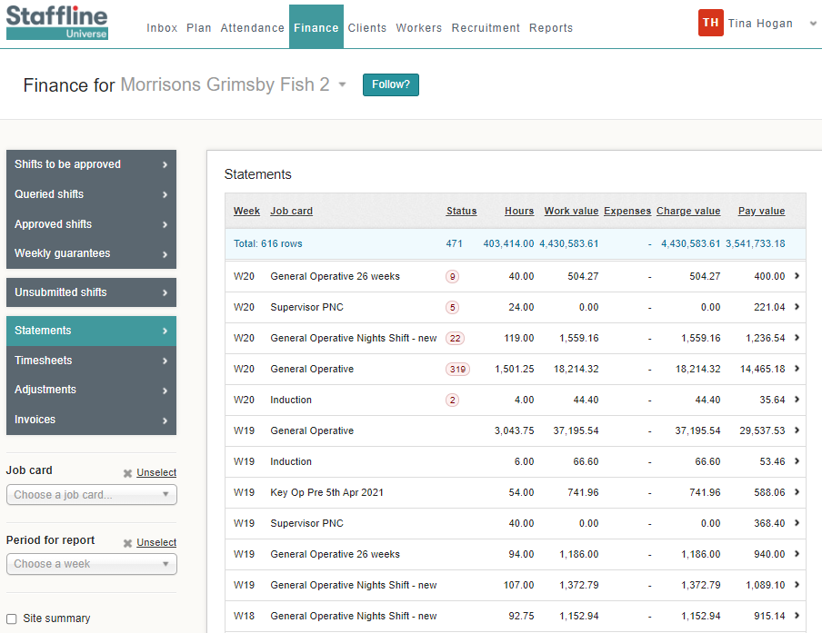
How To Find Statements?
Go to Finance > Statements
This gives you past or present timesheets where you can review hours and costings per job card.

Slide 9
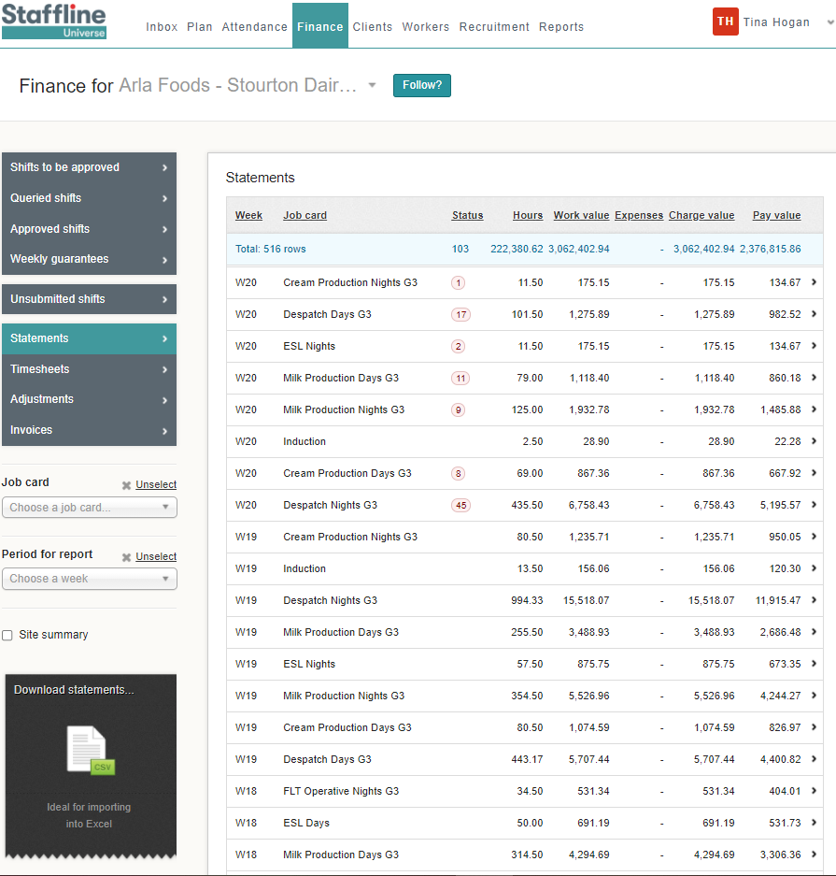
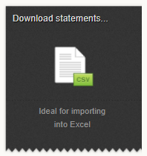
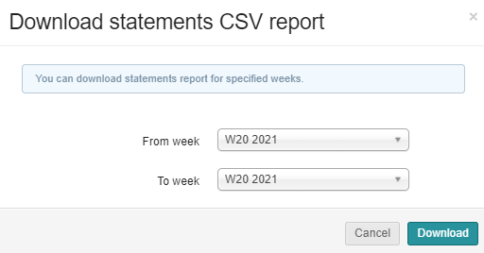
How To View Statements?
You can view a statement by downloading the CSV into excel spreadsheet.
Client on the week or weeks you require and click on download.

Slide 10
MANUAL ADJUSTMENTS -
BONUS

Slide 11
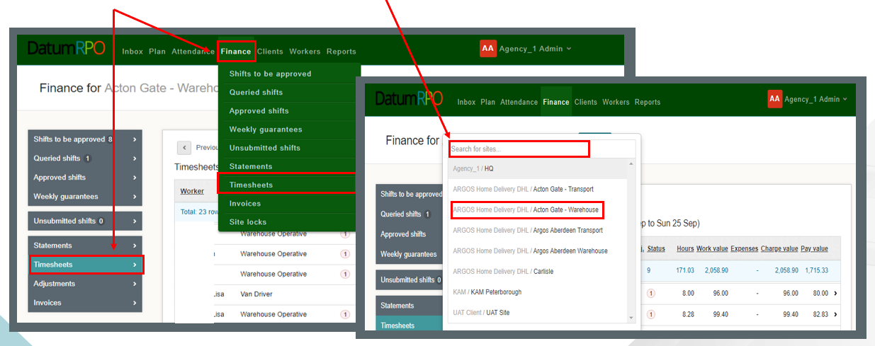
What Is A Manual Adjustment?
A manual adjustment can be entered at any time if there is a timesheet. A manual adjustment is where we need to deduct, refund or pay a shift bonus. The correct way to process this is through a manual adjustment and not an historic adjustment.
Click on Finance > Timesheets and search for your site.

Slide 12
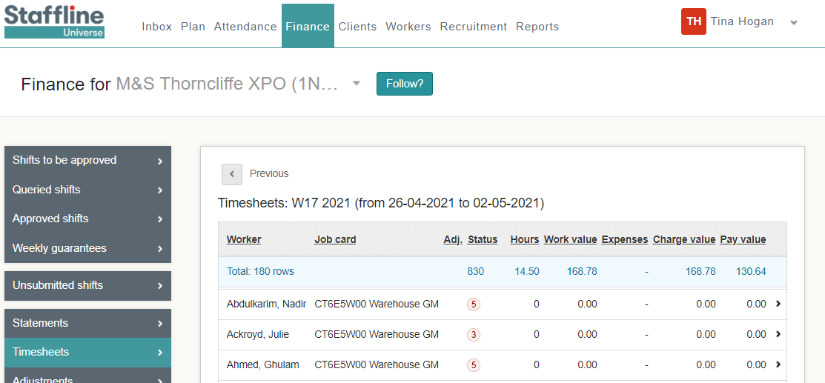
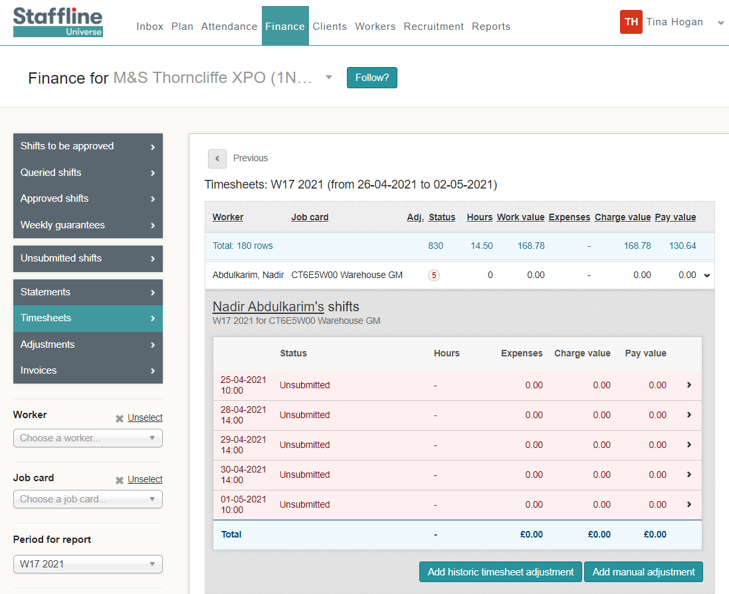
Where To Find Manual Adjustment To Add Shift Bonus?
To add a manual adjustment, click on the worker you require to make the adjustment to and open the timesheet.
cv
Next click on

Slide 13

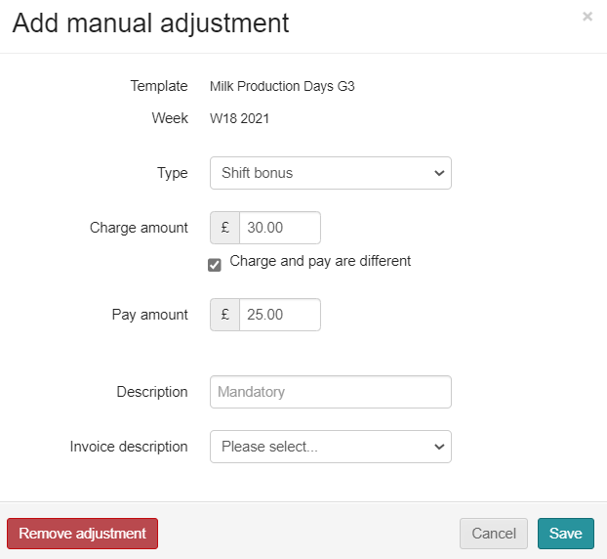
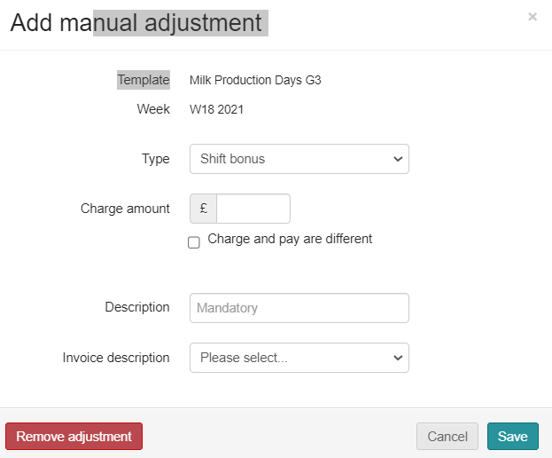

How To Add A Manual Shift Bonus Adjustment?
The manual adjustment can be entered at any time, if there is a timesheet.
Shift bonus payments are for any extra pay that is a bonus, and the worker doesn’t accrue holiday pay. This means it doesn’t go through the shift allocation but is done as a manual adjustment or a download adjustment.
Go to type and click in the box.
You will then see your drop down and click on shift bonus.
Next click on the charge amount then add the payment amount click on the
box and add amount.

Slide 14
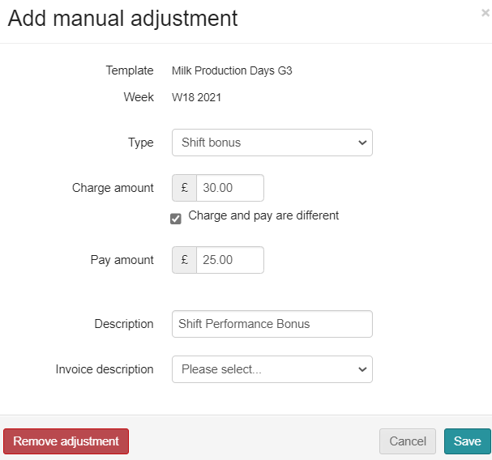
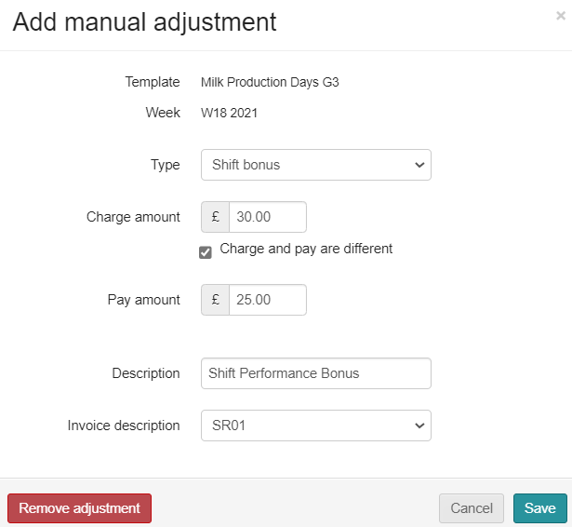
How To Add A Manual Shift Bonus Adjustment?
Next you need to add your description and invoice description.
Go to Description, click in the box and type in what it is for.
Last thing is to click on invoice description and select SR01 from the drop down.
If shift bonus is for supervisor check in don’t add charge amount, add in description 'Supervisor Check In'.

Slide 15
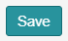
How To Complete A Manual Shift Bonus Adjustment?
Finally do your check list before saving.
Correct Type ✓
Correct Charge amount ✓
Correct Pay amount ✓
Correct Description ✓
Correct Invoice description ✓
Then click on

Slide 16
HISTORIC ADJUSTMENTS
RATES

Slide 17
What Is A Historic Adjustment?
A historic adjustment is where we have missed payment for a worker. It might be basic hours, overtime or backpay. This is the correct way to process missing payments and not through manual adjustments.
Click on Finance > Timesheets and then search for your site.

Slide 18

How To Add An Historic Adjustment?
To add an historic adjustment, click on the worker you require to make the adjustment to and open the timesheet.
cv
Next click on

Slide 19
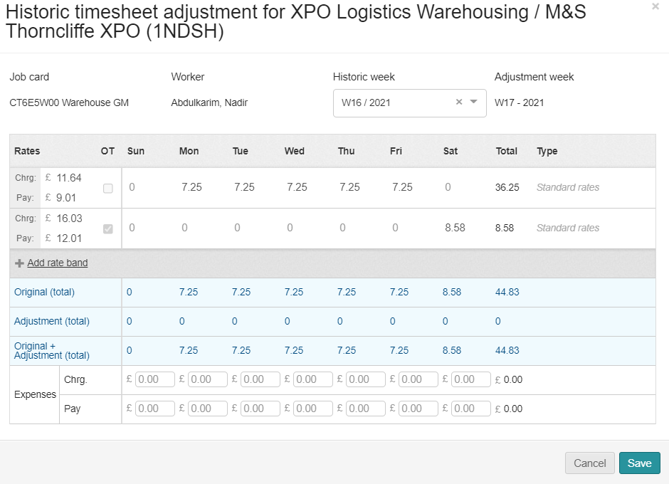
How To Add An Adjustment To The Relevant Week?
When adding an adjustment for a historic week you must ensure you are on the week you need to pay and the week the payment was missing from.
Adjustment week is the current week that you are payrolling.
Historic week is the week you need to pay the worker.
Click on the relevant week for the Historic Adjustment.

Slide 20
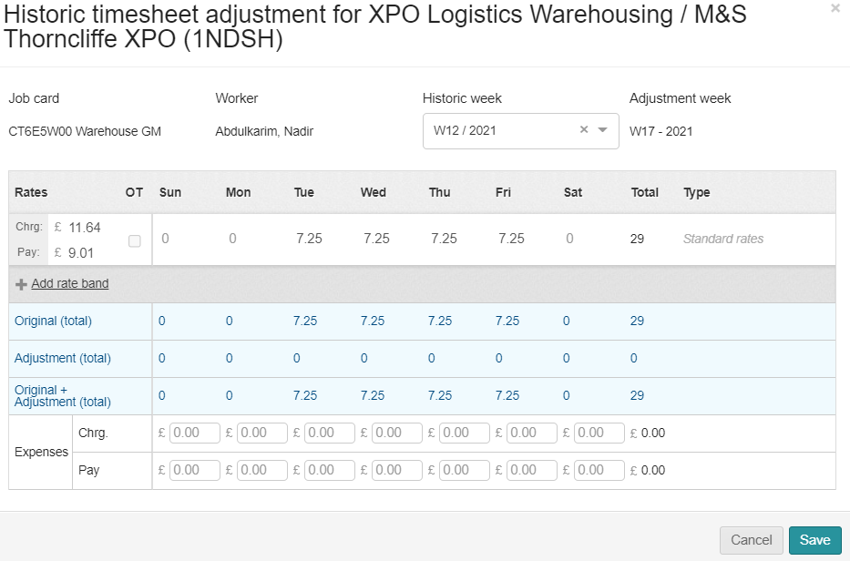
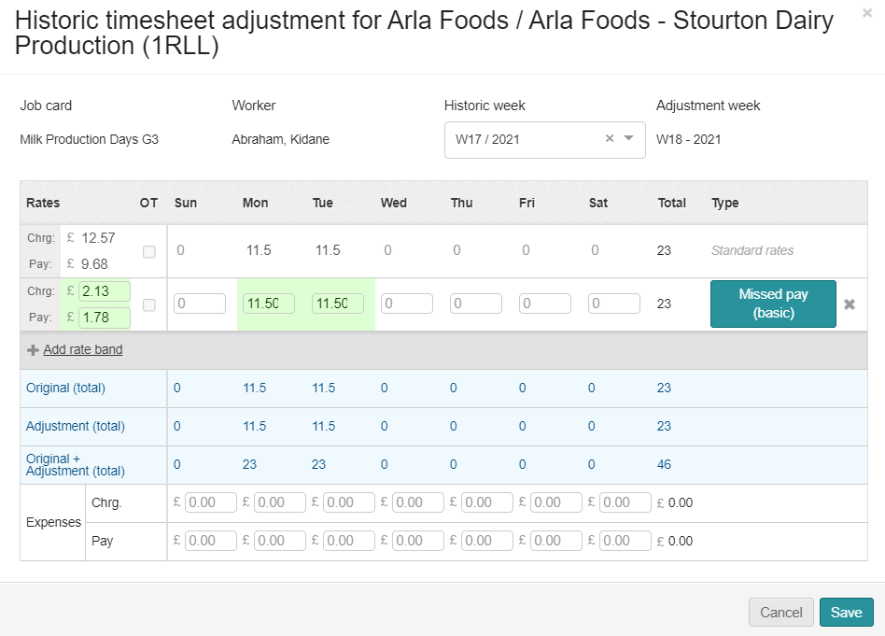
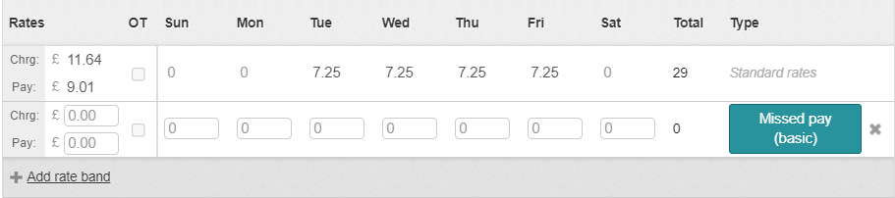
How To Add In The Charge And Pay Rate Difference?
Next, we need to add the rate band which will bring up charge rate and the pay rate for processing the hours.
You must ensure a charge rate is processed and not just a pay only.
Now add the difference of the charge rate and the pay rate. You can work this out by the difference between the New Pay Rate and Old Pay Rate. Then do the same with the charge rate.

Slide 21
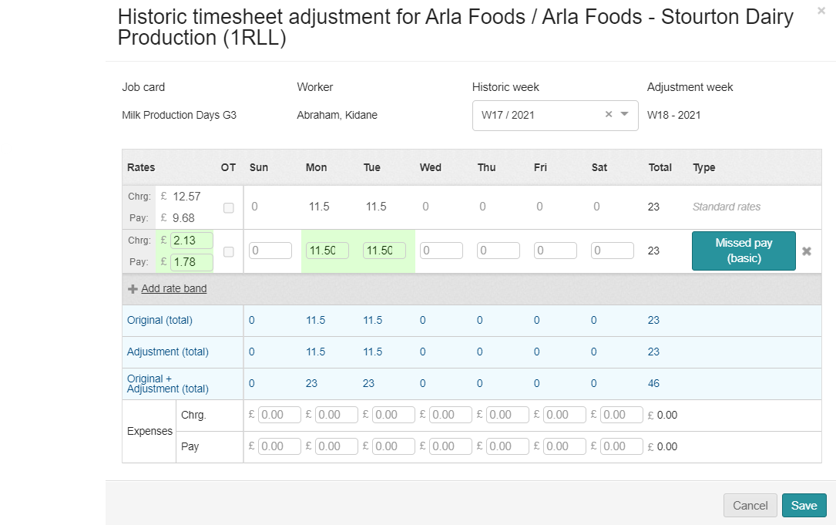
How To Add In The Hours?
Now we have added the charge and pay rate difference, we now need to add the hours in the correct day of which the hours need to be the same as the hours for the week you are adjusting.

Slide 22
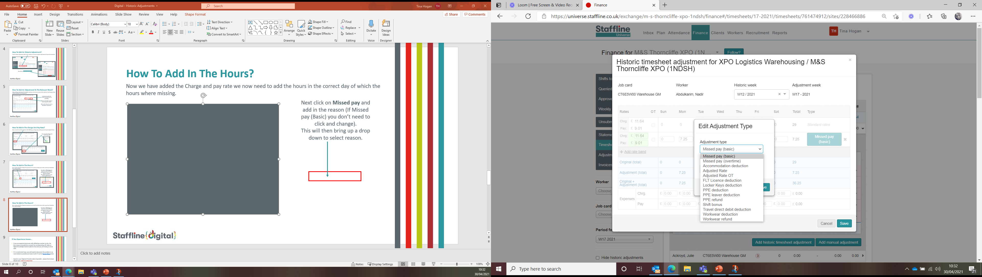
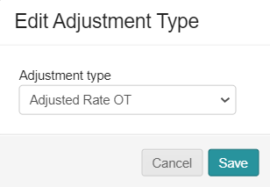

How To Add In Standard Rate Information?
Once with have opened the edit adjustment section, you need to select either Missed pay (basic), Missed pay (overtime),
Adjustment rate or Adjustment Rate Overtime ONLY.
Next click on Adjusted Rate or if overtime adjustment click Adjusted Rate OT.
This will be on your drop down.
Next click on the reason and

Slide 23
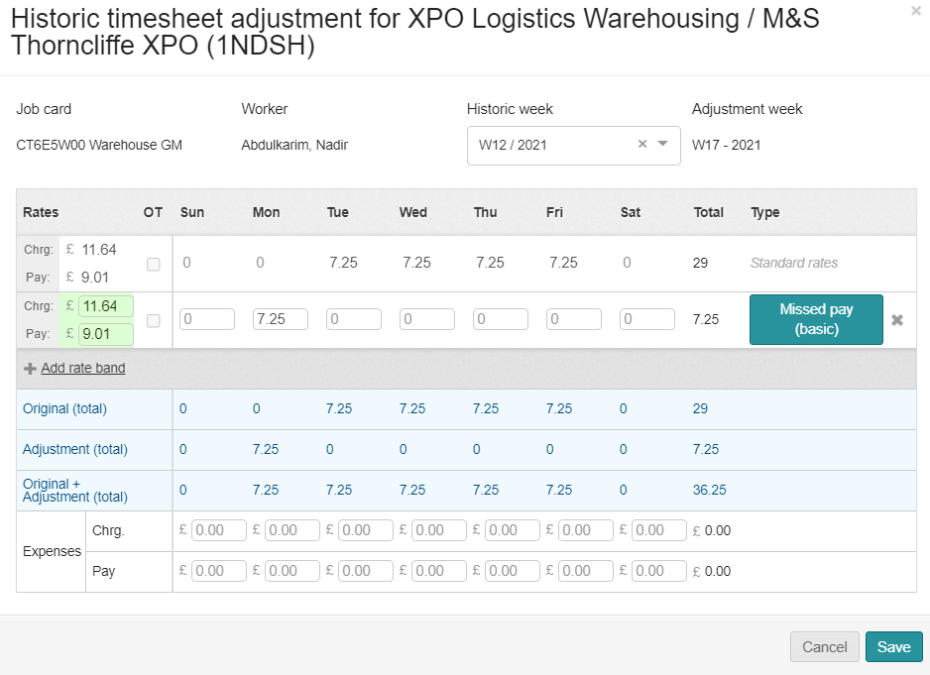
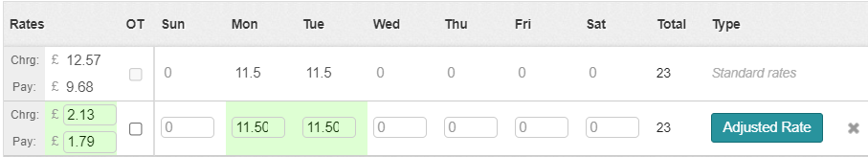

How To Check Before Saving?
We have now added all the information to save the adjustment. Next, we need to check to ensure the information is correct.
Correct Adjustment week of payment ✓
Correct Historic week of payment ✓
Correct Charge & Pay Rate Difference ✓
Correct Hours✓
Correct reason✓
Then click on
If you have inputted anything incorrect you will see the below message appear.

Slide 24
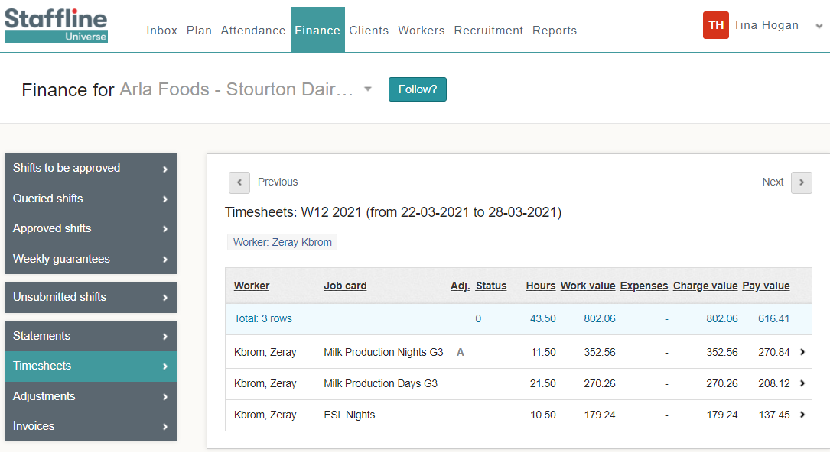
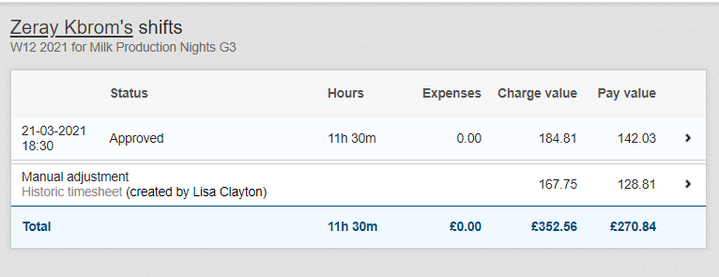


How To View The Adjustment In Timesheets?
The Adjustment has now been processed and there are two ways of finding the adjustment.
The first one is allocated on the timesheet
When you open the timesheet, you will see the adjustment.

Slide 25
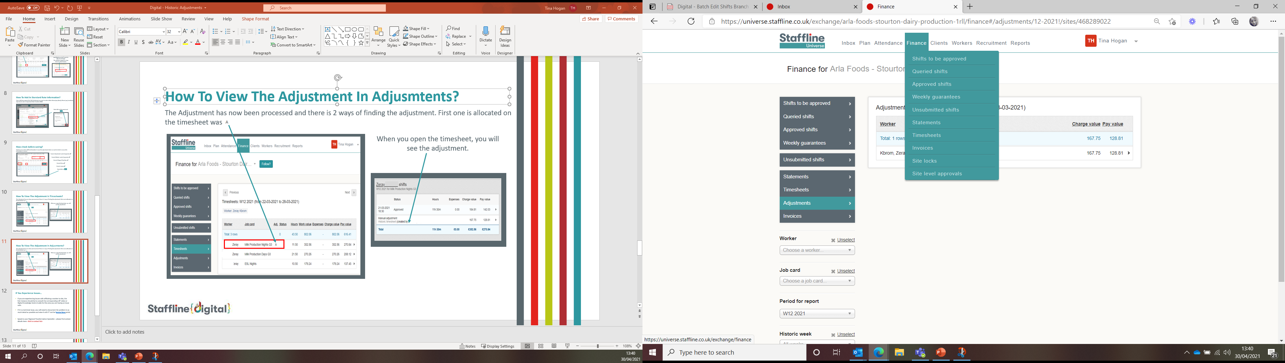
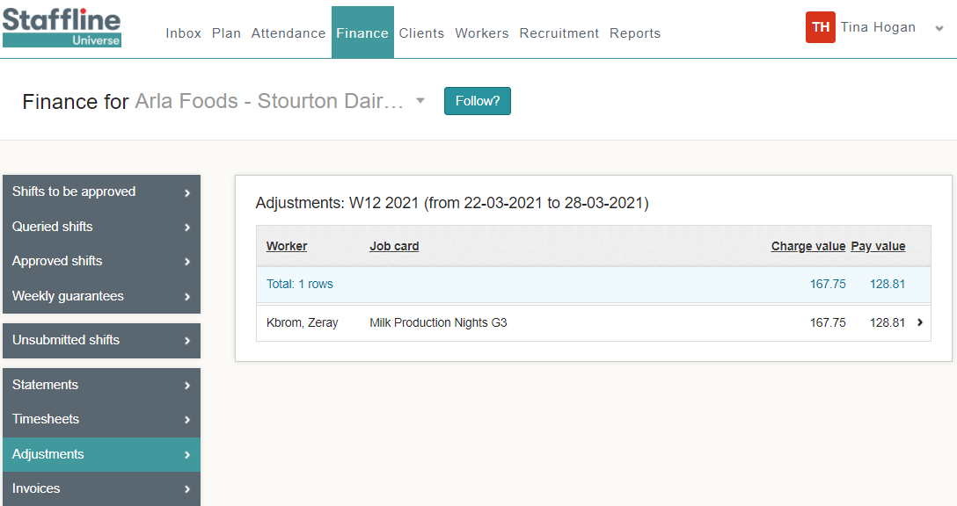
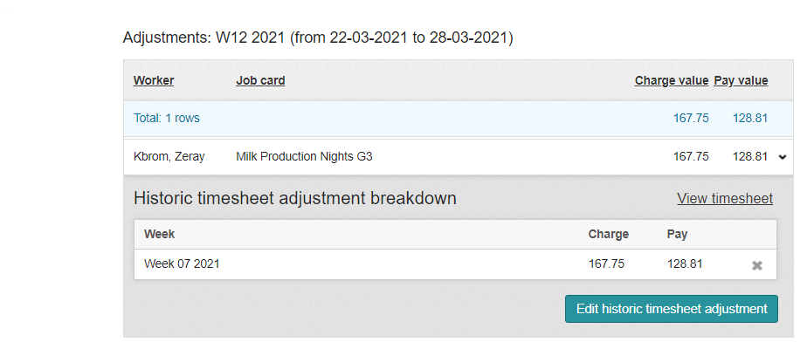
How To View The Adjustment In Adjustments?
The second way is to go to timesheets and on the left side you will see adjustments.
When you open the timesheet, you will see the adjustment. If required, you can adjust from here by clicking

Slide 26
HISTORIC ADJUSTMENTS
MISSING HOURS

Slide 27
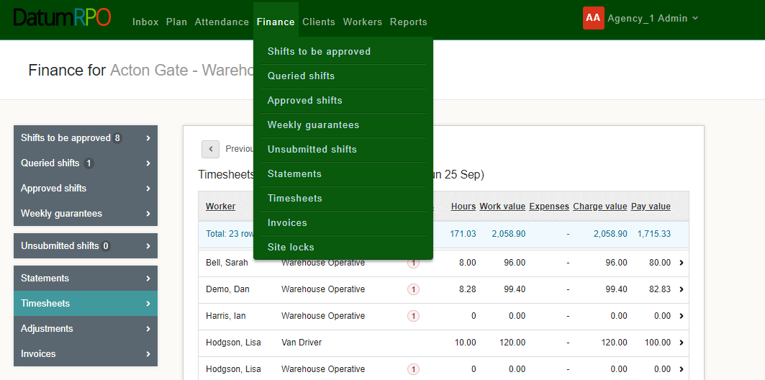
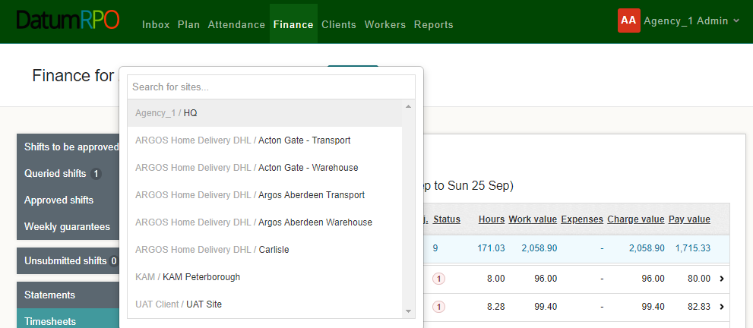
What Is An Historic Adjustment?
An historic adjustment is where we have missed payment for a worker. It might be basic hours, overtime or backpay. This is the correct way to process missing payments and not through manual adjustment.
Click on Finance > Timesheets and then search for your site.

Slide 28
How To Add An Historic Adjustment?
To add an historic adjustment, click on the worker you require to make the adjustment to and open the timesheet.
cv
Next click on

Slide 29
How To Add An Adjustment To The Relevant Week?
When adding an adjustment for a historic week you must ensure you are on the week you need to pay and the week the payment was missing from.
Adjustment week is the current week that you are payrolling.
Historic week is the week you need to pay the worker.
Click on the relevant week for the Historic Adjustment.

Slide 30
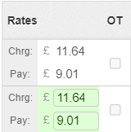
How To Add In The Charge And Pay Rate?
Next, we need to add the rate band which will bring up charge rate and the pay rate for processing the hours.
You must ensure a charge rate is processed and not just a pay only.
Now add in the charge rate and the pay rate.

Slide 31
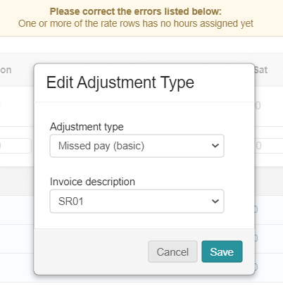
How To Add In The Hours?
Now we have added the charge and pay rate we now need to add the hours in the correct day of which the hours were missing.
Next, click on Missed pay and add in the reason (if missed pay (basic) you don’t need to click and change).
This will then bring up a drop down to select reason.

Slide 32
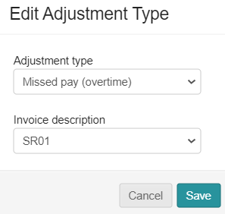
How To Add In Standard Rate Information?
Once you have opened the Edit Adjustment you need to select either Missed pay (basic), Missed pay (overtime),
Adjustment Rate or Adjustment Rate Overtime ONLY.
Next click on the reason and

Slide 33
How To Check Before Saving?
We have now added all the information to save the adjustment. Next, we need to check to ensure the information is correct.
Correct Adjustment week of payment ✓
Correct Historic week of payment ✓
Correct Charge & Pay Rate ✓
Correct Hours✓
Correct reason✓
Then click on
If you have inputted anything incorrect you will see the below message appear.

Slide 34
How To View The Adjustment In Timesheets?
The Adjustment has now been processed and there are two ways of finding the adjustment.
The first one is allocated on the timesheet
When you open the timesheet, you will see the adjustment.

Slide 35
How To View The Adjustment In Adjustments?
The second way is to go to timesheets and on the left side you will see adjustments.
When you open the timesheet, you will see the adjustment. If required, you can adjust here by clicking

Slide 36
APPROVED SHIFTS
CLIENT PROCESS

Slide 37
How To Approve Shifts?
Approved shifts need to either be completed daily or weekly. Deadline for hours daily is agreed with your agency.
Weekly needs to be approved 12 noon Monday (with the exception of bank holidays ie Christmas and Easter)

Slide 38
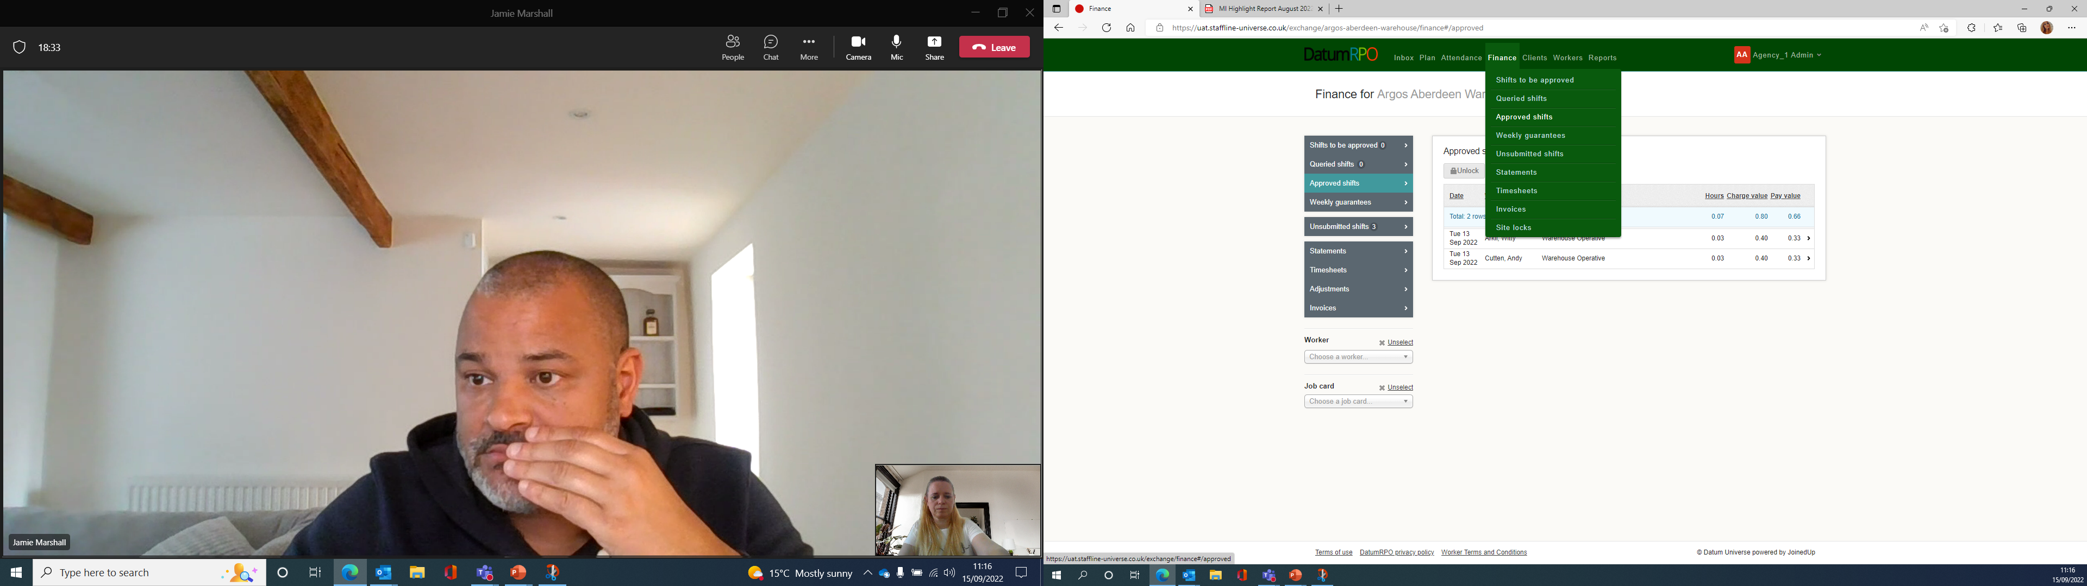
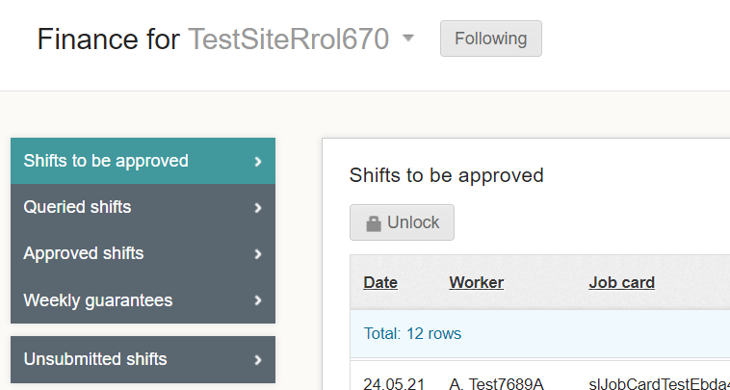
Where To Find Shifts To Be Approved?
This process happens after the shift has been submitted and continues the process of locking the payroll. The process will need to be completed by your client, find your site, go to Finance > Shifts to be approved.
Next Unlock the shifts to approve.

Slide 39
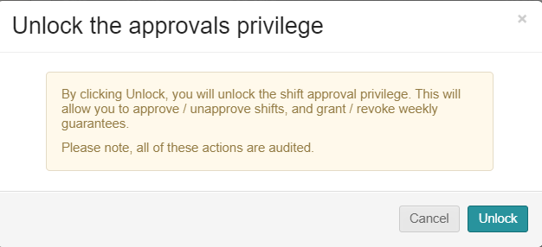
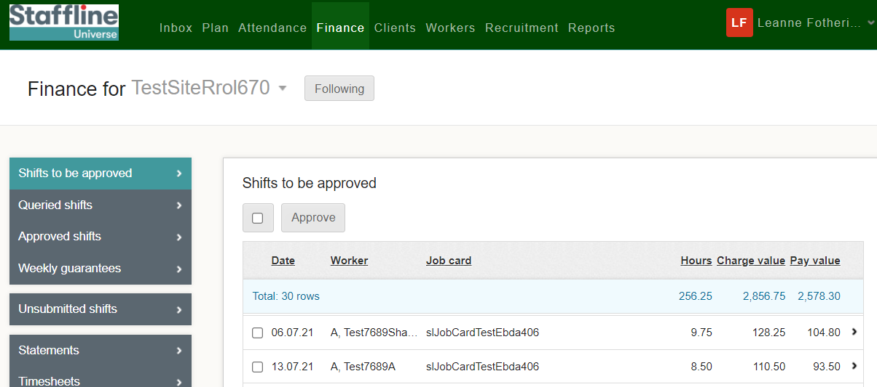
How To Approve Shifts?
Client can now approve the shifts either individually or select all shifts.
Then a warning sign will pop up, and your client will need to press

Slide 40
WORKERS OVERVIEW

Slide 41
WORKERS SEARCH

Slide 42
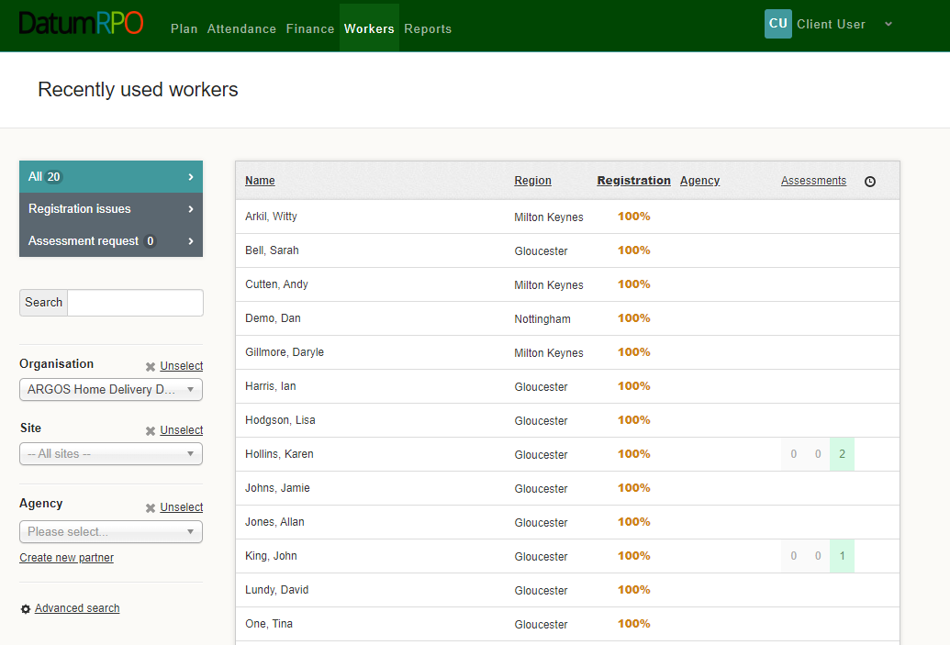
How To View Workers Page?
Go to Workers
All – Recently Used Workers
This area shows you -
Name
Region
Registration Status which should be 100%
Agency
Assessment
Clock is where you can add reminders
Which Workers Have Had Assessments

Slide 43
How Do I Search For A Worker?
You can type in the workers name from this section
Add In Your Organisation to filter down the workers
Add In Your Site to reduce the filter down more
Add In Your Agency to reduce the filter

Slide 44
WORKERS PROFILE

Slide 45
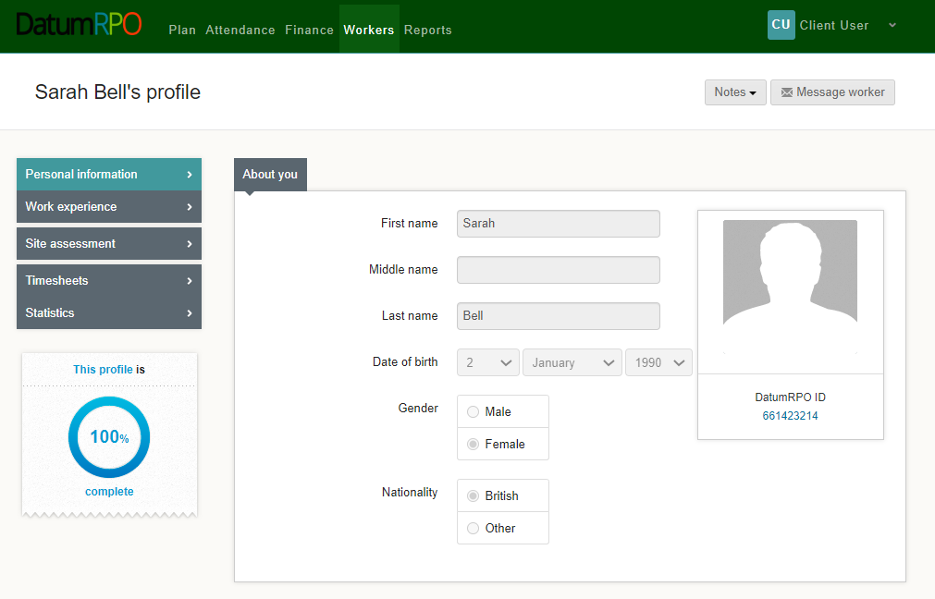
How To View A Workers Profile And Each Section?
The worker's profile Information page as limited information for you to view.
The section to message workers is not available
You can see
Name
Surname
DOB
Gender
Nationality
Workers ID Number
This section shows if the workers profile is complete

Slide 46
How To View A Workers Profile And Each Section?
In the section Notes you can click on the icon and add a note to the worker's profile.
Please Note
The notes wont automatically advise the agency

Slide 47
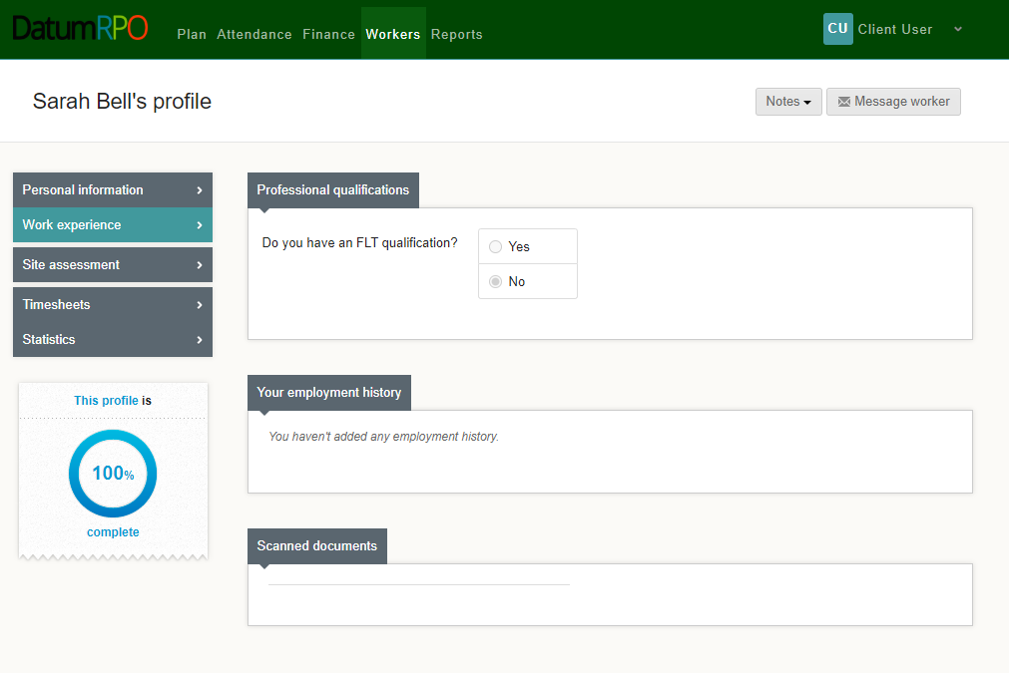
How To View A Workers Profile And Each Section?
This page shows the worker experience. This page will have limited information.
Do they have a FLT qualification Yes/No?
Any documents uploaded

Slide 48
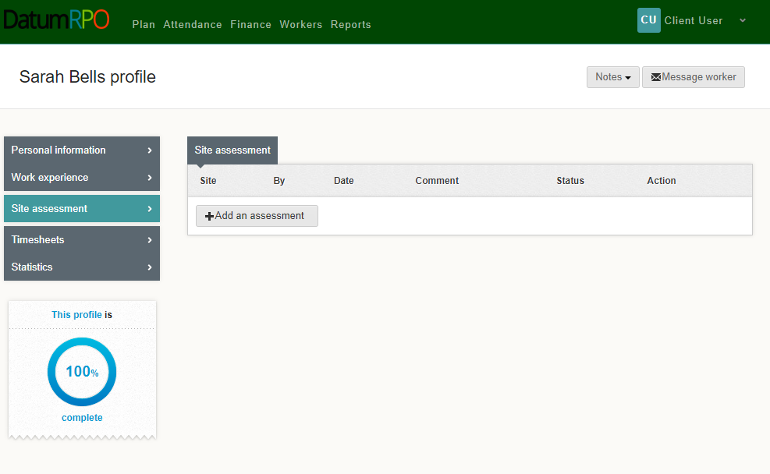
How To View A Workers Profile And Each Section?
Site assessment will show any assessments that have been completed and when

Slide 49
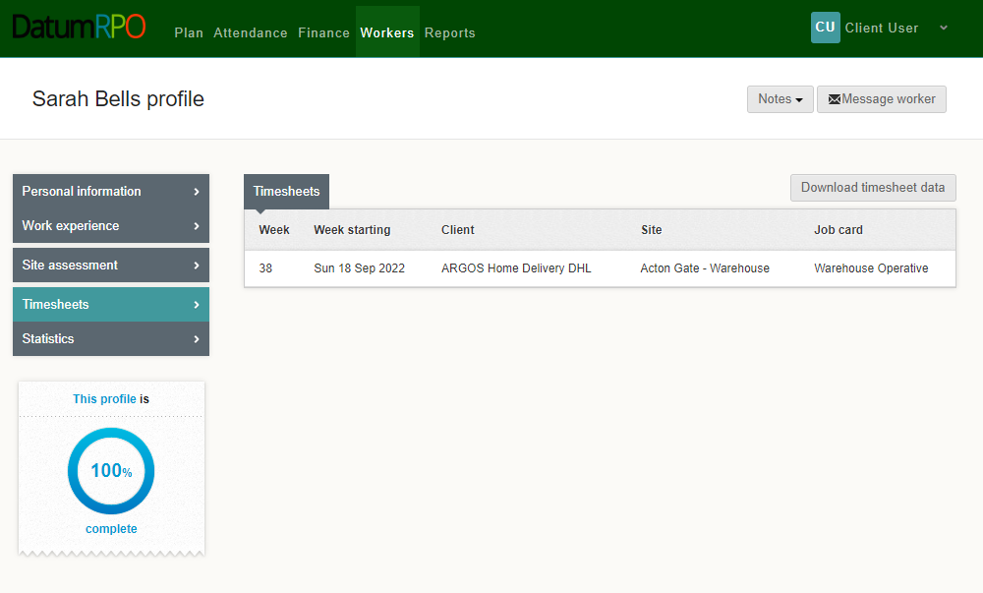
How To View A Workers Profile And Each Section?
Timesheets are any shifts/hours completed by the worker with charge rates.
Here you can download the data

Slide 50
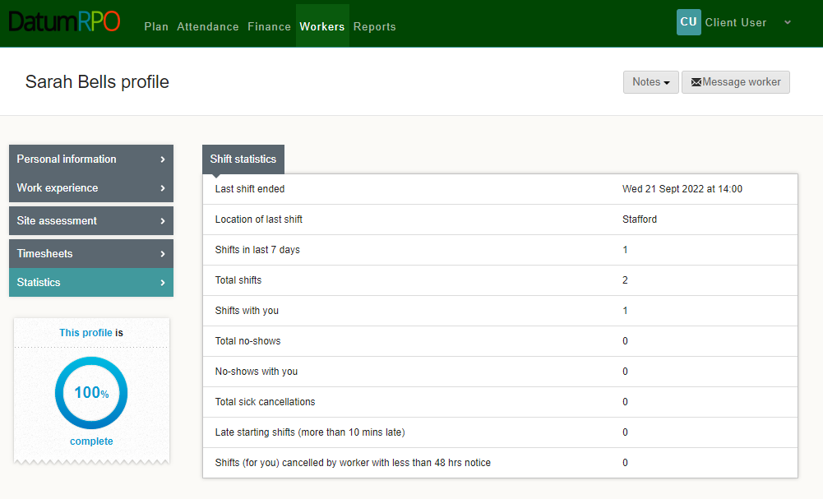
How To View A Workers Profile And Each Section?
Statistics – This information pages shows the workers attendance and absence

Slide 51
REPORTS OVERVIEW

Slide 52
COMING SOON

