Slide 1

CLIENT
“HOW TO DO GUIDE”

Slide 2


JOB CARDS
HOW TO VIEW

Slide 3
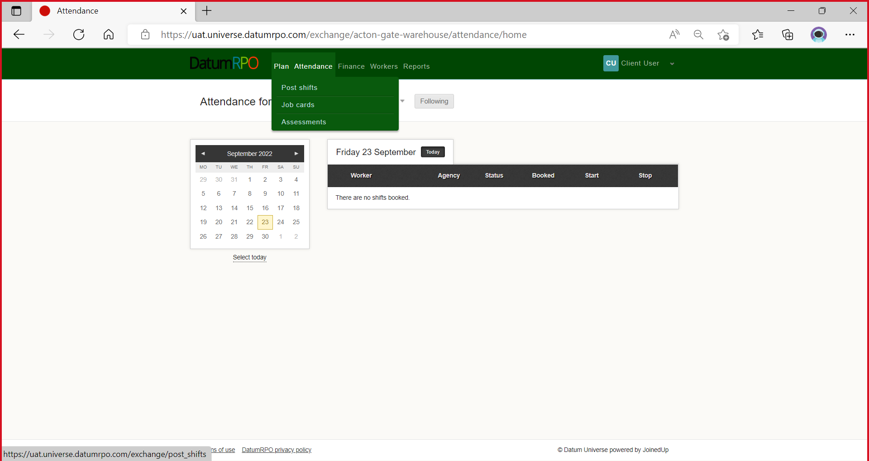
Where Do I Find Job Cards?
To view you job cards and order templates, go to ‘Plan’ and select ‘Job Cards’.

Slide 4
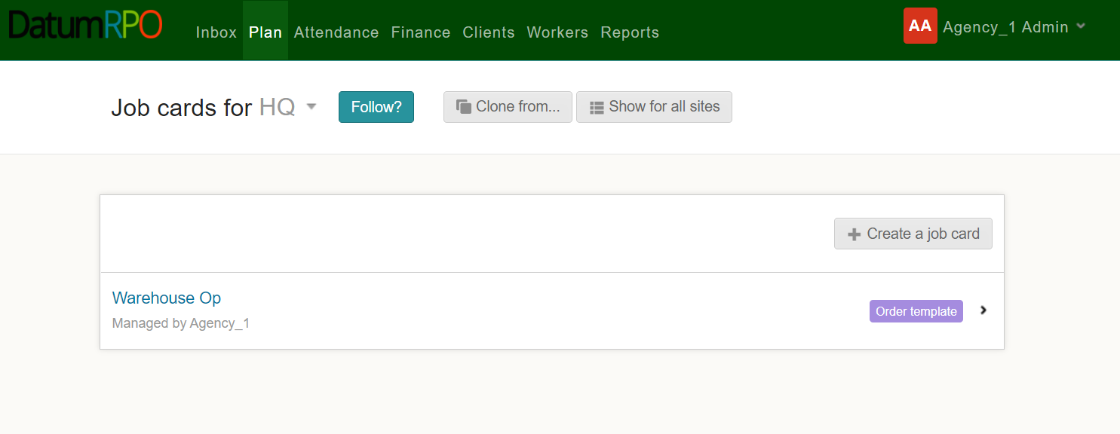
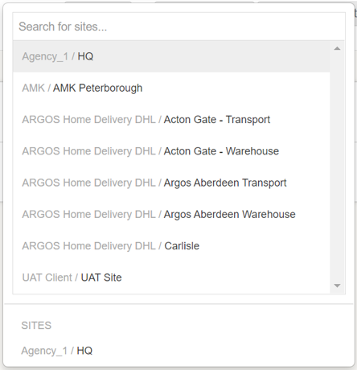
How Do I Find Job Cards For My Site?
Select the site for the ‘Job Cards’ you want to view using the dropdown box.

Slide 5
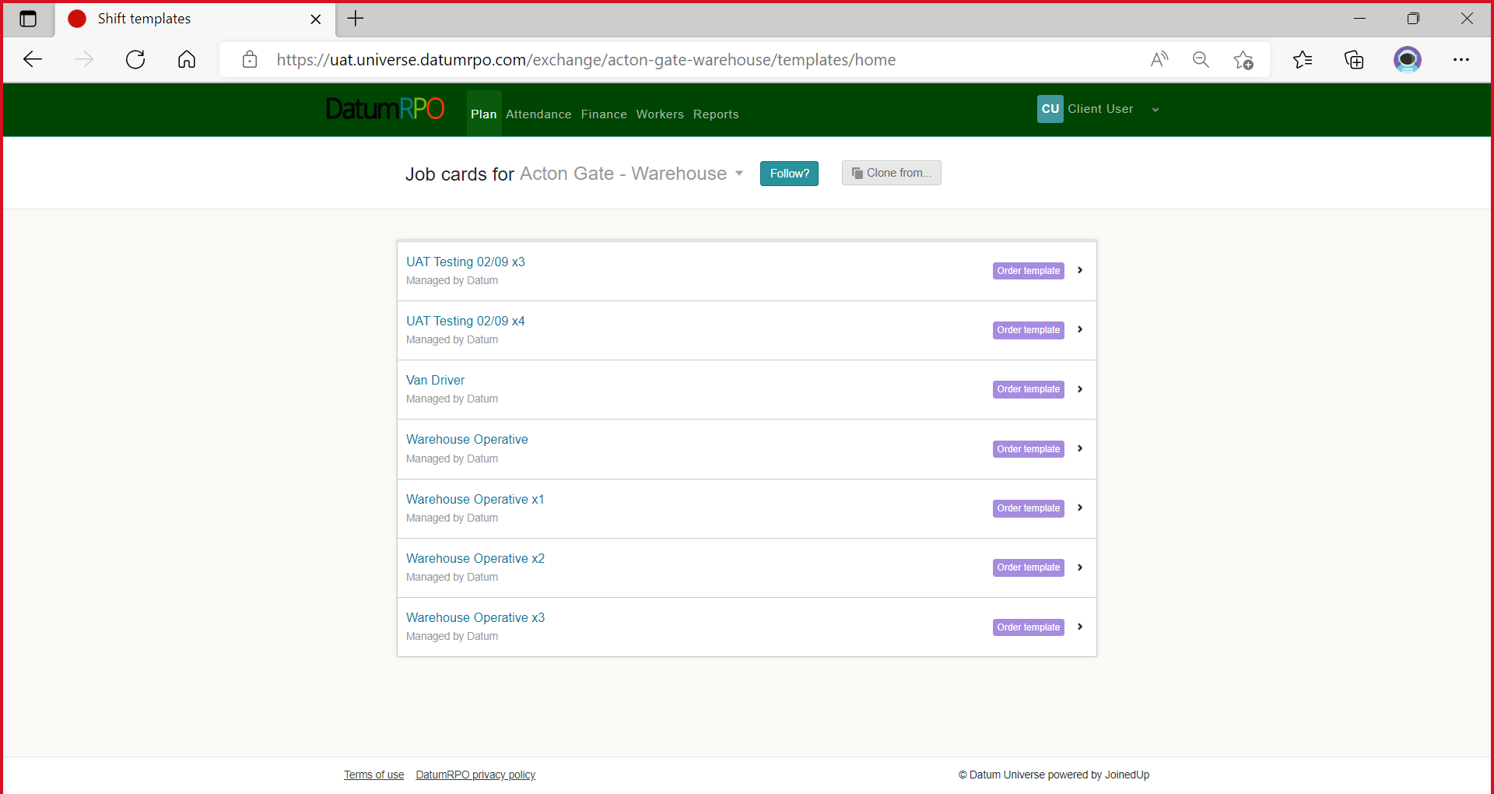
How Do I Find Job Cards For My Site?
You will now see a list of the job cards (Order Templates) for your chosen site.

Slide 6

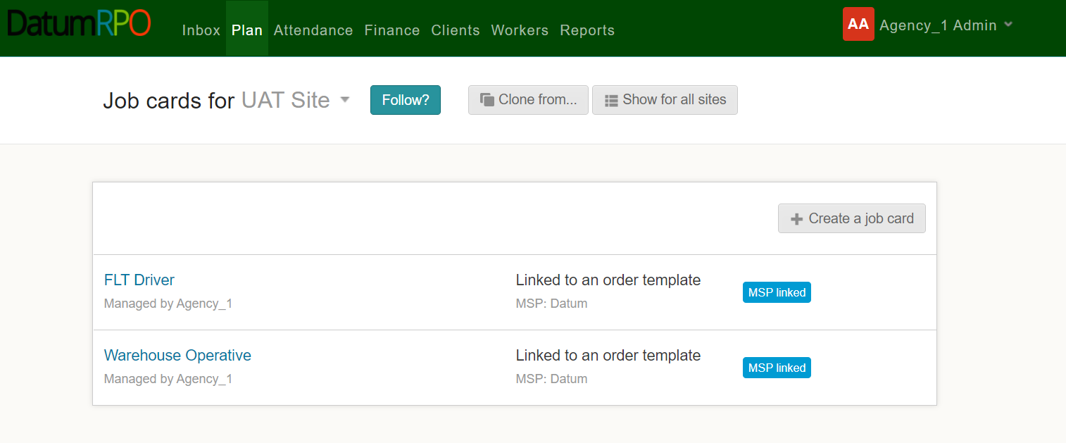
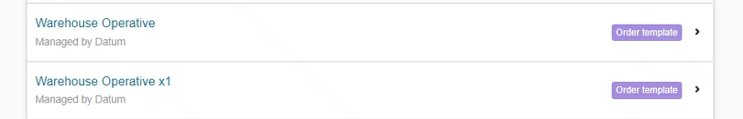
How Do I Follow My Site?
You can ‘Follow’ or ‘Unfollow a site by clicking

Slide 7
How Do I View The Job Card Details?
To view the job card details – click on the job card you want to see the details of.

Slide 8
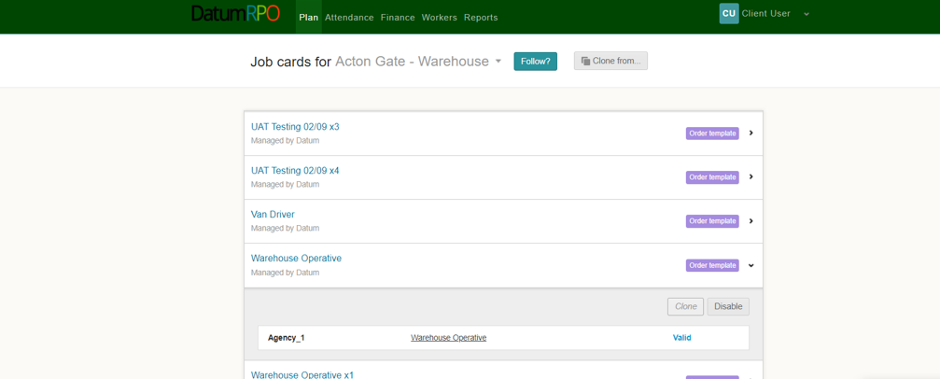
How Do I View The Job Card Details?
Then click on the hyperlinked name of the job card.

Slide 9
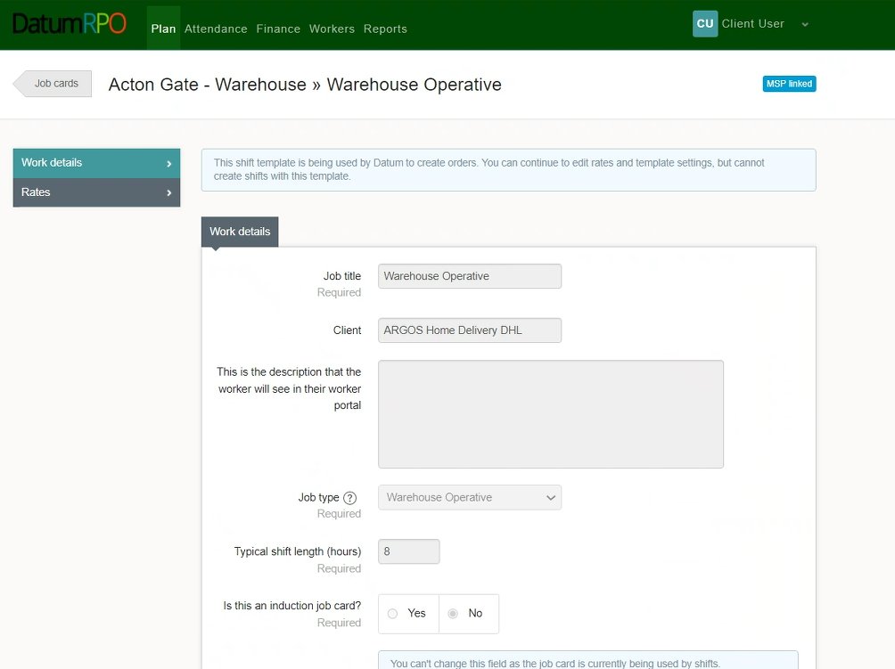
How Do I View The Job Card Details?
You will then be taken into the job card where you will be able to view the ‘Work Details’, ‘Rates’, ‘Advanced Settings’ and details of any ‘Template Changes’

Slide 10
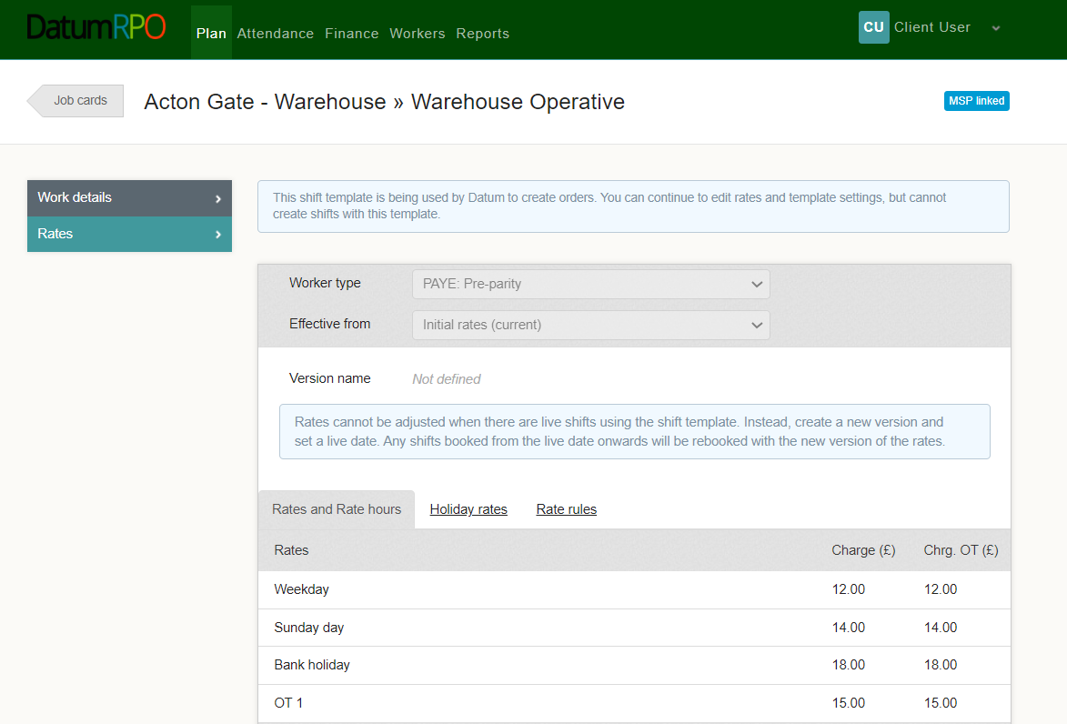
How Do I View The Job Card Details?
Rates – This section is the agreed rates per job card

Slide 11
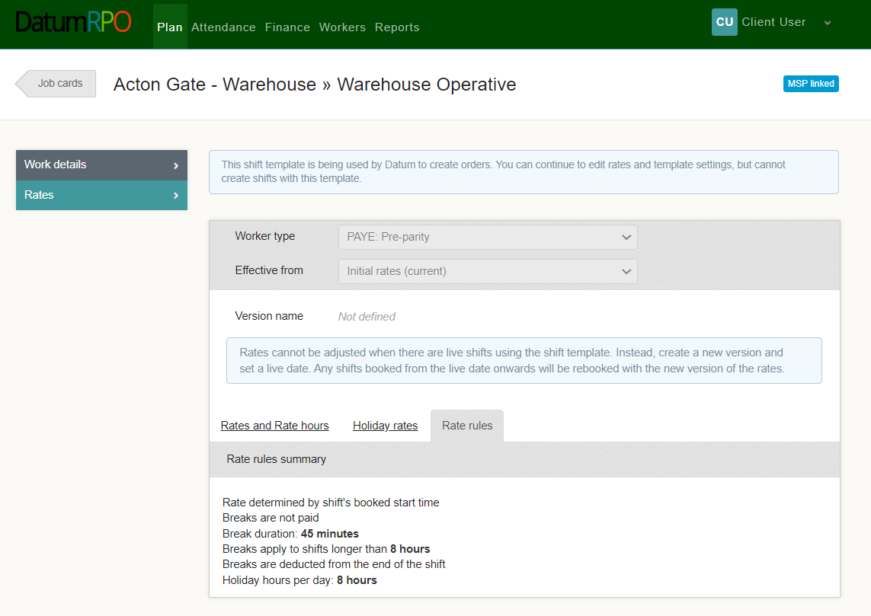
How Do I View The Job Card Details?
Rate Rules – This is the rules around payments and breaks and holiday hours per day.

