Slide 1

CLIENT
“HOW TO DO GUIDE”

Slide 2


POST SHIFTS OVERVIEW

Slide 3
POST SHIFTS BOOKINGS SENT TO DATUMRPO – SHARED SHIFTS WITH AGENCIES

Slide 4
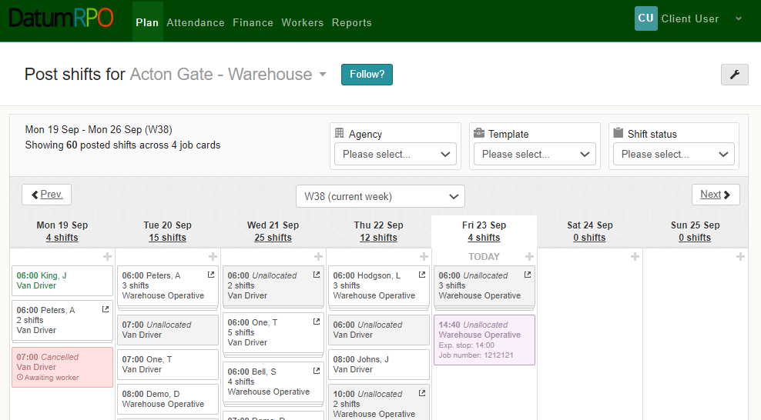
What Colour Does It Go When The Order Has Been Sent To DatumRPO?
When your booking has been sent out to the agencies, you will see it turn pink in your plan.

Slide 5
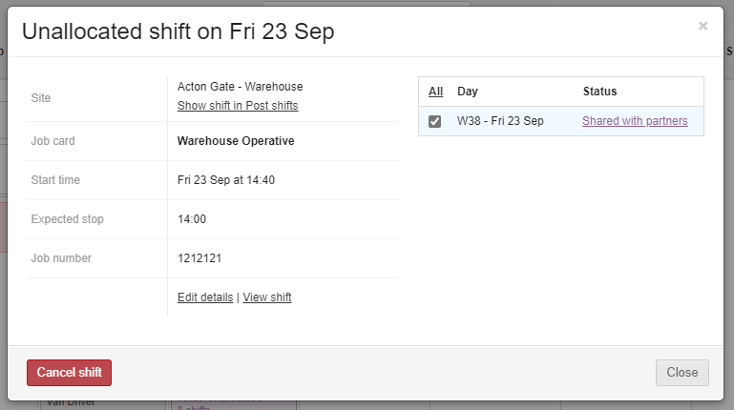
How Does It Show When The Orders Have Been Sent To Agency?
If you click on your actioned booking – you will now see that the status shows ‘Shared With Partners’

Slide 6
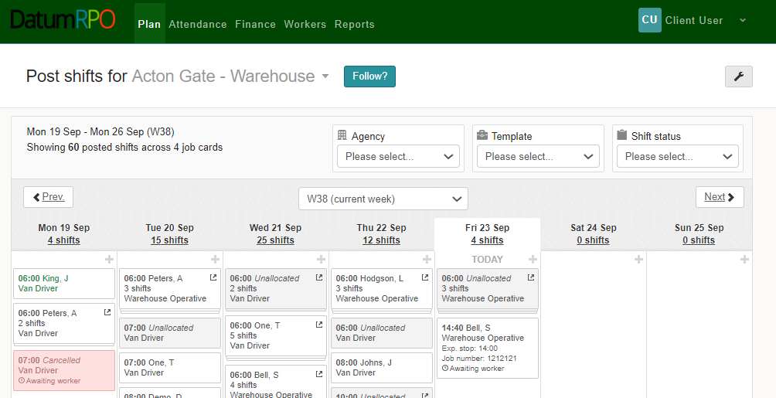
How Do I Know When The Agency Have Filled The Orders?
When workers start to be allocated to your booking, it will change to white in your plan.

Slide 7
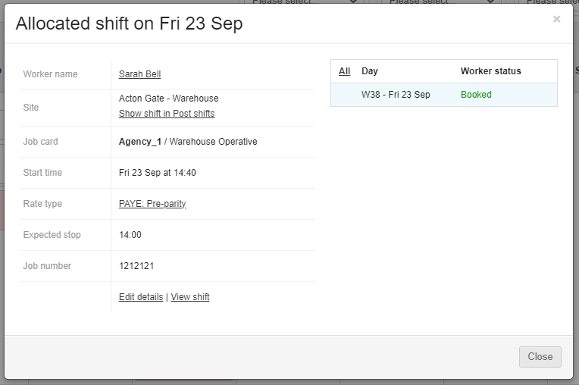
How Do I See The Worker Status Has Changed?
Words go here
If you click on your allocated booking – you will now see that the status shows ‘Booked’

